Slide 1

RECIPE FOR:
Disaster
Impact of extreme weather on nutrition and metabolic health, with a case study of Indigenous and Torres Strait Islander communities in Northern Australia

Slide 2
Supervisors: Professor Beverley-Ann Biggs, Professor Mark Daniel, and A/Professor Grant Blashki
Committee chair: Professor Stephen Rogerson
Caro S. Park
Department of Medicine, Royal Melbourne Hospital
Australian-German Climate and Energy College
MPhil in Medicine
University of Melbourne
August 2019
UNPUBLISHED DATA

Slide 3




Study 1: global nutrients
Background
Study 2: Indigenous heat
Concluding remarks

Slide 4
Background

Slide 5

Notes:
https://www.mdpi.com/2078-1547/9/1/13

Slide 6
Extreme weather events (EWEs):
weather phenomena that are historically rare for a particular place and/or time, especially severe or unseasonal weather
Notes:
https://www.emdat.be/Glossary

Slide 7
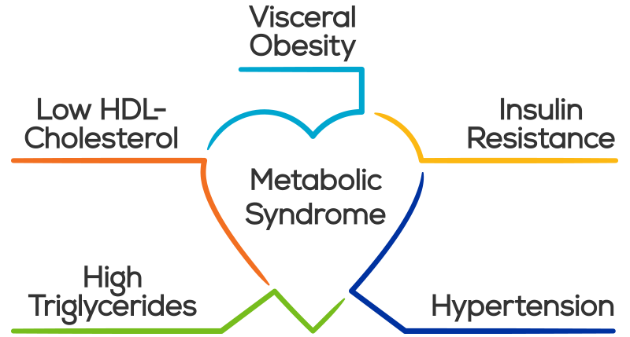
Visceral obesity
Low HDL-cholesterol
Insulin resistance
Metabolic
Syndrome
High triglycerides
Hypertension
Notes:
Cardiovascular disease → Ischaemic heart disease and stroke are the world’s biggest killers, accounting for a combined 15 million deaths in 2015. These diseases have remained the leading causes of death globally in the last 15 years.

Slide 8
My hypothesis
While extreme weather is not the lone driving force in poor health outcomes, I hypothesize that it further exacerbates cardiometabolic health burdens globally, and especially among vulnerable populations.

Slide 9
Study 1: global nutrient supply changes during extreme weather events
Study 2: associations between Indigenous cardiometabolic health and extreme weather indicators in Northern Australia

Slide 10
Vulnerability
  Socioeconomic marginalization
  Historical legacies of discrimination
  Physical exposure to climate hazards
  Close cultural relationships to the natural world
Adaptability
  “Climate change adaptation” is something Indigenous Australians have been doing for 60,000 years
Notes:
largely due to a complex mix of socioeconomic marginalization, historical legacies of discrimination, physical exposure to climate hazards, and close cultural relationships to the natural world
“Climate change adaptation” is something Indigenous Australians have been doing for 60,000 years

Slide 11
Study 1: global nutrients

Slide 12
Study 1: nutrient supply changes during an extreme weather event
Superposed Epoch Analysis

Slide 13

Main findings
Global EWE effects on nutrient supply are modest in isolation
Landlocked developing countries most vulnerable
In the context of nutrient needs for healthy child development, the effects observed are substantial
  consequences for health, growth, and development

Slide 14
Superposed Epoch Analysis
Isolated “most severe” extreme weather events (EWEs)
Produced 5-year nutrient supply windows around year of event
Normalized windows by taking country-specific averages
Composited all windows to produce one average time series, globally and by subgroup

Slide 15
2 datasets:
1. EM-DAT extreme disasters 1961-2010
2. Global Expanded Nutrient Supply model (GENuS) 1961-2010

Slide 16
250 countries
>4,000 disasters
2 filtering criteria…

Slide 17
>90th percentile
•Total financial damage, in absolute terms OR as a percentage of that country’s Gross Domestic Product (GDP) at the time of the EWE
•Total number of people affected, in absolute terms OR as a percentage of that country’s population at the time of the EWE

Slide 18
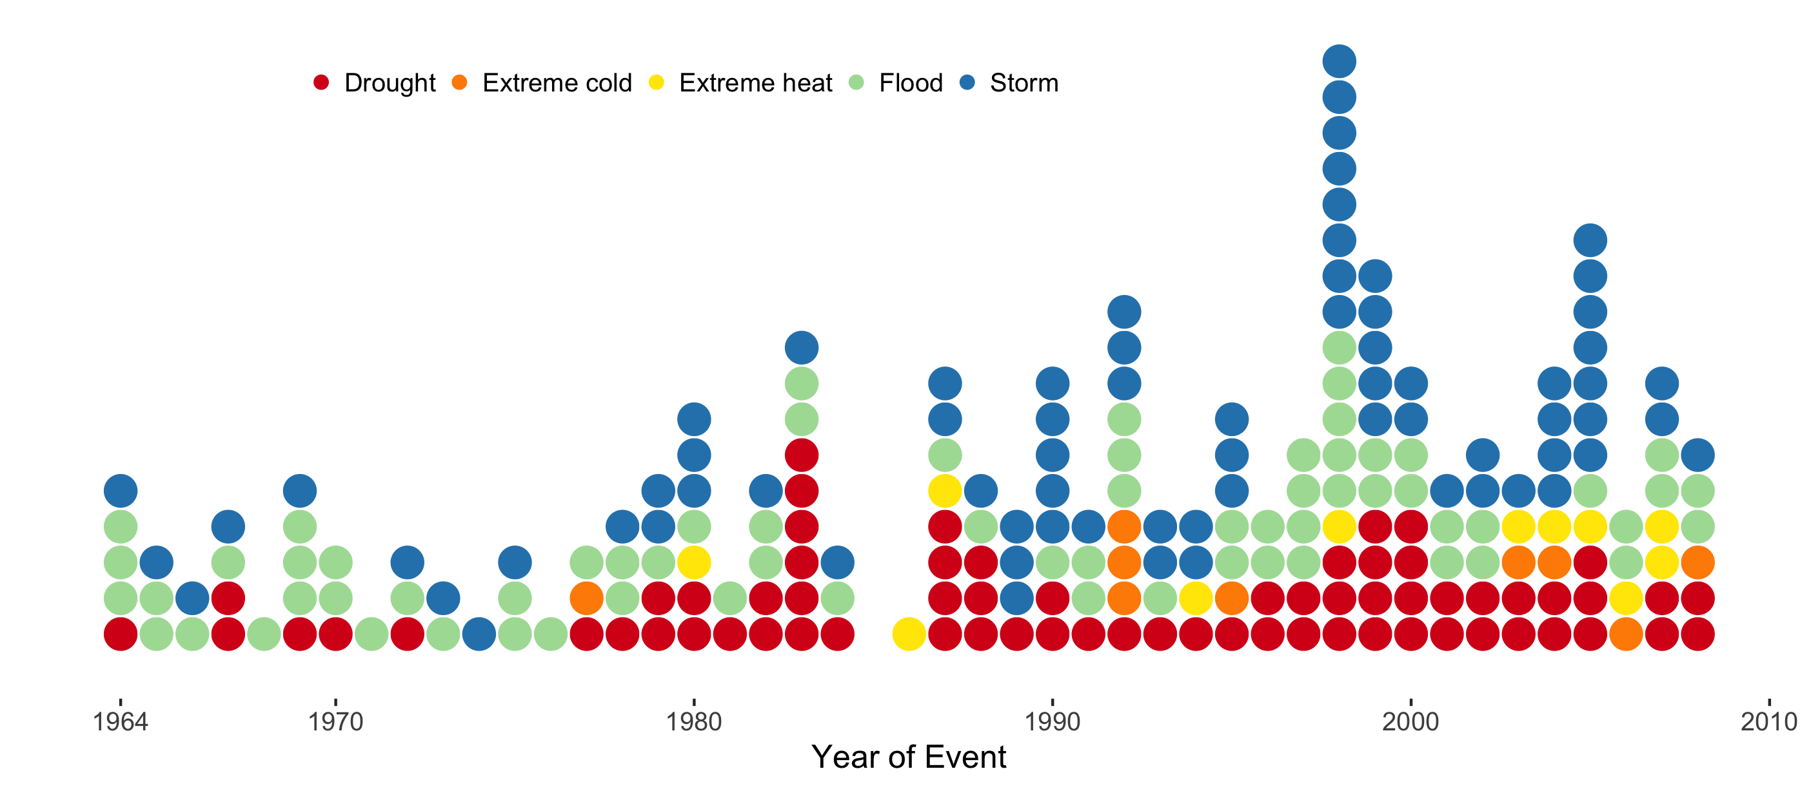

Slide 20
Method

Slide 21
HONDURAS storm
1961 2005 2010

Slide 22
HONDURAS storm
VIETNAM drought
1961 2005 2010
TUNISIA flood
1961 1997 2010
1961 1969 2010

Slide 23
2002 2003 2004 2005 2006 2007 2008
1995 1996 1997 1998 1999 2000 2001
1966 1967 1968 1969 1970 1971 1972

Slide 24








2002 2003 2004 2005 2006 2007 2008
1995 1996 1997 1998 1999 2000 2001
1966 1967 1968 1969 1970 1971 1972
89.2 88.3 86.2 81.5 85.6 88.0 90.2
Notes:
Mg per 100 grams

Slide 25
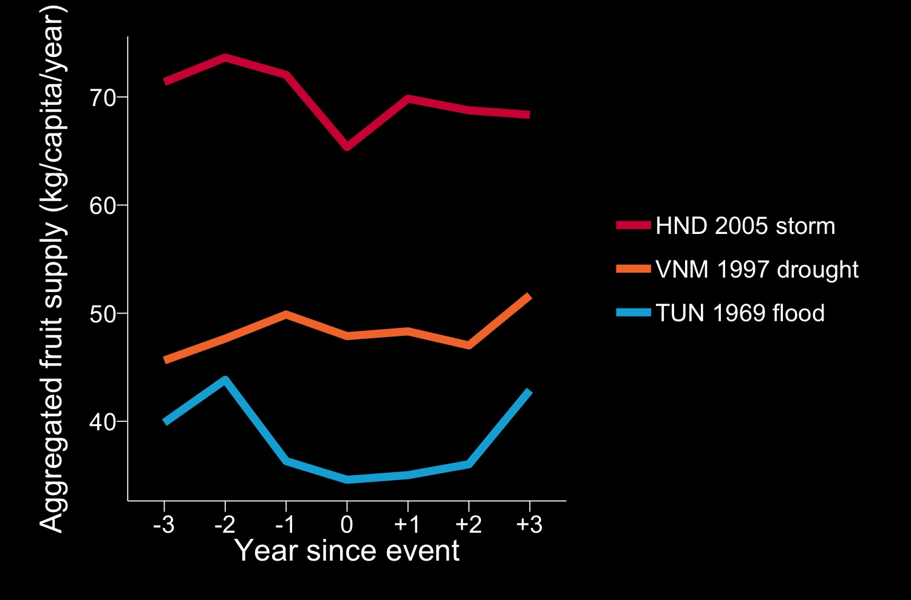
VitC

Slide 26

VitC

Slide 27
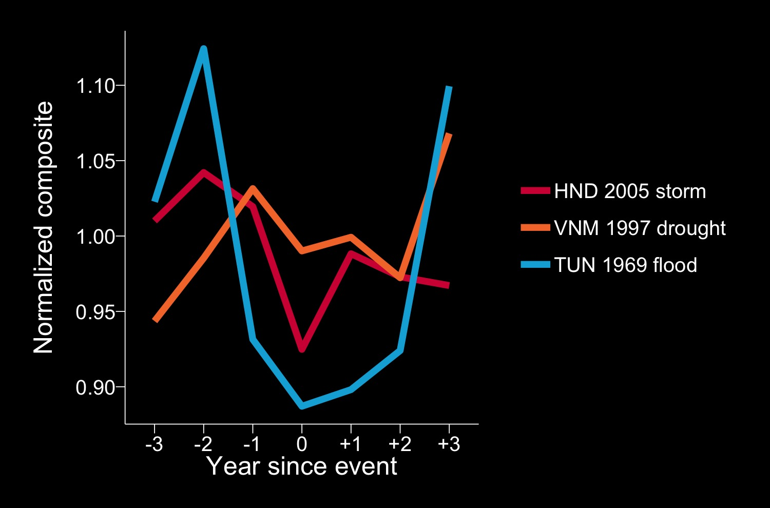
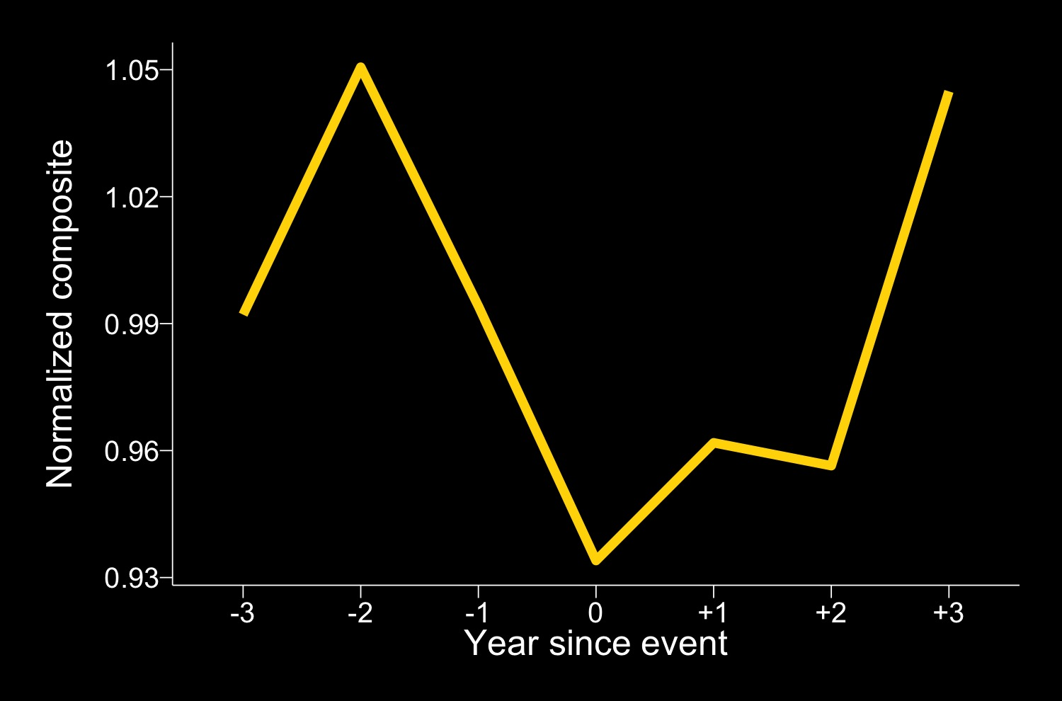
Normalized composite of Honduras (2005), Vietnam (1997), Tunisia (1969)

Slide 28
HONDURAS storm
VIETNAM drought
1961 2005 2010
TUNISIA flood
1961 1997 2010
1961 1969 2010

Slide 29
1961 2010
1961 2010
1961 2010
1961 2010
1961 2010
1961 2010
1961 2010
1961 2010
1961 2010
1961 2010
1961 2010
1961 2010

Slide 30
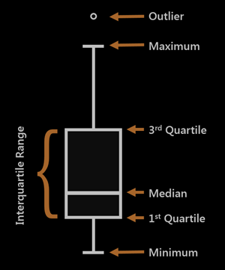

Slide 31
Results

Slide 32
–0.98%
–1.12%
*
*
*
*
*
*
*
*
*
*
*
*
*
*
*
*
*
*
–1.73%
Normalized composite
*
*
*
*
*
*
Year since event

Slide 33
Notes:
5706 29
2 5801 15
3 5802 19
4 5815 32
5 5817 64

Slide 35
*
*
*
*

Slide 36
^{ns}
^{ns}

Slide 37
–7.6% (–13.7, –2.6)
–2.0% (–5.5, –0.4)

Slide 38
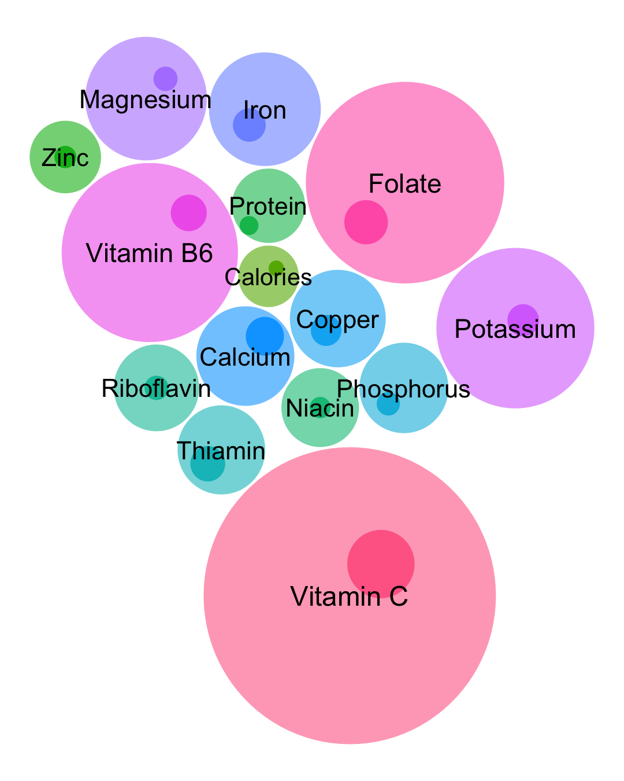
–5.2%
(–9.5, –2.5)
–1.1%
(–2.0, –0.4)
–4.1%
(–7.3, –1.6)
–0.9%
(–1.7, –0.3)
–7.6%
(–13.7, –2.6)
–1.7%
(–3.1, –0.4)

Slide 39
Recommended Dietary Allowance (RDA) is the average daily dietary intake level that is sufficient to meet the nutrient requirement of nearly all (97 to 98%) healthy individuals in a group
In terms of environmental hazards, children are an especially vulnerable subpopulation due to the high nutritional needs of their developing physiology

Slide 40

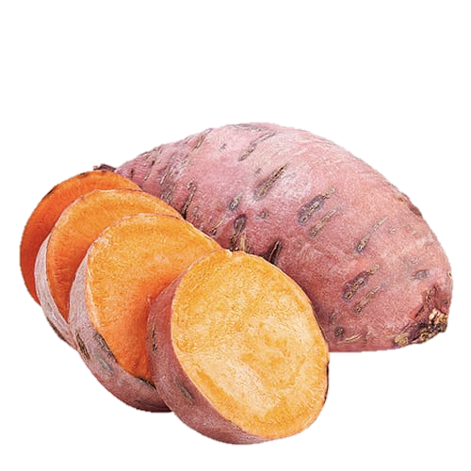

For children 1-3 years in Landlocked Developing Countries, the EWE effect is substantial.
Potassium 300 mg/person/day
–39.2% (–73.3, –15.7)
Vitamin B6 0.5 mg/person/day –15.2% (–27.3, –6.5)
Protein 7.7 mg/person/day –17.0% (–55.8, –4.1)

Slide 41
Study 2: Indigenous heat

Slide 42
LOCAL study: Associations between climate and health in northern Australia
Principal component analysis and MM-est robust regression

Slide 43


Slide 44
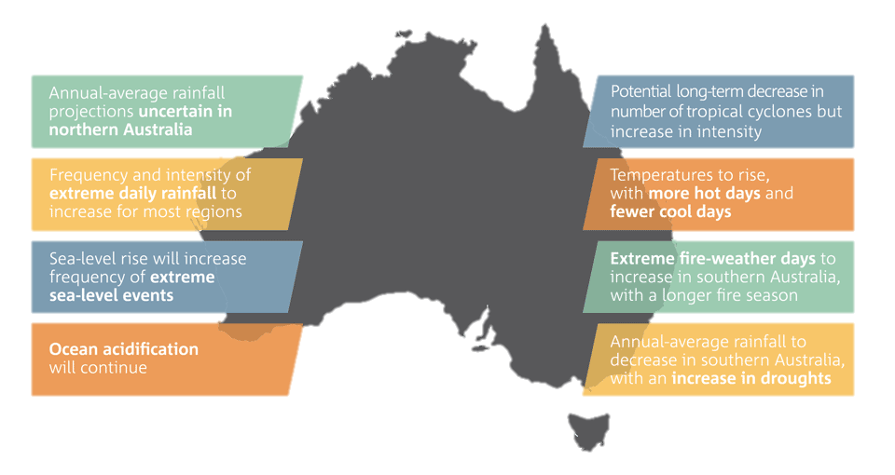

Notes:
https://www.vectorstock.com/royalty-free-vector/map-of-australia-northern-territory-vector-20392629

Slide 45
Within the next 50 years, the Northern Territory is projected to experience: higher average temperatures, higher sea surface temperatures, rising sea levels, more extreme hot days, and more intense cyclones

Slide 46
Indigenous Australians compose 30% of the population in the Northern Territory. Nationally, they compose 3.3% of the population.
Compared to the rest of the country, age-standardised DALY (disability-adjusted life years) rates for Indigenous Australians are highest in the Northern Territory.

Slide 47
Compared to non-Indigenous Australians, Aboriginal and Torres Strait Islander people
are 3x more likely to have diabetes
are 2x as likely to be obese
have 2x the rate of mortality from coronary heart disease
have 5x the rate of mortality from diabetes
experience 2.3x the age-standardised hospitalisation rate

Slide 48
Environments and Remote Indigenous Cardiometabolic Health: EnRICH study

Slide 49
Main findings
Relative heat poses a significant threat to cardiometabolic health among Indigenous communities in northern Australia
Severity of the heat shock matters more than duration or frequency
Relative heat shocks should be the focus of environmental public health preparation and response

Slide 50
Environments and Remote Indigenous Cardiometabolic Health: EnRICH study
For 104 remote Indigenous communities in NT:
33 physical environment variables (2010 – 2015)
  Collected by field workers using ARCGIS
118 census variables (2010 – 2015)
    Australian Bureau of Statistics
67 climate variables (2000 – 2015)
  Bureau of Meteorology

Slide 51
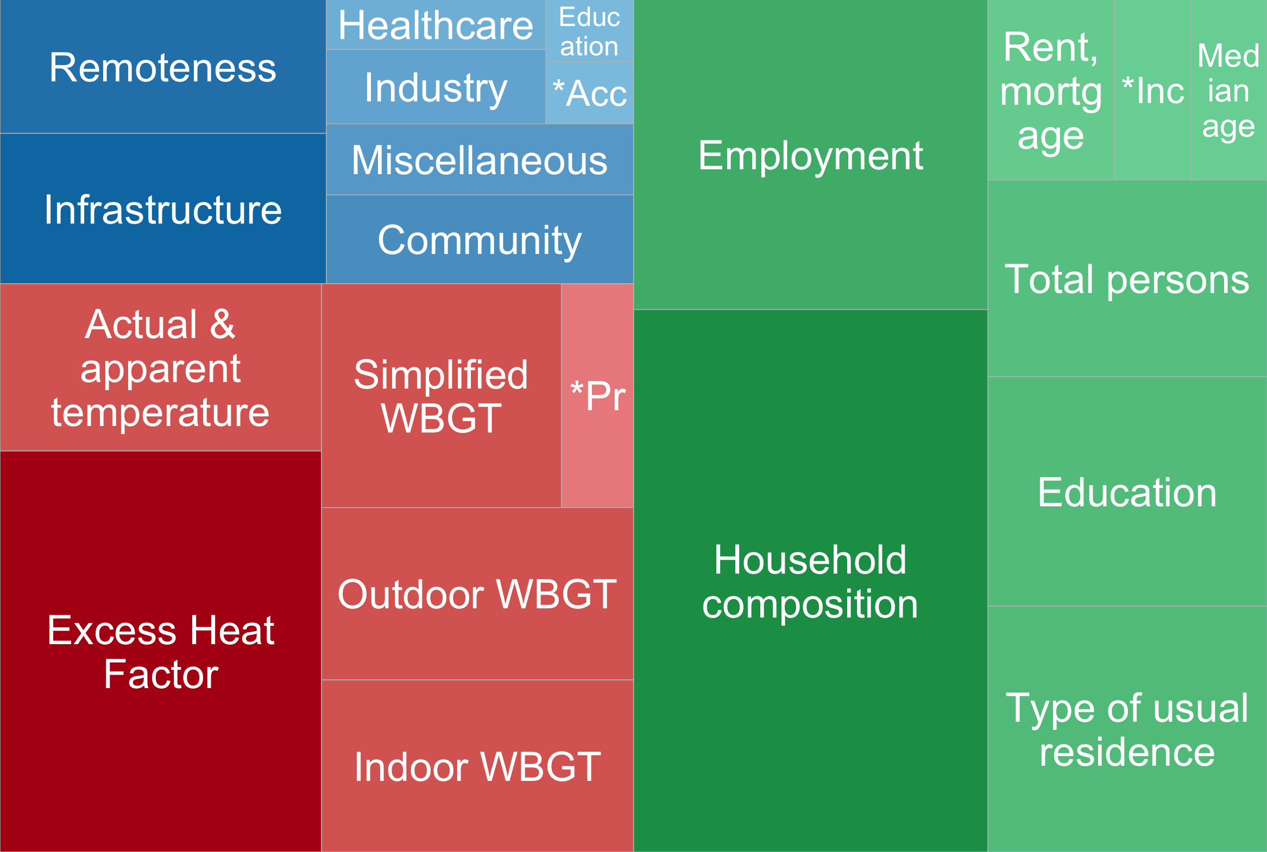
Physical (built)
environment
Census

Slide 52
Apparent Temperature (AT)
perceived temperature by humans; or ambient temperature adjusted based on humidity and wind speed
Wet Bulb Globe Temperature (WBGT)
heat stress indicator that incorporates temperature, humidity, wind speed, sun angle, and cloud cover
Excess Heat Factor (EHF)
heat shock indicator that incorporates how hot a three-day period is with respect to 1) an annual threshold and 2) the recent past (past 30 days)

Slide 53
Environments and Remote Indigenous Cardiometabolic Health: EnRICH study
Cardiometabolic health outcomes from NT Department of Health (2010-2015)
  Primary healthcare presentations
  Inpatient admission rates
  Emergency room presentations
  Mortality rates

Slide 54
Methodology
Multivariate data is projected on high-dimensional data space
Principal Component Analysis is conducted to determine a lower-dimensional projection
Scores are adjusted through varimax-rotation
OLS and MM-estimator regressions are run

Slide 55
Layman’s terms?
PCA does not pick and choose variables → it creates
PCA looks for properties that show as much variation across the data as possible
  Maximum variance
PCA simplifies all the information so that you can predict, or “reconstruct”, the data
  Minimum error
  LOADINGS → PC1 & PC2 SCORES initial variables regressors

Slide 56
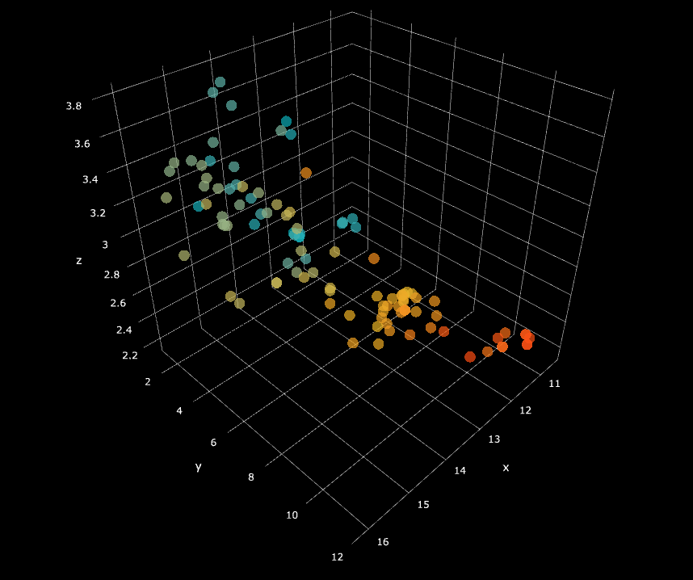

Slide 57
PC2
PC1

Slide 58
PC2
PC1

Slide 59
Physical environment PC1
Physical environment PC2
Census PC1
Census PC2
Climate PC1
Climate PC2
  LOADINGS → PC1 & PC2 SCORES
  initial variables regressors

Slide 60
Results

Slide 61
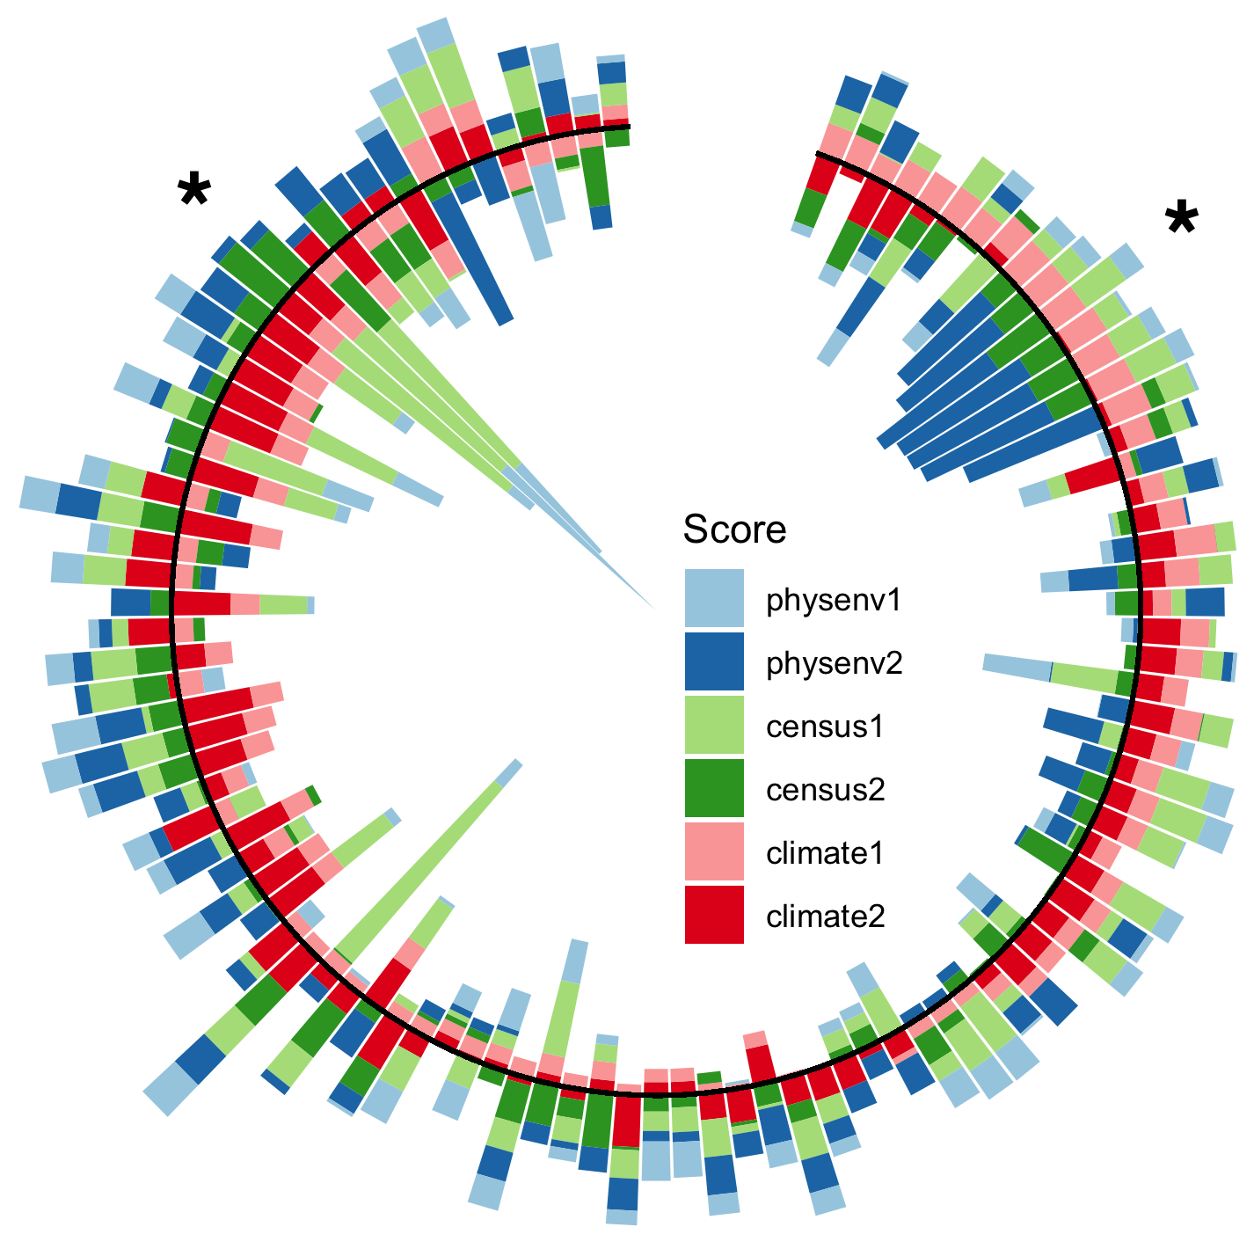
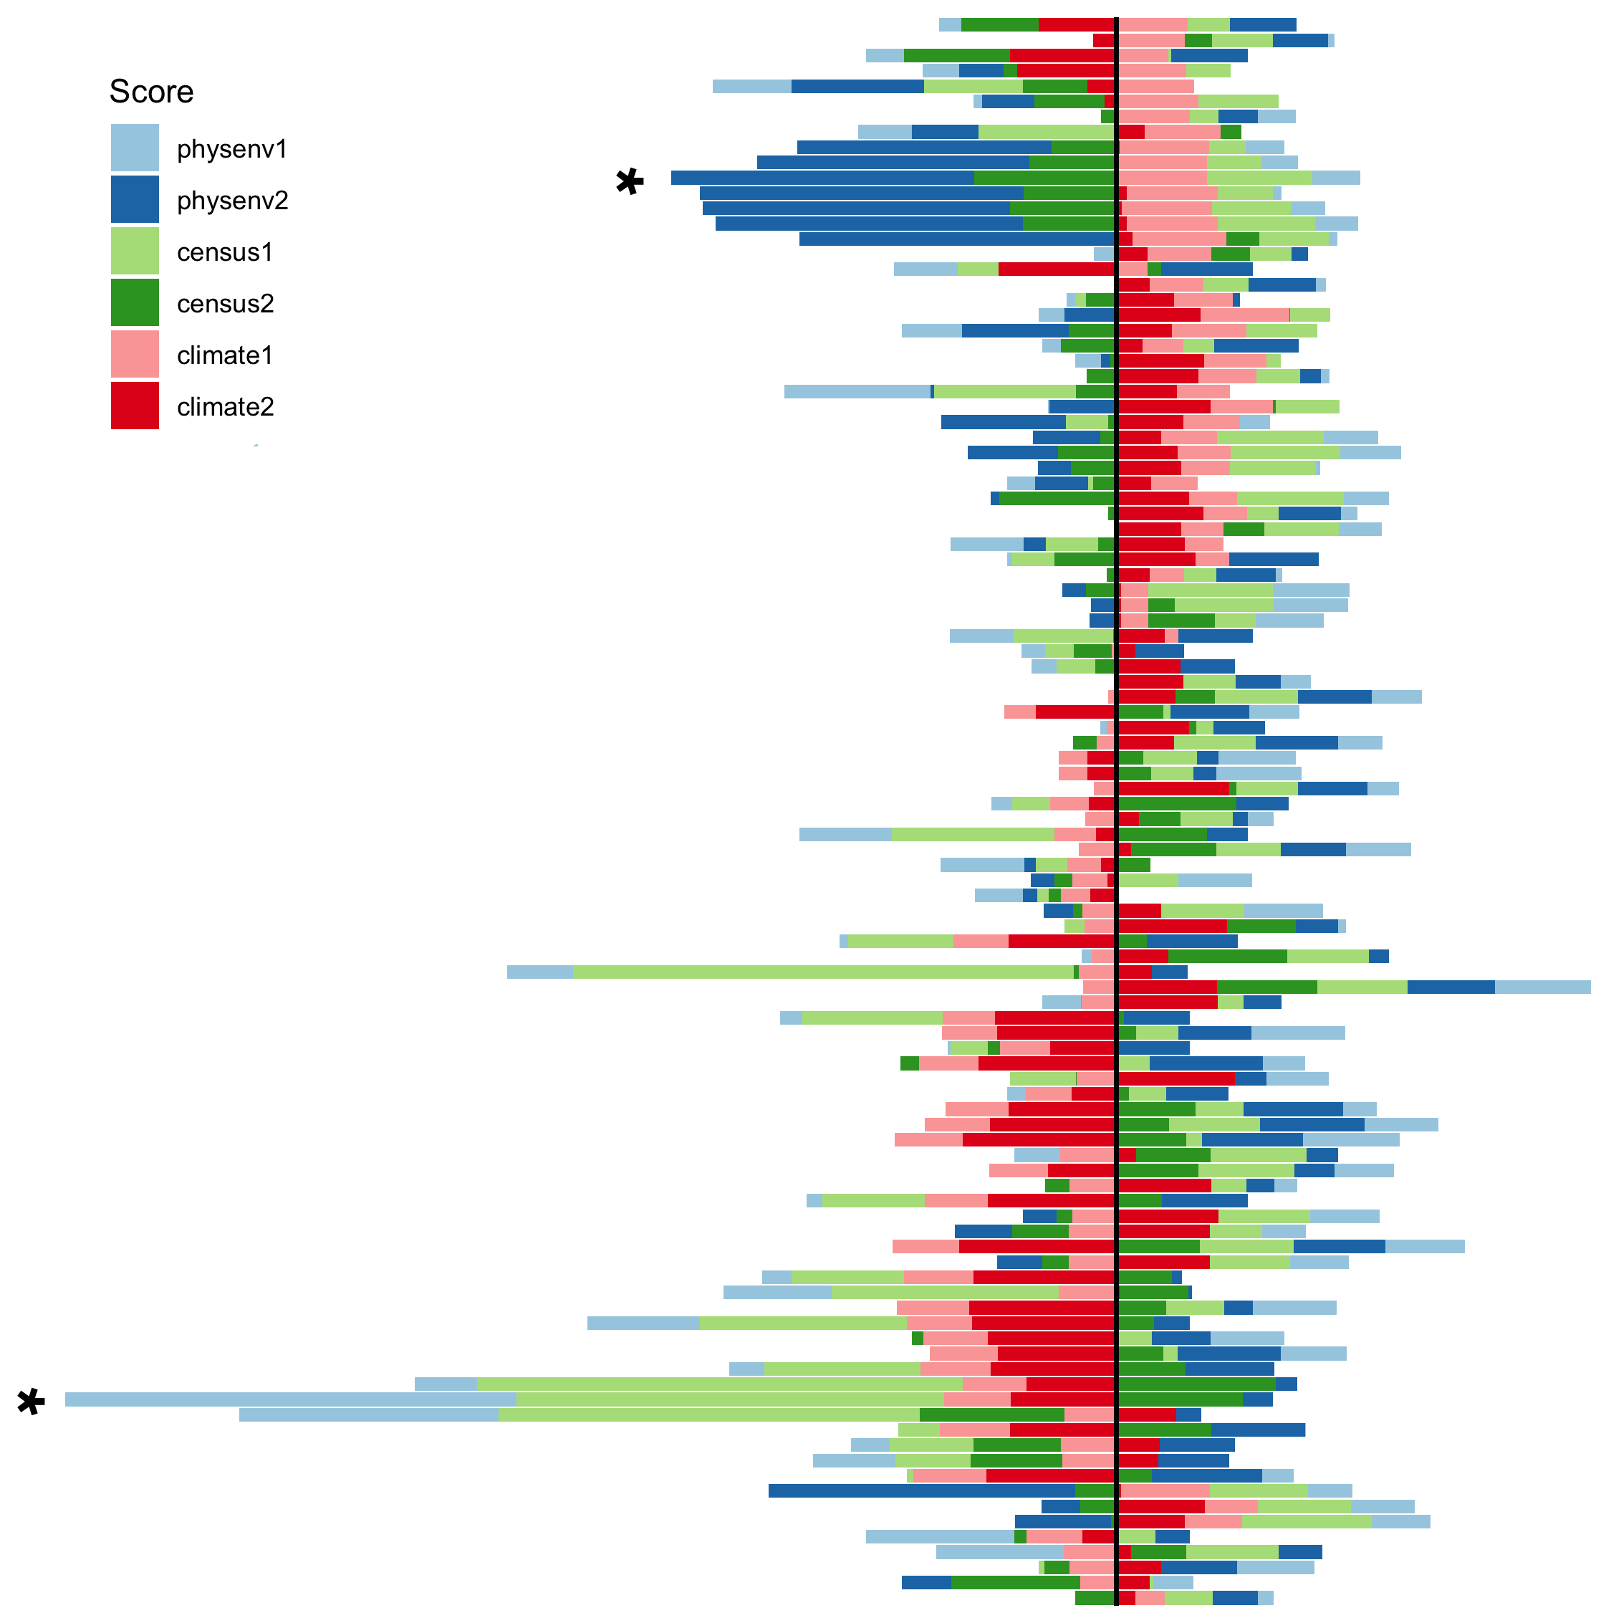
S
N

Slide 62
PC
Top loadings
A community with a large positive Climate1 score experiences lower apparent temperature and humidity, but greater maximum relative heat shock severity.
– annual avg of max AT
– avg of AT 1500, spring
– avg of outdoors WBGT 1500, spring
– avg of indoor WBGT 1500, spring
+ annual avg of max EHF values, summer
– avg of max EHF duration, summer
– avg duration of consecutive EHF, summer
– avg EHF values, summer
– avg of max EHF duration, autumn
– annual avg of EHF duration
A community with a large positive Climate2 score experiences shorter relative heat shocks compared to other communities.

Slide 66
MM-estimator regression

Slide 67
A unit increase in climate PC1 score is associated with a 77.8% change in emergency room rates, 6.72 percentage point increase in inpatient rates, and 9.25 percentage point increase in primary healthcare rates
A larger cardiometabolic health burden is strongly correlated with communities that experience relatively lower apparent temperature and humidity but greater maximum relative heat shock severity

Slide 68
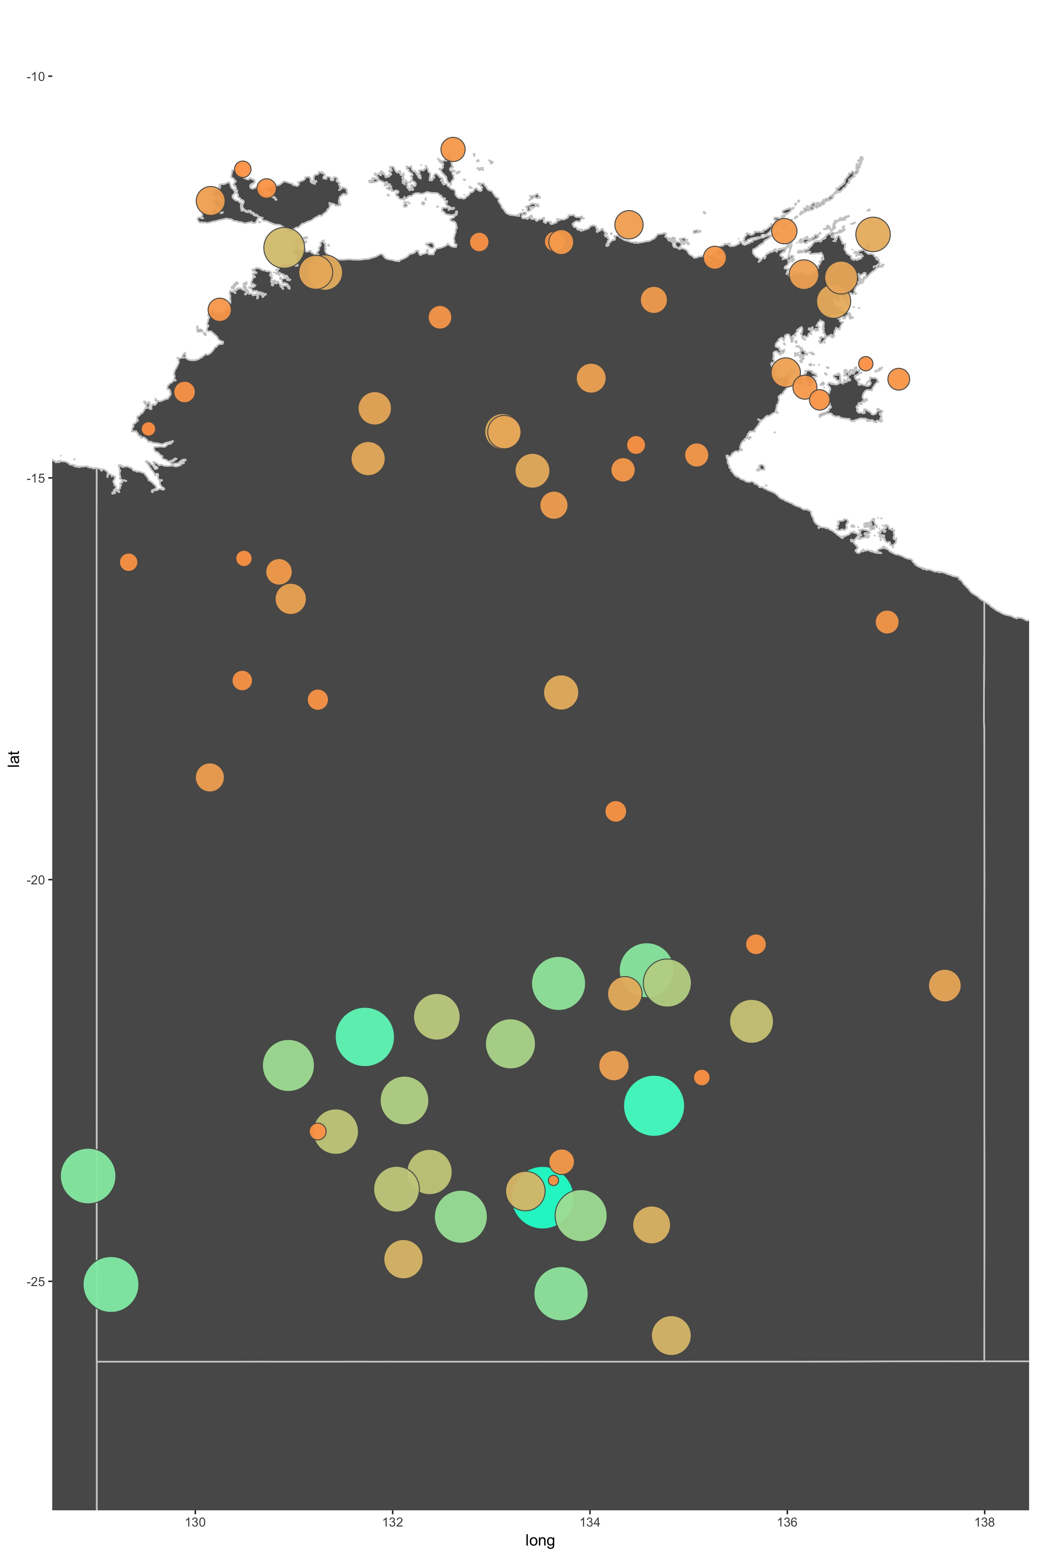
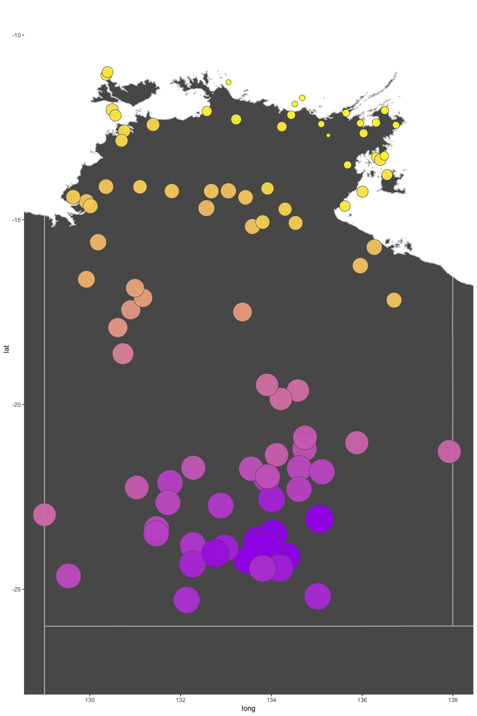
ED rates
Climate PC1 scores

Slide 69
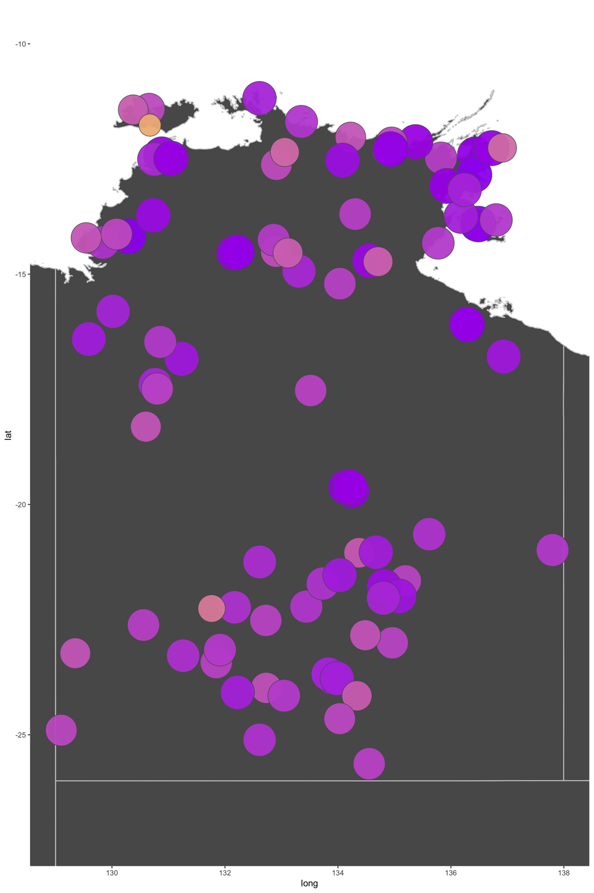
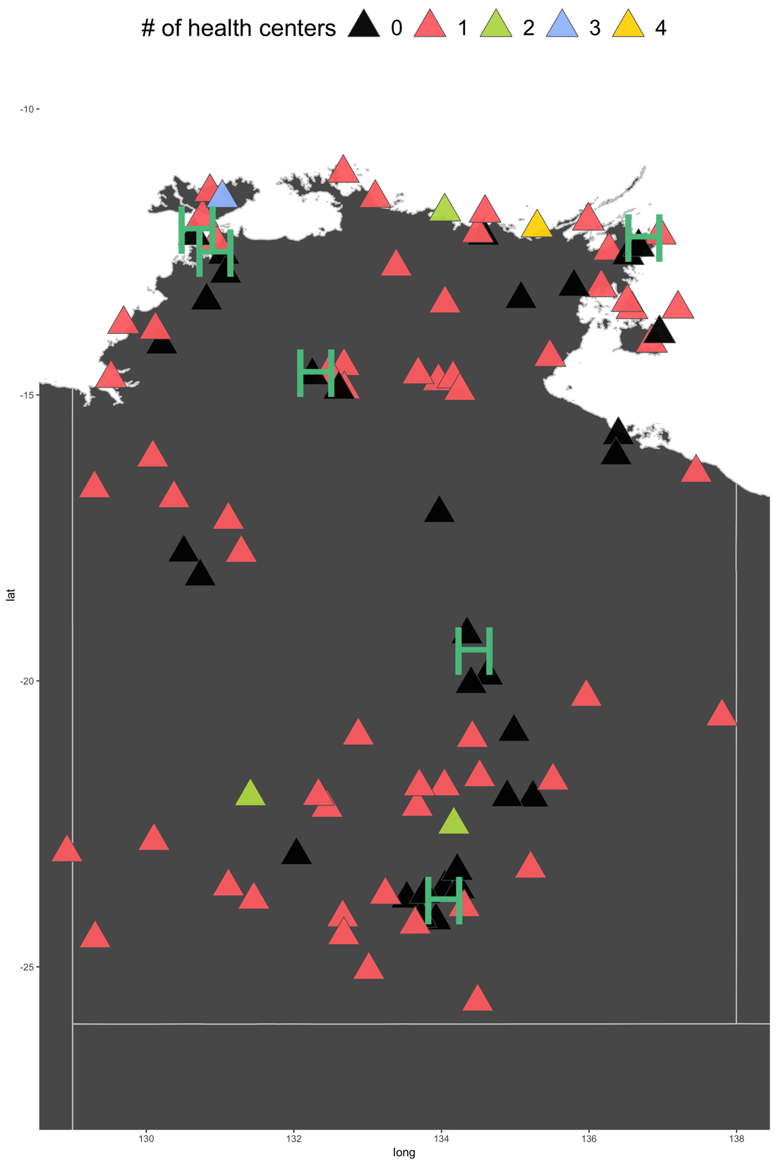
Health centers
Phys_env PC1 scores

Slide 70
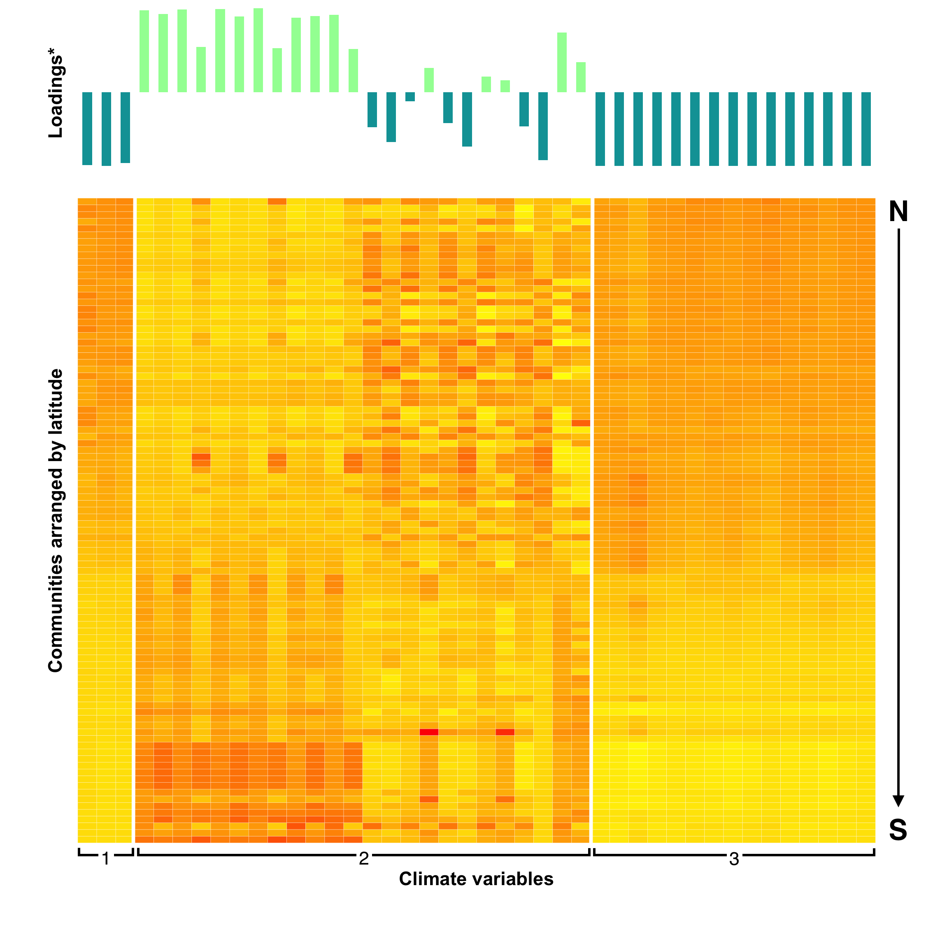
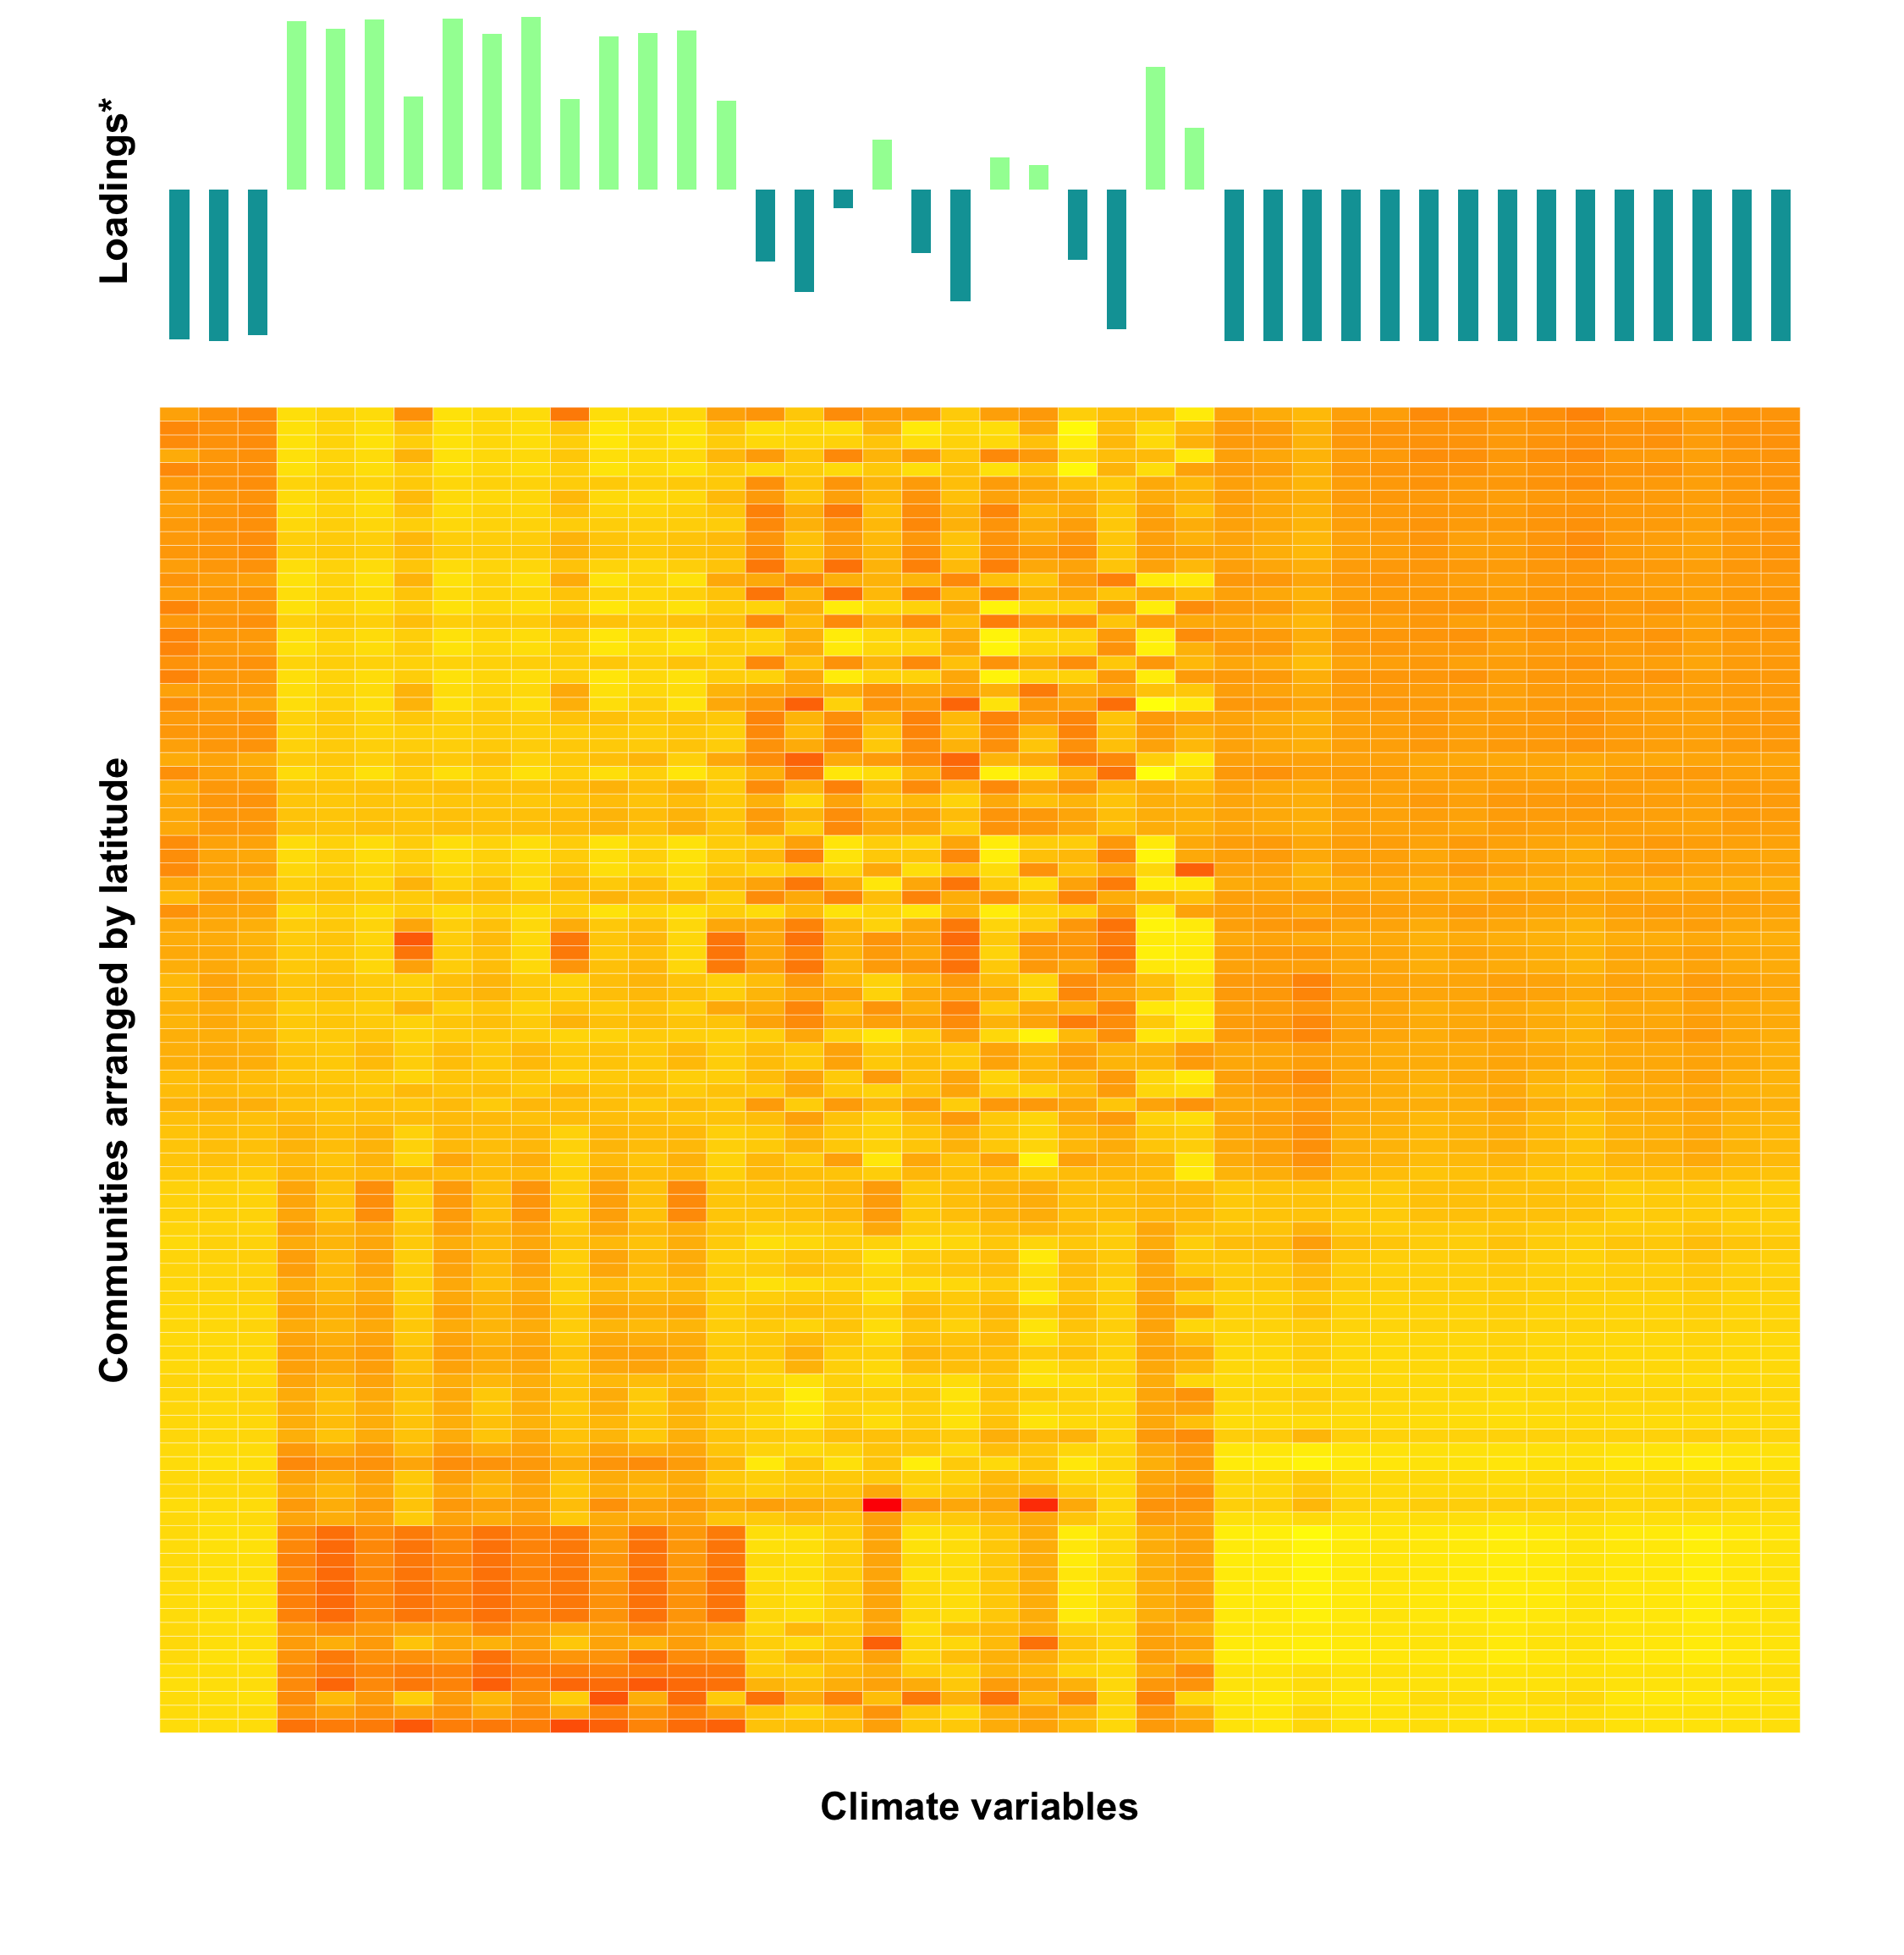

Slide 74
Section 1: Atmospheric moisture
Rainfall total (mm)

Slide 75
Atmospheric moisture and the humidity/heat indicators share the same N → S gradient
Loadings are all negatively correlated with climate PC1 score

Slide 76
Opposite gradient for EHF values and load
Positively correlated to climate PC1 scores
Mixed pattern for EHF duration and count

Slide 77
Nicolas F. Trudel
Concluding remarks

Slide 78
Main findings
Globally, all micronutrient supplies exhibited modest deficits during the year of an EWE
Landlocked developing countries show magnified effects
Observed year-of-event nutrient supply deficits were a large percentage of what a healthy child’s sufficient average dietary intake level should be

Slide 79
Main findings
Emergency room rates, inpatient admission, and primary healthcare presentations are all significantly associated with EHF
Community with the highest absolute temperature year-round does not have the highest EHF value
Relative heat shock – intensity, not frequency – should be the target
Notes:
Relative heat poses a significant threat to cardiometabolic health among Indigenous communities in northern Australia
Severity of the heat shock matters more than duration or frequency
Relative heat shocks should be the focus of environmental public health preparation and response

Slide 80
Both studies echo previous literature in stressing the urgency with which the international community must tackle the issue of nutritional and metabolic health among vulnerable populations, especially because this health landscape is poised to worsen with climate change.

Slide 81


Slide 82

Emma Constance
Notes:
https://www.deviantart.com/emma-constance/art/Australian-Aboriginal-Flag-2-148547477

Slide 83

Anything else you’re interested in is not going to happen if you can’t breathe the air and drink the water. Don’t sit this one out. Do something. You are by accident of fate alive at an absolutely critical moment in the history of our planet.
Carl Sagan

Slide 84






Slide 85
Action News Jax. (2017). Hurricane Irma: Food assistance program begins in Jacksonville area. Retrieved from http://www.actionnewsjax.com/news/local/hurricane-irma-food-assistance-program-begins-in-jacksonville-area/622991627
Brimblecombe, J., Liddle, R., & O'Dea, K. 2012. Use of point-of-sale data to assess food and nutrient quality in remote stores. Public Health Nutrition, 1-9.
Burrow S, Ride K (2016) Review of diabetes among Aboriginal and Torres Strait Islander people. Australian Indigenous HealthInfoNet. Retrieved from http://www.healthinfonet.ecu.edu.au/chronic-conditions/diabetes/reviews/our-review
Coast Adapt (2017). Climate change and sea-level rise in the Australian region. Retrieved from https://coastadapt.com.au/climate-change-and-sea-level-rise-australian-region
Climate Council. (2017). Tropical cyclones and climate change: factsheet. Climate Council. Retrieved from https://www.climatecouncil.org.au/uploads/3cf983377b8043ff1ecf15709eebf298.pdf
Commonwealth of Australia, Department of the Prime Minister and Cabinet, Closing the Gap Prime Minister’s Report 2017. Retrieved from http://closingthegap.pmc.gov.au/sites/default/files/ctg-report-2017.pdf.
Esmaillzadeh, A., Kimiagar, M., Mehrabi, Y., Azadbakht, L., Hu, F. B., & Willett, W. C. (2006). Fruit and vegetable intakes, C-reactive protein, and the metabolic syndrome. The American journal of clinical nutrition, 84(6), 1489-1497.
Forouzanfar, M. H., Alexander, L., Anderson, H. R., Bachman, V. F., Biryukov, S., Brauer, M., ... & Delwiche, K. (2015). Global, regional, and national comparative risk assessment of 79 behavioural, environmental and occupational, and metabolic risks or clusters of risks in 188 countries, 1990–2013: a systematic analysis for the Global Burden of Disease Study 2013. The Lancet, 386(10010), 2287-2323.
Grundy, S. M., Brewer, H. B., Cleeman, J. I., Smith, S. C., & Lenfant, C. (2004). Definition of metabolic syndrome. Circulation, 109(3), 433-438.
Grundy, S. M., Cleeman, J. I., Daniels, S. R., Donato, K. A., Eckel, R. H., Franklin, B. A., ... & Spertus, J. A. (2005). Diagnosis and management of the metabolic syndrome. Circulation, 112(17), 2735-2752.
Hurricane Irma. (n.d.). In Wikipedia. Retrieved from http://ncdrisc.org/diabetes-population-stacked.html
Institute of Medicine Forum on Microbial Threats. (2008). Global Climate Change and Extreme Weather Events: Understanding the Contributions to Infectious Disease Emergence: Workshop Summary. Washington (DC): National Academies Press. Available from: https://www.ncbi.nlm.nih.gov/books/NBK45750/
Lemaire. M. and Walton, I. (2016). Metabolic Syndrome – what will it take to change you? Retrieved from https://www.vivehealth.com.au/blog/2016/08/23/metabolic-syndrome-what-will-it-take-to-change-you/
Moise, A et al., 2015, Monsoonal North Cluster Report, Climate Change in Australia Projections for Australia’s Natural Resource Management Regions: Cluster Reports, eds. Ekström, M et al., CSIRO and Bureau of Meteorology, Australia.
Myers, S. S., Smith, M. R., Guth, S., Golden, C. D., Vaitla, B., Mueller, N. D., ... & Huybers, P. (2017). Climate change and global food systems: Potential impacts on food security and undernutrition. Annual review of public health, 38, 259-277.
NCD Risk Factor Collaboration (2017). Diabetes: evolution over time [stacked plot]. Retrieved from http://ncdrisc.org/diabetes-population-stacked.html
Springmann, M., Mason-D'Croz, D., Robinson, S., Garnett, T., Godfray, H. C. J., Gollin, D., ... & Scarborough, P. (2016). Global and regional health effects of future food production under climate change: a modelling study. The Lancet, 387(10031), 1937-1946.
World Health Organization (2017). Percentage of deaths due to noncommunicable diseases occurring under age of 70, both sexes, 2015 [graph]. Retrieved from http://gamapserver.who.int/mapLibrary/Files/Maps/Global_NCD_mortality_under70_both_sexes_2015.png
World Health Organization (2017). Mean Body Mass Index (kg/m2), ages 18+, 2016 (age standardized estimate), female [graph]. Retrieved from http://gamapserver.who.int/mapLibrary/Files/Maps/Global_BMI_2016_Female.png
World Health Organization (2017). Mean Body Mass Index (kg/m2), ages 18+, 2016 (age standardized estimate), male [graph]. Retrieved from http://gamapserver.who.int/mapLibrary/Files/Maps/Global_BMI_2016_Male.png
World Health Organization (2009). Global health risks: Mortality and burden of disease attributable to selected major risks. Retrieved from http://www.who.int/healthinfo/global_burden_disease/GlobalHealthRisks_report_full.pdf
Image credit
http://weclipart.com/gimg/7AD898E6EF4A5491/il_fullxfull.588539815_t9s2.jpg
https://upload.wikimedia.org/wikipedia/commons/thumb/f/f5/Hurricane_Juan_27_sept_2003_1725Z.jpg/1200px-Hurricane_Juan_27_sept_2003_1725Z.jpg
https://www.youtube.com/watch?v=bhvjfC5qenQ
http://3.bp.blogspot.com/-6Y_kR7Qv7Rg/VgN6P9bJINI/AAAAAAAANIE/gvdQVasoIM4/s1600/picjumbo.com_HNCK7947.jpg
http://nisciencefestival.com/im/events/cropped/1964963740.jpeg
https://cdn2.bigcommerce.com/server2400/5c00a/product_images/uploaded_images/gummy-bear-invasion-harmful-junk-food-concept-g1j7mtcd.jpg?t=1418540356
http://viralrang.com/wp-content/uploads/2016/12/Impact-Processed-Foods.jpg
http://www.assureasmile.com/wp-content/uploads/2017/03/AdobeStock_101558377-1260x840.jpeg
https://greatist.com/sites/default/files/processed-foods.jpg
https://images1.miaminewtimes.com/imager/u/original/9648515/img_1270.jpg
http://www.abc.net.au/news/image/7804196-3x2-940x627.jpg

Slide 86
Intro
Study 1: SEA global nutrients
Methods
Results
Supplementary
Study 2: EnRICH Indigenous heat
Methods
Results
Supplementary
Thanks

Slide 87
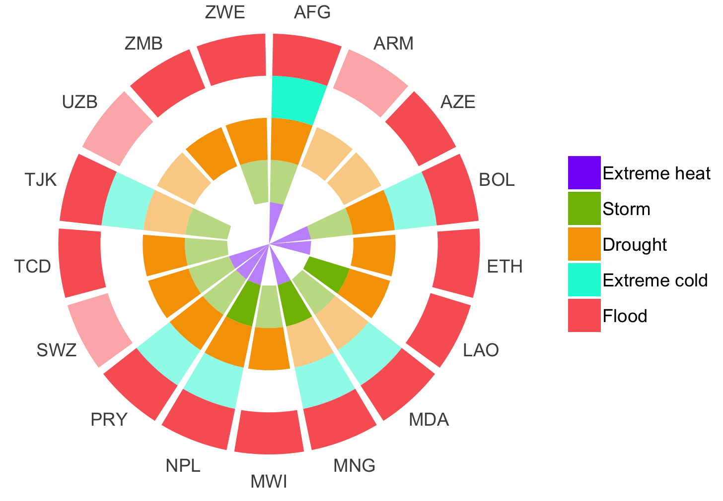

Slide 88
Global n=175
European Union n=29
Least Developed Countries n=15
Landlocked Developing n=19
Low Income Food Deficit Countries n=32
Net Food Importing Developing Countries n=64

Slide 91
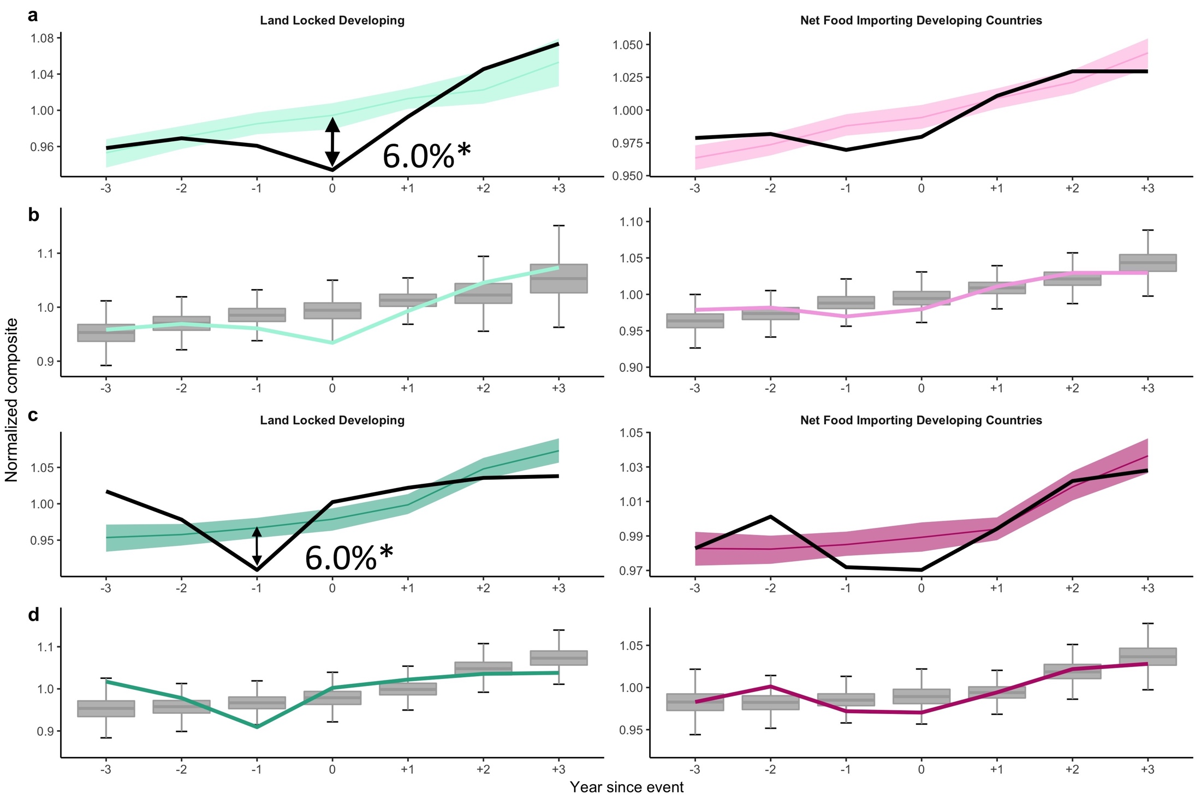

Slide 95
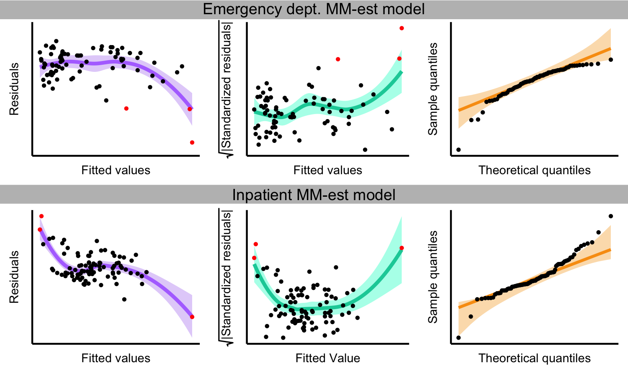

Slide 96
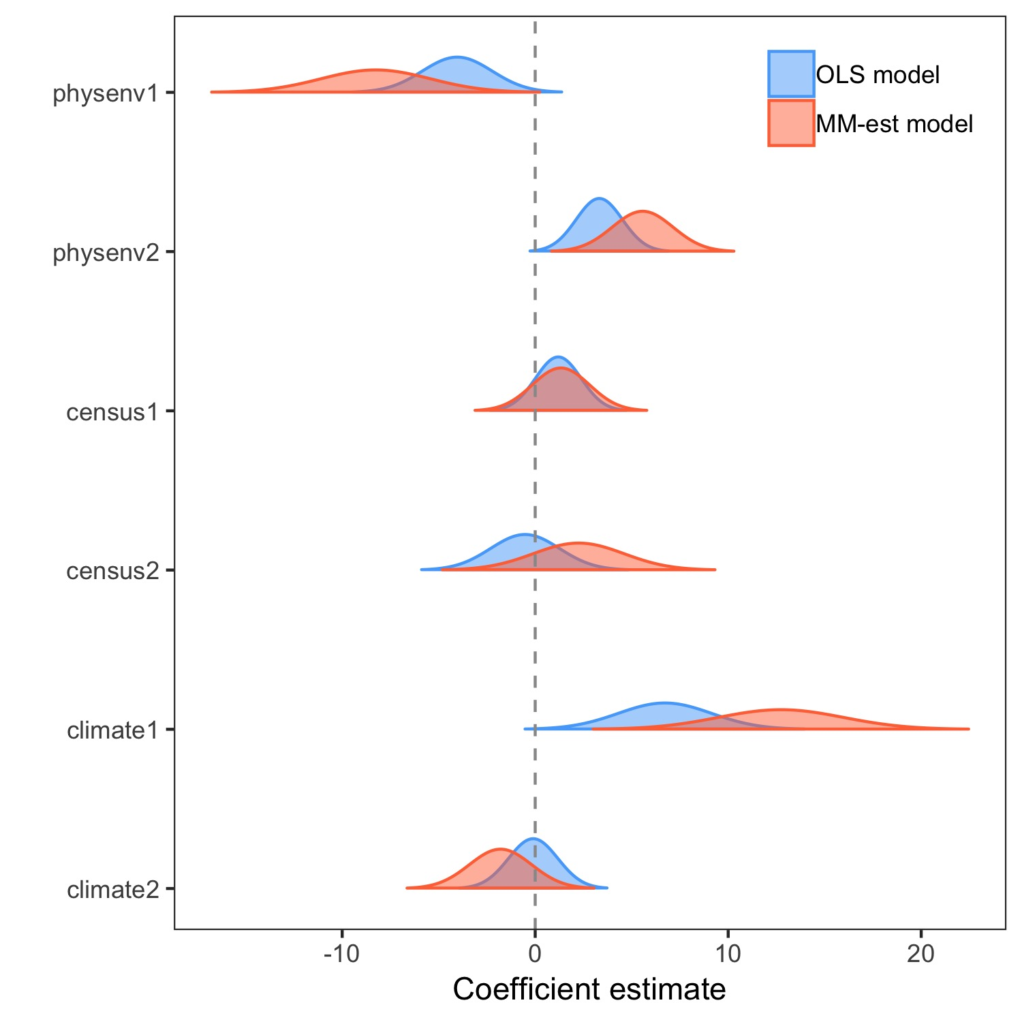

Slide 98







