Slide 1





Degrees of displacement:
The impact of household PV battery prosumage on utility generation and energy storage
Kelvin Say & Wolf-Peter Schill

Slide 2
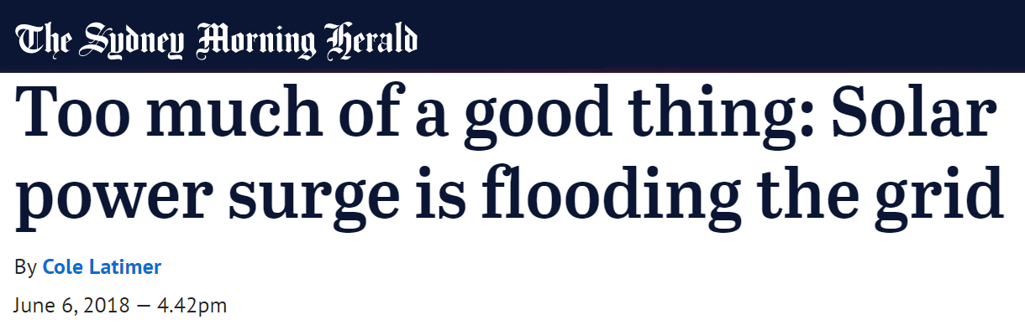
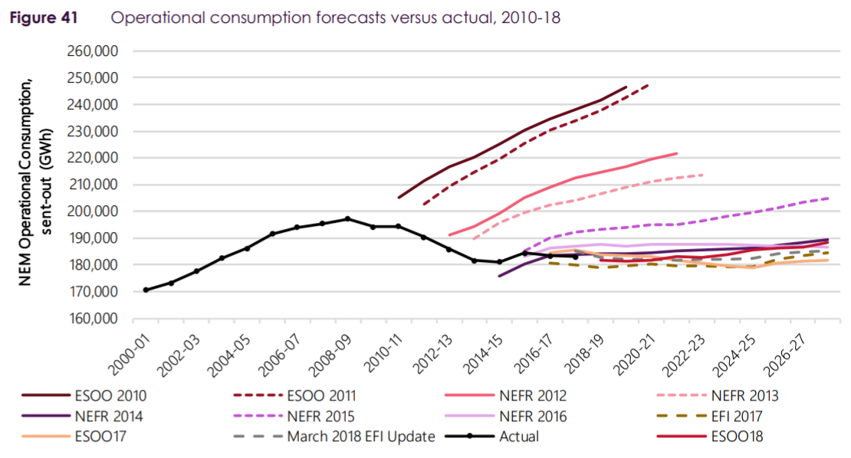


Electricity customers are changing.
AEMO, 2018. 2018 Electricity Statement of Opportunities for the NEM.

Slide 3
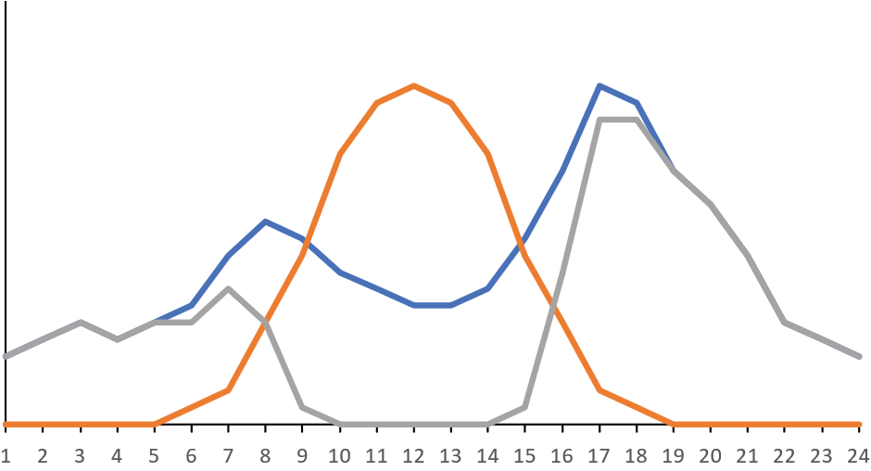
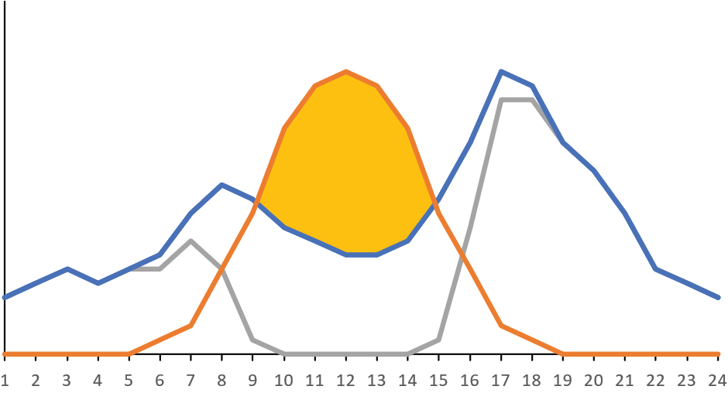
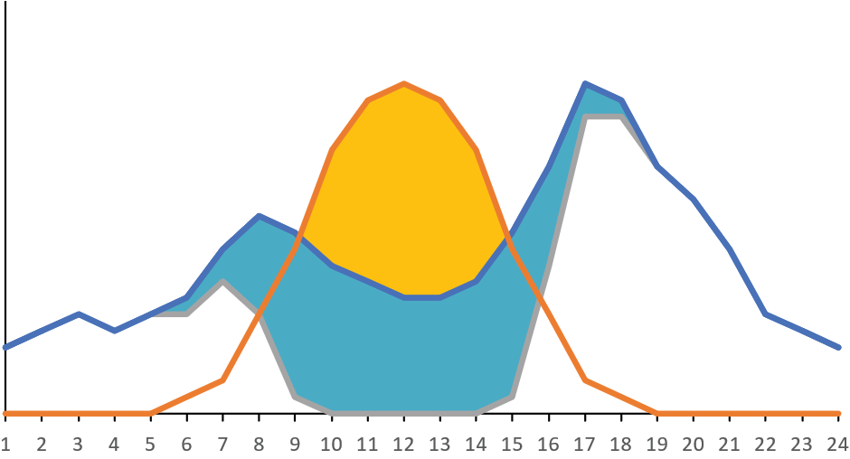
Derivation of customer value.
Diminishing returns for additional PV capacity + eligibility considerations
Retail usage charges/kWh:
7c/kWh
22c/kWh

Slide 4
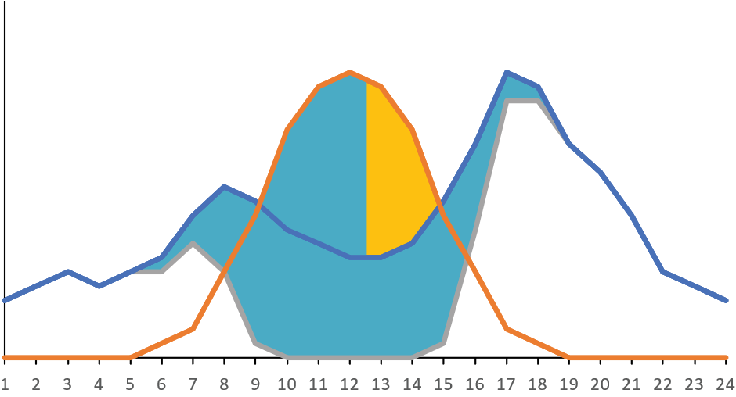

The value shifts with PV-battery prosumage.
PV and battery investments are intertwined
7c/kWh
Batteries revalue excess PV generation (minus losses)
Prosumage adoption becomes a combined consideration of PV and battery capacity
Interaction with FiT eligibility
FiT incentives are “flipped”
22c/kWh
* Assuming batteries only operate to maximise self-consumption

Slide 5
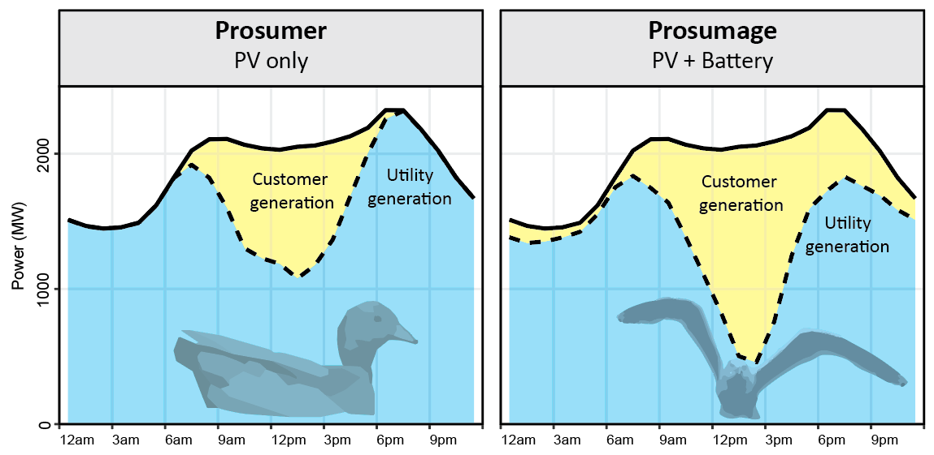
Changing shape of residual network demand.
Batteries incentivise additional PV capacity
Declining minimum midday demand
Declining late-afternoon peak
Emerging residual morning peak
Increased morning to midday down ramping
Say, K., John, M. (Under revision). Shifting sands: Transitions in diurnal and seasonal demand arising from household PV battery adoption

Slide 6
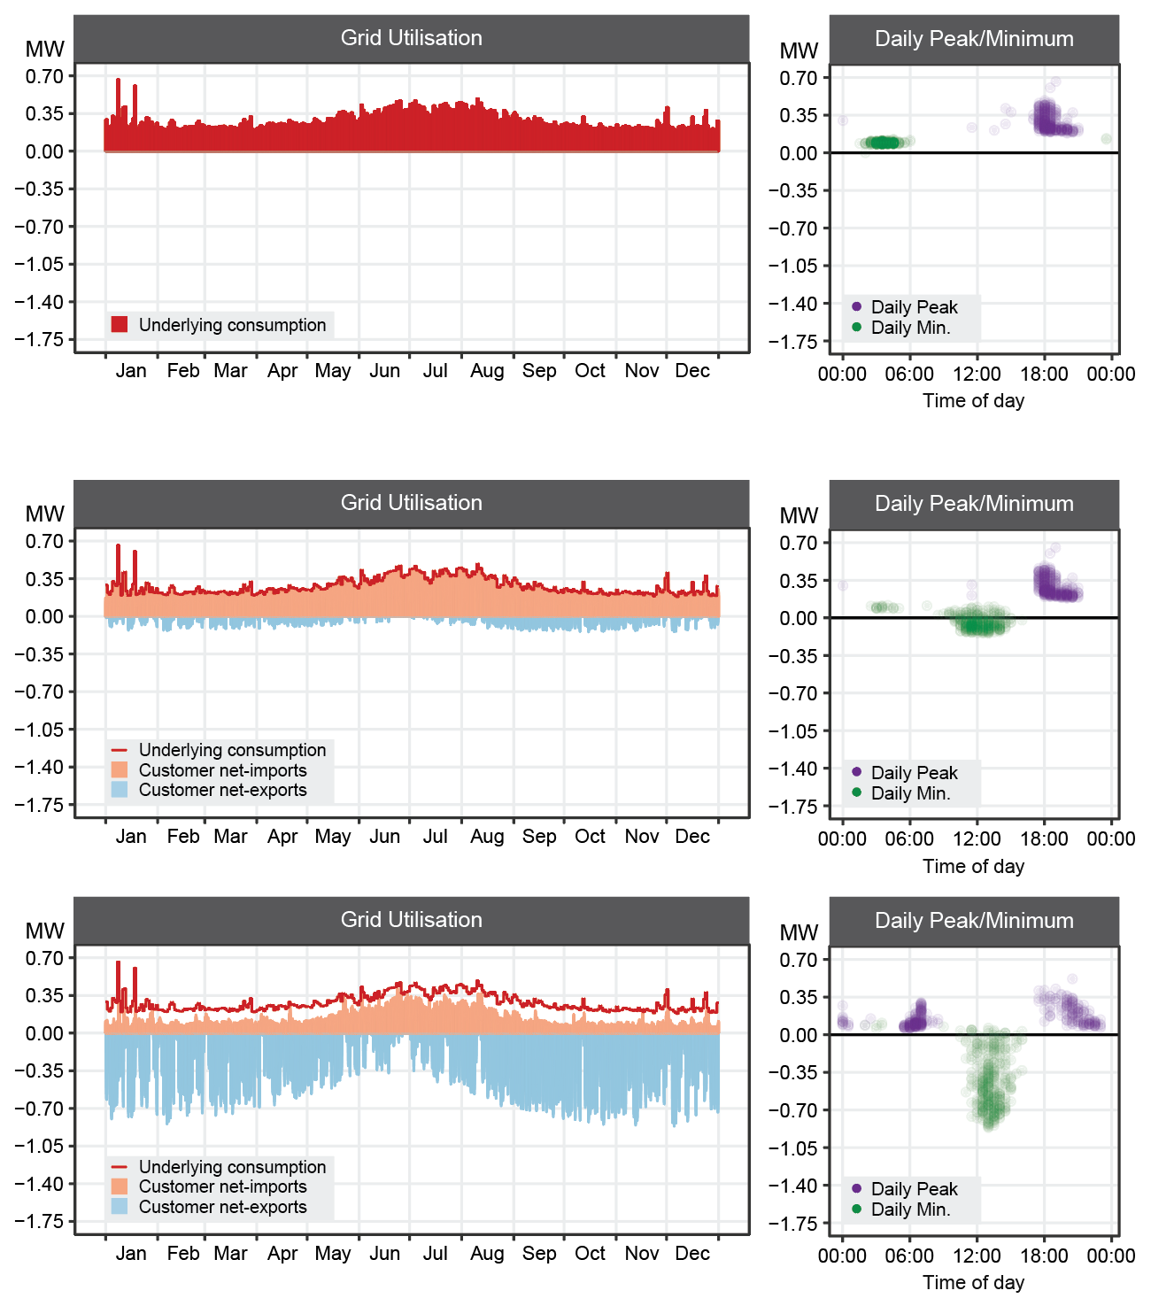


Changing shape of residual network demand.
Shifting into winter dominant demand
Say, K., John, M. (Under revision). Shifting sands: Transitions in diurnal and seasonal demand arising from household PV battery adoption

Slide 7




A changing customer, a changing power sector.
With costs of battery systems declining and electricity prices rising,
what impacts could household PV-battery adoption have on the power sector?
Household investment simulation model
Residual network demand
Utility-scale dispatch and investment model
2019 to 2030
2030

Slide 8

The case study.
Western Australia’s South West Interconnected System (SWIS) Network
Islanded network, currently unable to export elsewhere or curtail household PV
Significant wind and solar resources
Around 18 TWh of annual energy consumption with households consuming around 30%

Slide 9
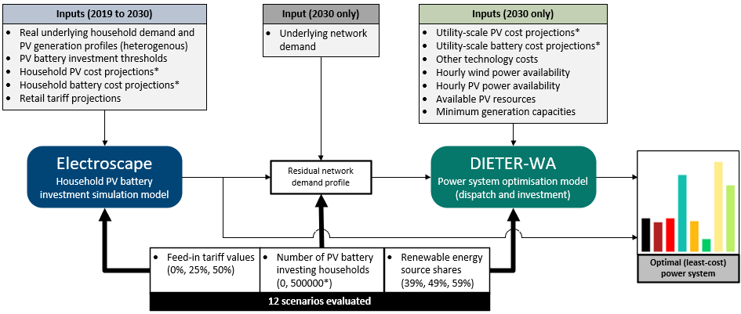


The research setup.
Customer
Household batteries only operate for
“self-consumption”

Slide 10
Data sources.
Input Parameters | Value | Source
Household underlying demand and generation (heterogenous) | 261 Sydney homes via half-hourly gross meter data 2012-13 | (Ausgrid)
Residential/utility PV cost projection curves | Scaled by 0.78 | (Solar Choice, GenCost 2018)
Residential/utility battery cost projection curves | Scaled by 0.73 | (Solar Choice, Schmidt et al. )
Retail usage tariff projections | 29c/kWh +4%pa (Synergy, ABS) | (Synergy, ABS)
Underlying network demand | SWIS operational demand 2012-13 | (AEMO)
Number of investing households | 500,000 | Forecasted number of PV installations (AEMO)
Other technology costs | Conventional, wind, hydrogen, biomass | (GenCost 2018)
Wind resource | Time-series | (AEMO)
Solar resource | Time-series average of household insolation data | (Ausgrid)

Slide 11
The scenarios investigated.
We compare scenarios with varying FiT and RES shares to a counterfactual setting without prosumage.
FiTs at 0%, 25%, 50% of retail usage charge
Constrained RES share at 39%, 49%, 59%
Residual
network
demand
RES share @ 39%
RES share @ 49%
RES share @ 59%
FiT @ 50%
Residual
network
demand
FiT @ 25%
Residual
network
demand
FiT @ 0%
Residual
network
demand
2019
2030
Counterfactual
(Reference)

Slide 12
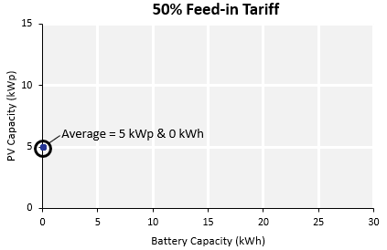
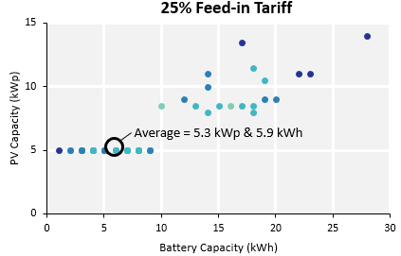
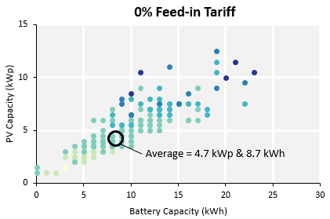

Various degrees of prosumage.
Higher FiTs discourage battery adoption and keeps households at the eligibility limit (5 kW_{P})
Lowering FiTs encourages battery adoption
Larger consumption households may exceed FiT eligibility limit
PV-only
PVB
PVB+
Annual Consumption

Slide 13
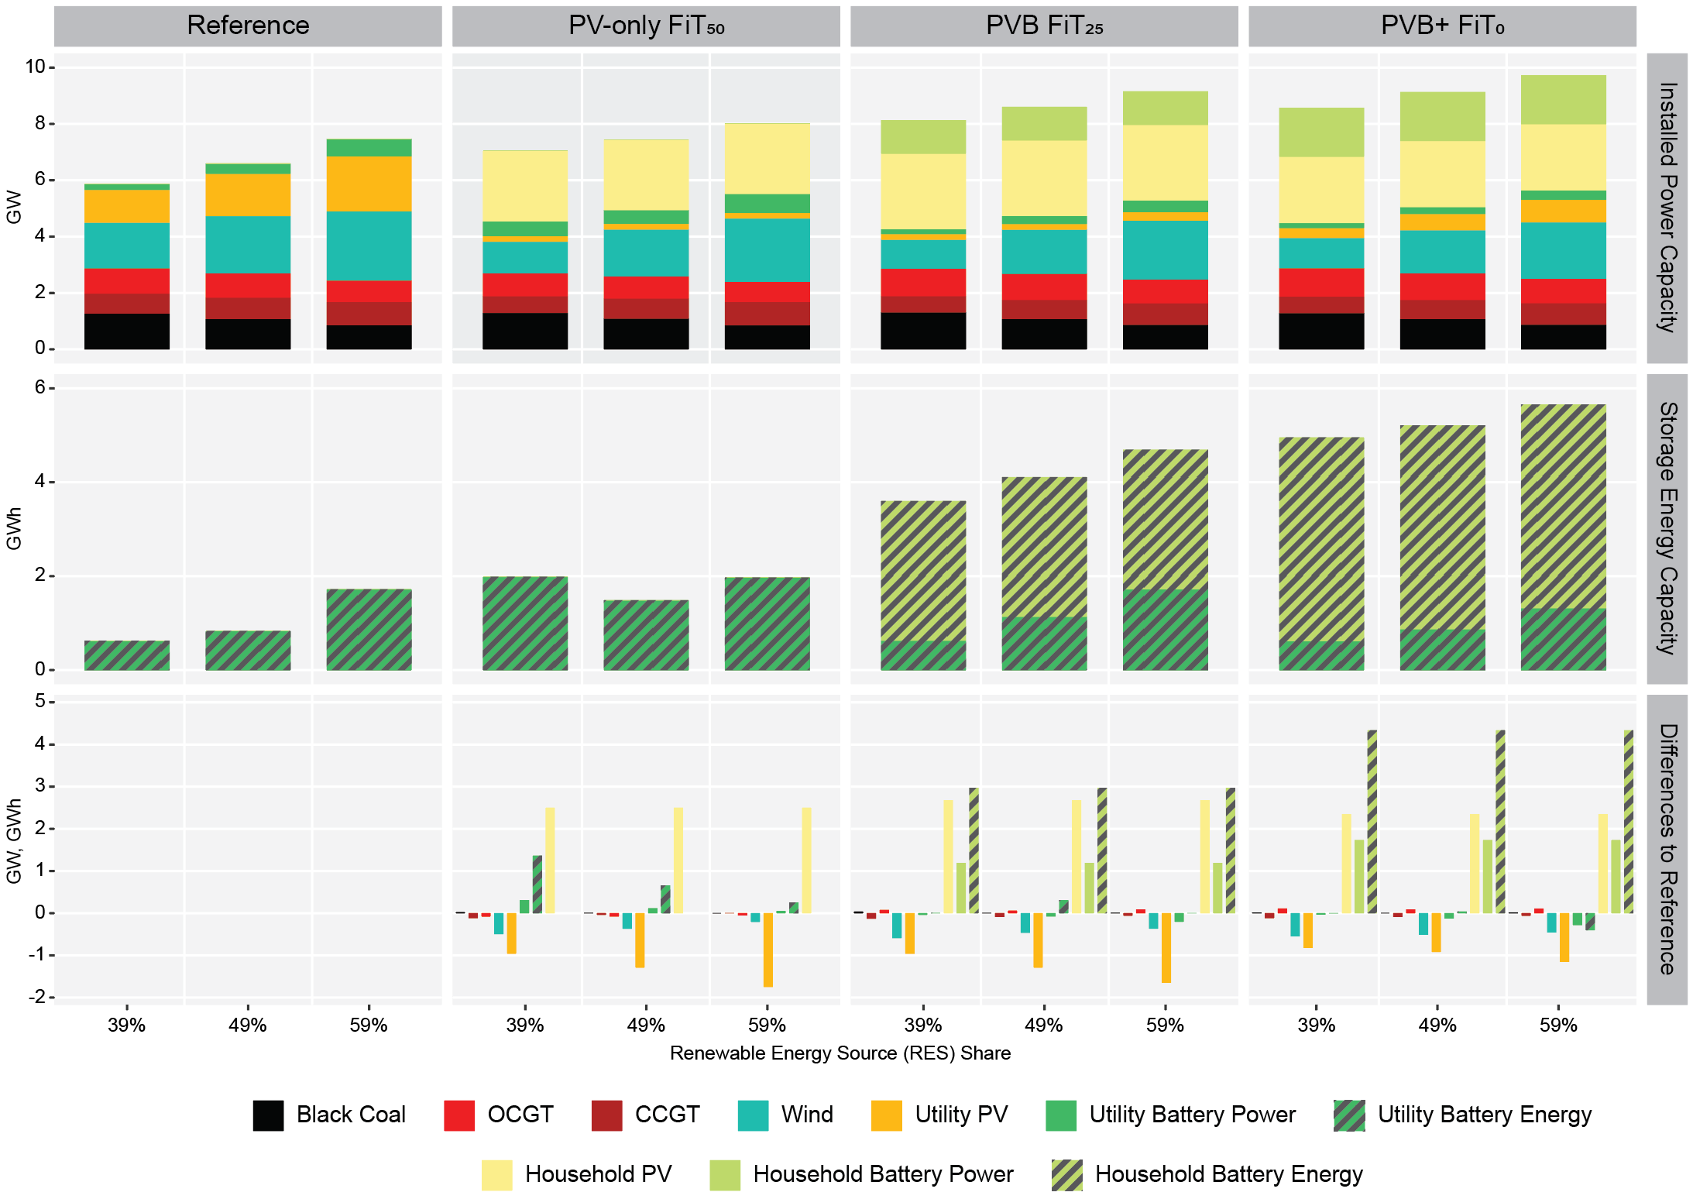

Capacity impacts.
Reference (counterfactual) scenario
No PV battery investing households
More wind than utility PV capacity
Increased utility battery capacity as RES share rises

Slide 14
Capacity impacts.
PV-only FiT₅₀ scenario
Average 5 kW_{P} with no batteries
Displacement in both utility PV and wind capacity
Wind capacity recovers as RES increases
Greater utility PV capacity displacement as RES increases
Further utility battery capacity added

Slide 15
Capacity impacts.
PVB FiT₂₅ scenario
Average 5.3 kW_{P} + 5.9 kWh
Displacement in both utility PV and wind capacity
Wind capacity recovers as RES increases
Greater utility PV capacity displacement as RES increases
Little effect on utility battery capacity

Slide 16
Capacity impacts.
PVB+ FiT₀ scenario
Average 4.7 kW_{P} + 8.7 kWh
Reduced displacement of utility PV capacity
Wind capacity recovers as RES increases
Greater utility PV capacity displacement as RES increases
Little effect on utility battery capacity

Slide 17
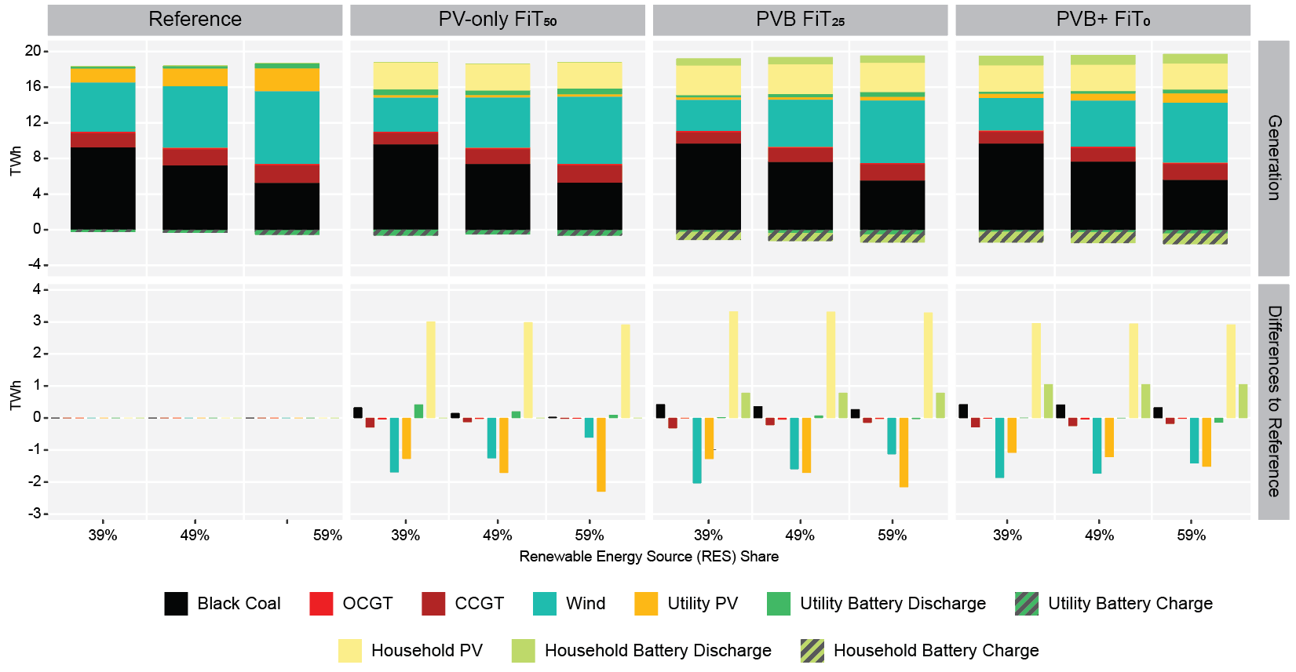
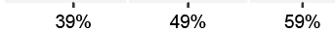
Generation impacts.
Reference (counterfactual) scenario
No PV battery investing households
Wind is an increasingly important resource, higher capacity factor of wind means that wind contributes more to the generation mix
Coal has greatest reduction
OCGT, CCGT generally unaffected

Slide 18
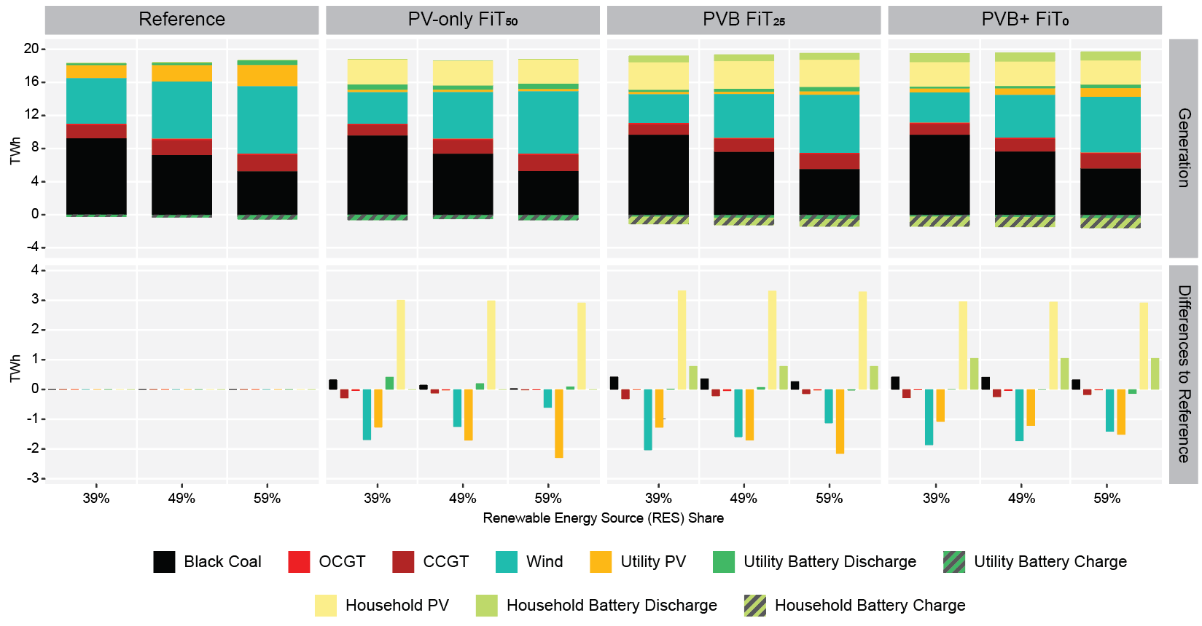
Generation impacts.
Slight coal enhancing effect

Slide 19
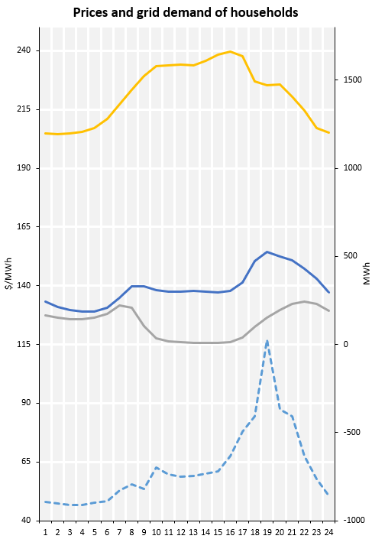
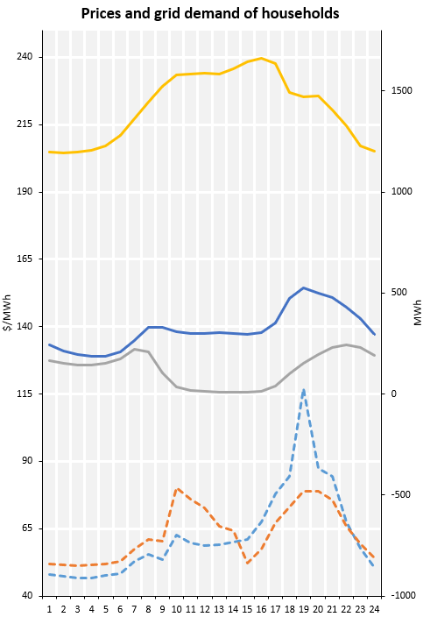
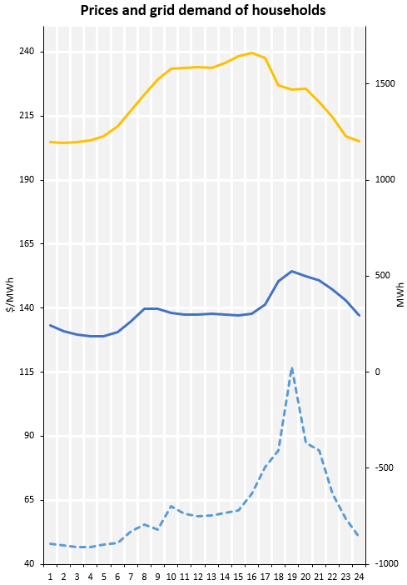
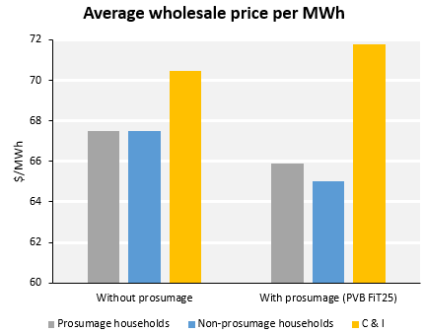
Wholesale price impacts.
e.g. PVB FiT₂₅ and 49% RES share
Late-afternoon peak prices fall
Mid-morning prices rise
Wholesale prices for non-prosumage also fall slightly
Cost of supply to C&I rises slightly
Commercial & industrial demand
Commercial & industrial demand
Commercial & industrial demand
500,000 non-prosumage households
500,000 non-prosumage households
Household demand
500,000 prosumage households
500,000 prosumage households
Average wholesale price
?
?
Average wholesale price
Average wholesale price
?

Slide 20
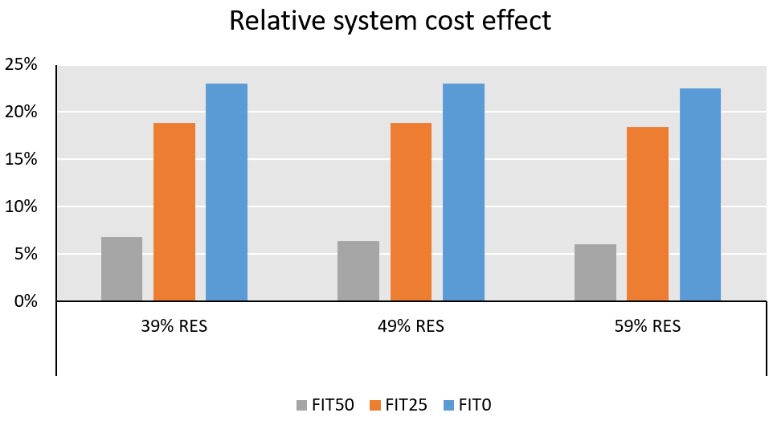
Overall system cost effects.
Higher PV battery investment costs for customers leads to sub-optimal allocation of capital across the power sector

Slide 21
Key findings.
Utility PV generally substituted by household PV capacity
but less so as additional household batteries are installed
Wind power is less affected
especially in scenarios with higher shares of renewables
Utility battery capacities are hardly substituted
with household batteries operating to maximise self-consumption
Slight decrease in wholesale prices faced by non-prosumage households
less so with prosumage households, while other consumers are slightly increased
Potential system benefits from more system-oriented household battery operation

Slide 22


Date/Location | Presenter | Topic
Mon 24 Feb 11am Climate College | Craig Memery (Public Interest Advocacy Centre) | Industrial demand response (Victorian Clean Technology Fund Series)
Wed 26 Feb 11am Climate College | Prof Jörg Niewöhner (Humboldt University) | Human/Environment research for/in the anthropocene: A land-use perspective
Wed 4 Mar 11am Climate College | Felix Schenuit (University of Hamburg) | Governance of carbon dioxide removal in the European Union
Wed 11 Mar 11am Climate College | Violette Mouchaileh (AEMO) Tim Nelson (AEMC) | Regulatory support for industrial demand response (VCTF Series)
climatecollege.unimelb.edu.au/seminars
@climatecollege

Slide 23
Effects on residual load duration curves (RLDCs)
RLDC:
Hourly total load minus variable renewable generation
Sorted in descending order
Note: the sorting changes between curves
Here: example for 49% RES share and FiT₂₅

Slide 24
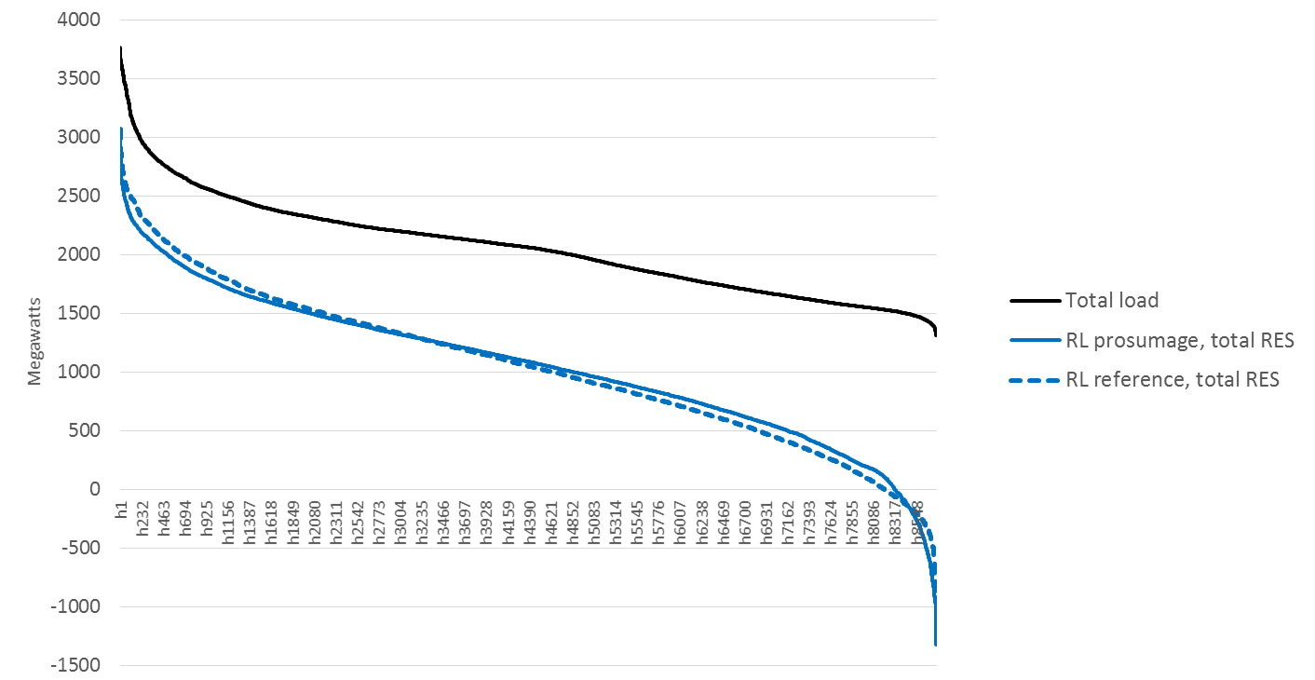
Overall: prosumage leads to slightly flatter RLDC
There are two effects:
More PV
Household batteries
Overall flatter RLDCs
Also slightly higher surplus generation

Slide 25
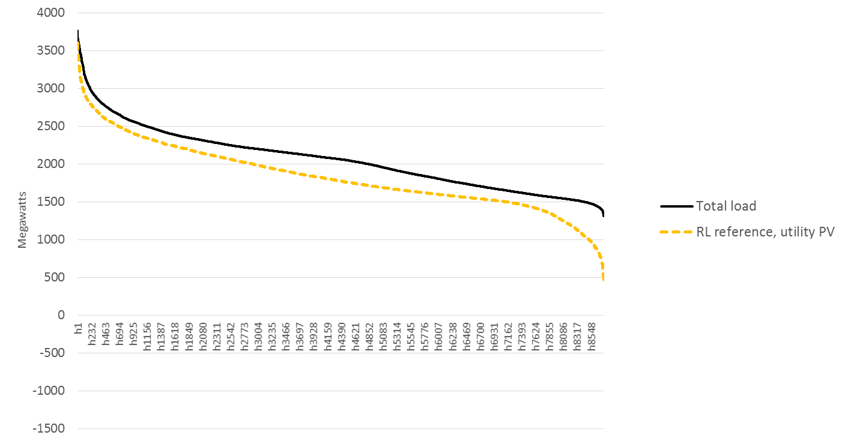
i) More PV
Effect of utility-scale PV

Slide 26
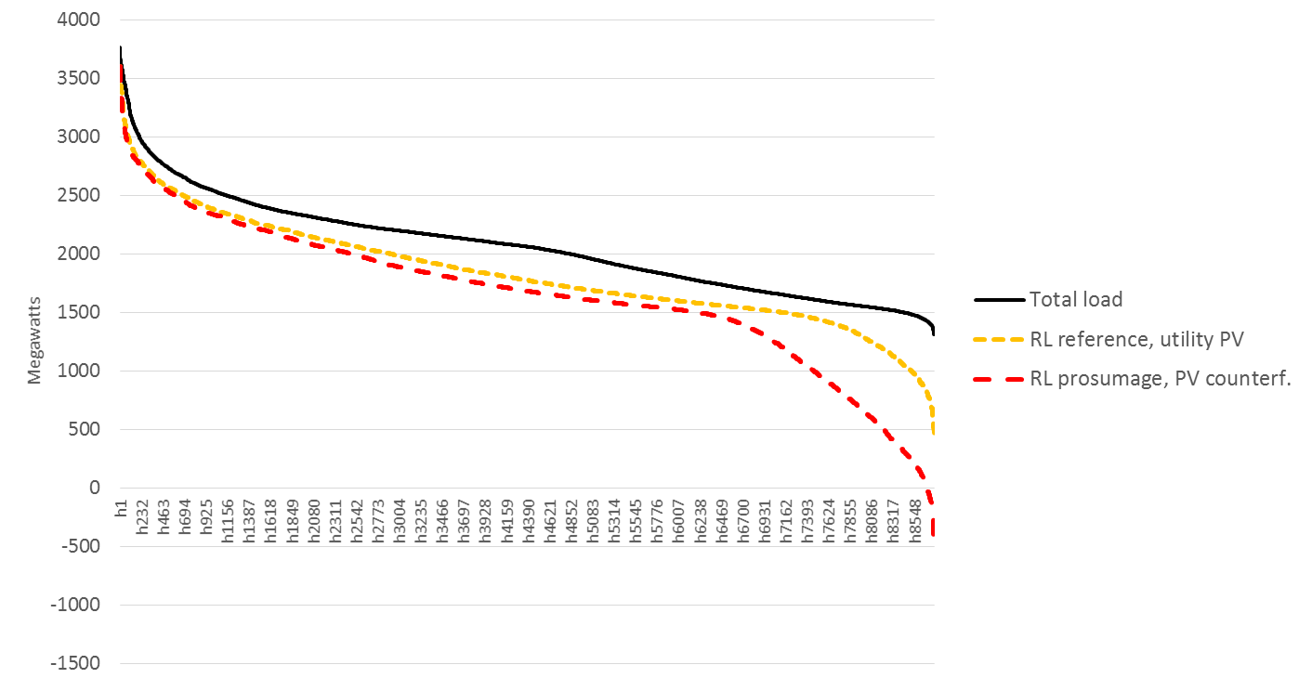
i) More PV
PV capacity increases to
prosumage capacity level,
but dispatched as utility PV
“Belly of the duck”

Slide 27
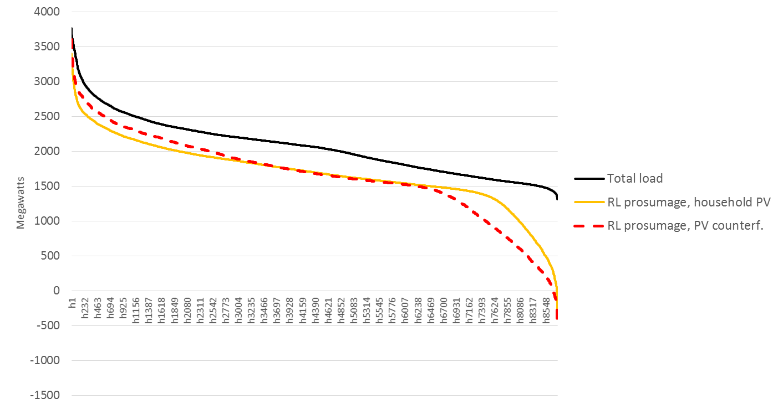
ii) Household batteries
Smooting effect of PV batteries
on left and right-hand side

Slide 28
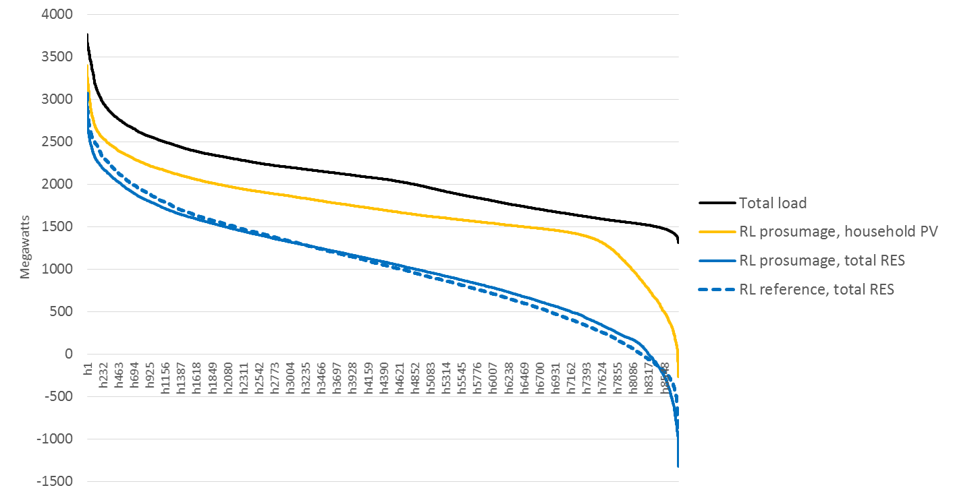
ii) Household batteries
This effect is still visible if wind power is also considered

Slide 29
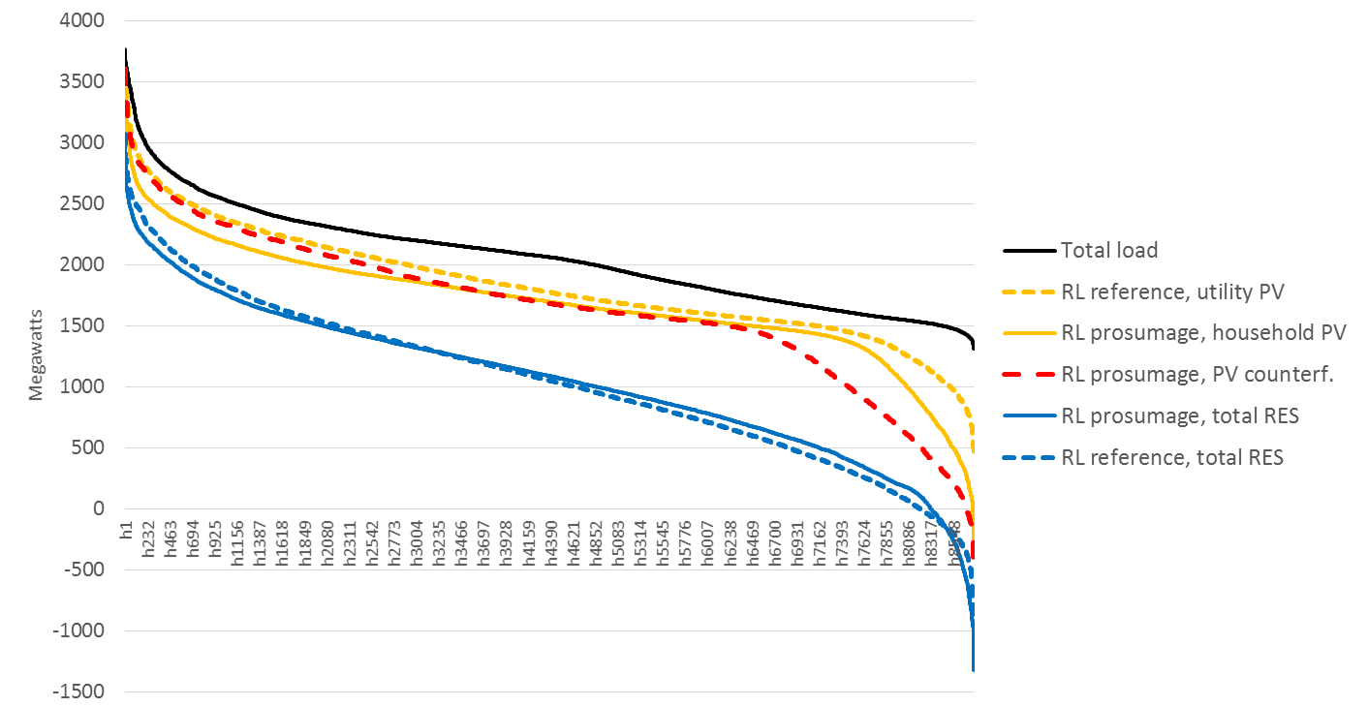
Overall: prosumage leads to slightly flatter RLDC

