Slide 1
The Europeanization of the Renewable Energy Directive in France and the United Kingdom
Nick Parry
School of Geography, Faculty of Science
School of Social and Political Sciences, Faculty of Arts

Slide 3
Unpacking the title
The Europeanization of the Renewable Energy Directive in France and the United Kingdom

Slide 4
Unpacking the title: Europeanization
Europeanization
European Union
Member States
Notes:
Europeanization differs from implementation

Slide 5
Unpacking the title: Europeanization
Processes of a) construction, b) diffusion, and c) institutionalization of formal and informal rules, procedures, policy paradigms, styles, ‘ways of doing things’ and shared beliefs and norms which are first defined and consolidated in the EU policy process and then incorporated in the logic of domestic (national and subnational) discourse, political structures and public policies.
Processes of a) construction, b) diffusion, and c) institutionalization of formal and informal rules, procedures, policy paradigms, styles, ‘ways of doing things’ and shared beliefs and norms which are first defined and consolidated in the EU policy process and then incorporated in the logic of domestic (national and subnational) discourse, political structures and public policies.
(Radaelli 2003, p. 30)

Slide 6
Unpacking the title: Europeanization
Europeanization
European Union
a) construction
b) diffusion
c) institutionalisation
Member States
Notes:
Europeanization differs from implementation

Slide 7
Unpacking the title: Renewable Energy Directive
Renewable Energy Directive
20% Renewable Energy by 2020
20% Renewable Energy by 2020
Binding national targets
Binding national targets
SE | LV | FI | AT | PT | DK | SI | EE | RO | LT | FR | ES | HR | EL | DE | IT | IE | BG | UK | PL | SK | NL | HU | CZ | CY | BE | LU | MT
49% | 40% | 38% | 34% | 31% | 30% | 25% | 25% | 24% | 23% | 23% | 20% | 20% | 18% | 18% | 17% | 16% | 16% | 15% | 15% | 14% | 14% | 13% | 13% | 13% | 13% | 11% | 10%
SE | LV | FI | AT | PT | DK | SI | EE | RO | LT | FR | ES | HR | EL | DE | IT | IE | BG | UK | PL | SK | NL | HU | CZ | CY | BE | LU | MT
49% | 40% | 38% | 34% | 31% | 30% | 25% | 25% | 24% | 23% | 23% | 20% | 20% | 18% | 18% | 17% | 16% | 16% | 15% | 15% | 14% | 14% | 13% | 13% | 13% | 13% | 11% | 10%
National Renewable Energy Action Plan (NREAP)
Electricity
Transport
Heating & Cooling

Slide 8
Unpacking the title: Renewable Energy Directive
EU Climate Policy
Emissions Trading System (ETS)
2020 Package
20% emissions reduction
20% renewables
20%energy efficiency
2030 Package
40% emissions reduction
32% renewables
32.5% energy efficiency
2050 Net-zero emissions?

Slide 9
Unpacking the title: Renewable Energy Directive
Notes:
The new President of the Commission, Ursula von de Leyen, pledged to increase the EU’s emission reduction target to 55% by 2030 in an effort to win support of MEPs in the lead up to her confirmation vote.

Slide 10
Uneven implementation
Notes:
According to the Commission’s 2019 progress report (using figures from 2017) 11 Member states have surpassed their targets, 10 have met interim targets and will likely meet their 2020 targets and 7 have missed their interim targets and are deemed to be at risk of missing 2020 targets.

Slide 11
Research question and hypothesis
What are the drivers of, and impediments to, the effective implementation of the RED in France and the UK?

Slide 12
France and the UK
UK: 31%
Notes:
Existing hydro accounted for about 80% of France’s renewables in 2010. If that is subtracted, the two curves look very similar

Slide 13
France and the UK
Notes:
No of employees gives a better indication of the size of SOEs than market value due to negative equity value for AREVA (-2.5 billion euro), which became part of EDF at end of 2015

Slide 14
France and the UK
Notes:
Herfindahl-Hirschman Index

Slide 15
France and the UK
Power Generation Mix
Notes:
Power generation is dominated by a single technology (nuclear) with support from hydro and gas. Note that the nuclear share is normally closer to 75% but there were a higher number of plants closed for maintenance/safety inspections in 2017.
UK’s generation mix is far more diverse with Gas, renewables and nuclear all providing significant shares.

Slide 16
France and the UK
State-controlled
Highly concentrated
Nuclear dependent
Privatised
Liberalised
Diversified

Slide 17
Research question and hypothesis
What are the drivers of, and impediments to, the effective implementation of the RED in France and the UK?
What are the drivers of, and impediments to, the effective implementation of the RED in France and the UK?
The historical development of state institutions has created path dependencies in policy making that determine the ability of a member state to meet the requirements of the Directive

Slide 18
Institutions and institutionalism
A theory of institutions must be able to explain how institutions they form, how they change or persist, and how they shape behaviour

Slide 19
Institutions and institutionalism
North (1990, p. 4): “any form of constraint that human beings devise to shape human interaction”.
Steinmo and Thelen (1992, p. 2): the “rules of electoral competition, the structure of the party systems, the relation among various branches of government, and the structure and organization of economic actors like trade unions”
Hall and Taylor (1996, p. 938): “Formal and informal procedures, routines, norms and conventions embedded in the organizational structure of the polity or political economy”
Notes:
North distibguishes between institutions (the rules of the game) and organisations (the players)

Slide 20
Institutions and institutionalism
Ideology of the state
Policy styles, political parties and the distribution of power
Administrative traditions and the civil service
State ownership, investment and control
Party positions, policies
Government departments, research agencies
Regulatory bodies, firms (relationship to the state)
Notes:
North distibguishes between institutions (the rules of the game) and organisations (the players)

Slide 21
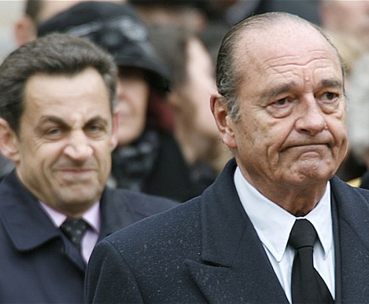
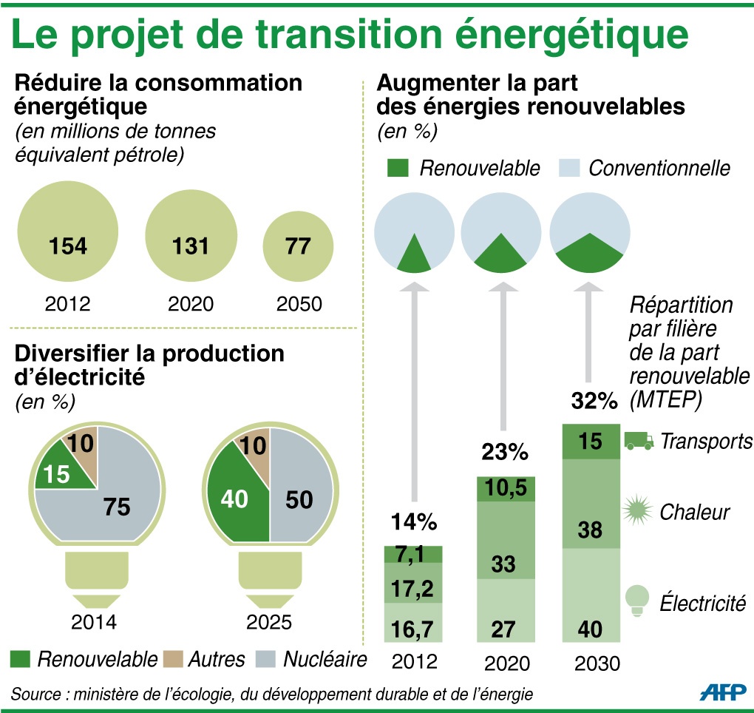
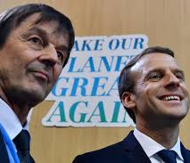
Three phases of renewable energy policy
1990-2008
2008-2017
2017-Present
Resistance
Ambition and claims to leadership
Ambition delayed
Notes:
following the oil shock in the 1970s and the subsequent stagnation in economic performance. At first, member states turned inwards to protect their own industries, ushering in a period of ‘Eurosclerosis’ (Javanovic, 2013, pp. 515-16). Without significant reform the EU would have faded into irrelevance; however, the adverse economic conditions eventually changed the calculation for member states. The slowing economy, increasing unemployment and concerns about European competitiveness relative to the United States and Japan provided impetus for the adoption of the SEA in 1986 (Egan, 2010, pp. 264-266). The SEA ushered in a new phase of European integration that replaced “a functionalist and constitutionalist approach of markedly French origins with an approach of more federalist and evolutionary inspiration, strongly influenced by the German experience and presence” (Patrizio, 1998, p.7).

Slide 22
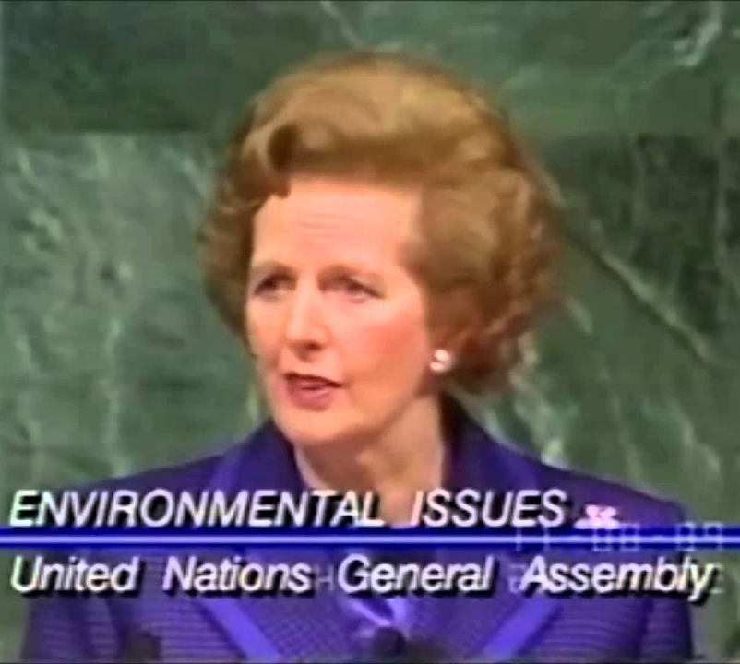
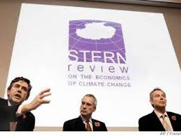
Three phases of renewable energy policy
1990-2005
2005-2010
2010-Present
Soft market mechanisms
A window for change
“Ideological limbo”
Notes:
following the oil shock in the 1970s and the subsequent stagnation in economic performance. At first, member states turned inwards to protect their own industries, ushering in a period of ‘Eurosclerosis’ (Javanovic, 2013, pp. 515-16). Without significant reform the EU would have faded into irrelevance; however, the adverse economic conditions eventually changed the calculation for member states. The slowing economy, increasing unemployment and concerns about European competitiveness relative to the United States and Japan provided impetus for the adoption of the SEA in 1986 (Egan, 2010, pp. 264-266). The SEA ushered in a new phase of European integration that replaced “a functionalist and constitutionalist approach of markedly French origins with an approach of more federalist and evolutionary inspiration, strongly influenced by the German experience and presence” (Patrizio, 1998, p.7).

Slide 23
Progress toward RED targets

Slide 24
France Generation mix

Slide 25
UK Generation mix

Slide 26
Conclusions: France
Drivers:
Claims to leadership
Engineering and research capacity
Impediments
Nuclear (meso-corporatist system that favours incumbents)
Dual policy style
Conflict between emissions and renewable energy commitments
France has failed to meet the requirements of the RED in the electricity sector
However, if France’s dual policy style is aligned, a rapid transition may be possible
Notes:
North distibguishes between institutions (the rules of the game) and organisations (the players)

Slide 27
Conclusions: The UK
Drivers:
Party competition
Dispersed control of the sector
Other policies (LCPD, Carbon Price Floor)
Market conditions
Impediments
The commitment to economic liberalism and market-based mechanisms
Decline in political salience
The UK has been better able to meet its electricity sector targets
However, the UK has picked the low-hanging fruit: “The 2020s are therefore a crucial decade for the future of the power sector” (CCC, 2015, p. 6)
Notes:
North distibguishes between institutions (the rules of the game) and organisations (the players)

Slide 28
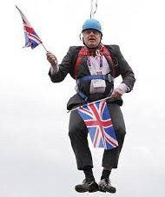
Further research
Other sectors:
Do the conclusions hold in other sectors (transport, heating & cooling)
Future targets
Will the conclusions hold for 2030 targets and beyond
The role of nuclear
The future role of nuclear
Notes:
North distibguishes between institutions (the rules of the game) and organisations (the players)

Slide 29
© Copyright The University of Melbourne 2011

Slide 30
EU emissions
Source: World Resources Institute 2016
Notes:
Why focus on the EU? The EU is the third largest source of greenhouse gas emissions, behind China and the United States; therefore its efforts could be significant in the global effort to reduce emissions (CAIT Climate Data Explorer 2015).

Slide 31
Emissions reductions under the ETS
Source: EEA
Notes:
According the the Commission emissions from the sector will be 21% lower than 2005. The question is, to what extent has the ETS contributed to this decline?

Slide 32
EU energy mix for electricity generation
Source: European Commission
Notes:
Nuclear: 130 plants in the EU, 58 of which are in France. Sweden and the UK account for another 30 (15 each)

