Slide 1
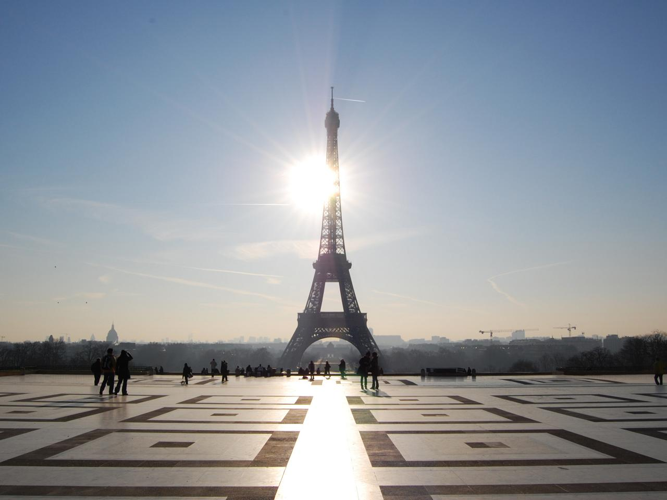



The Paris outcomes on emissions
A/Prof. Malte Meinshausen
26 Feb 2016
© Image by Alex Lecea

Slide 2
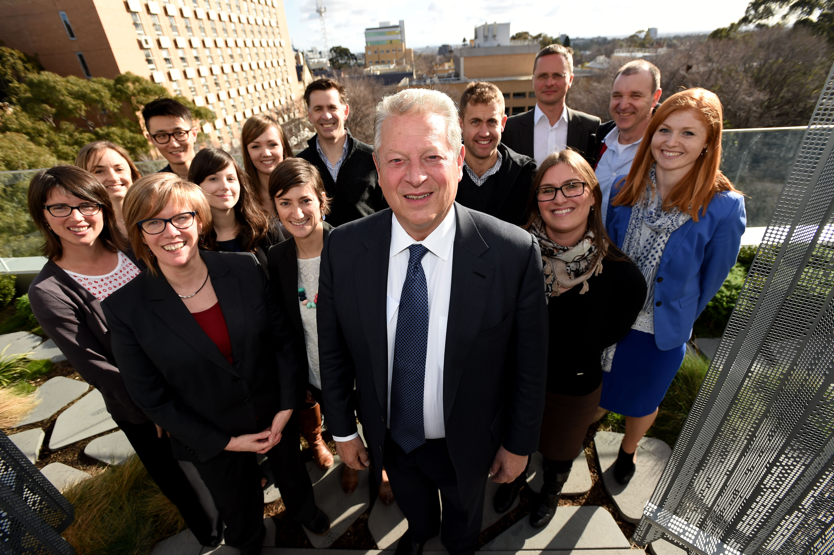

Slide 3
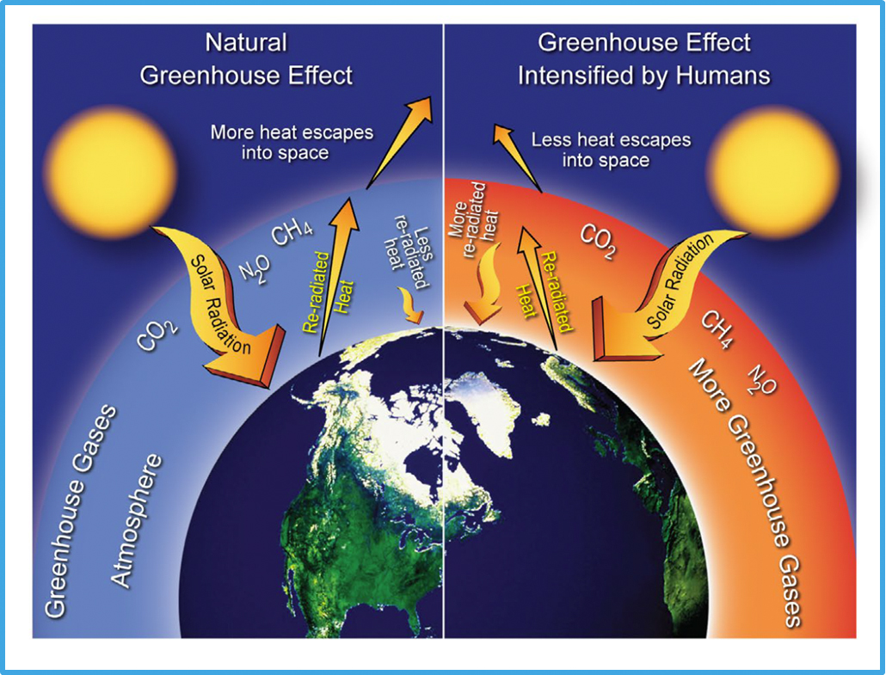

Slide 4
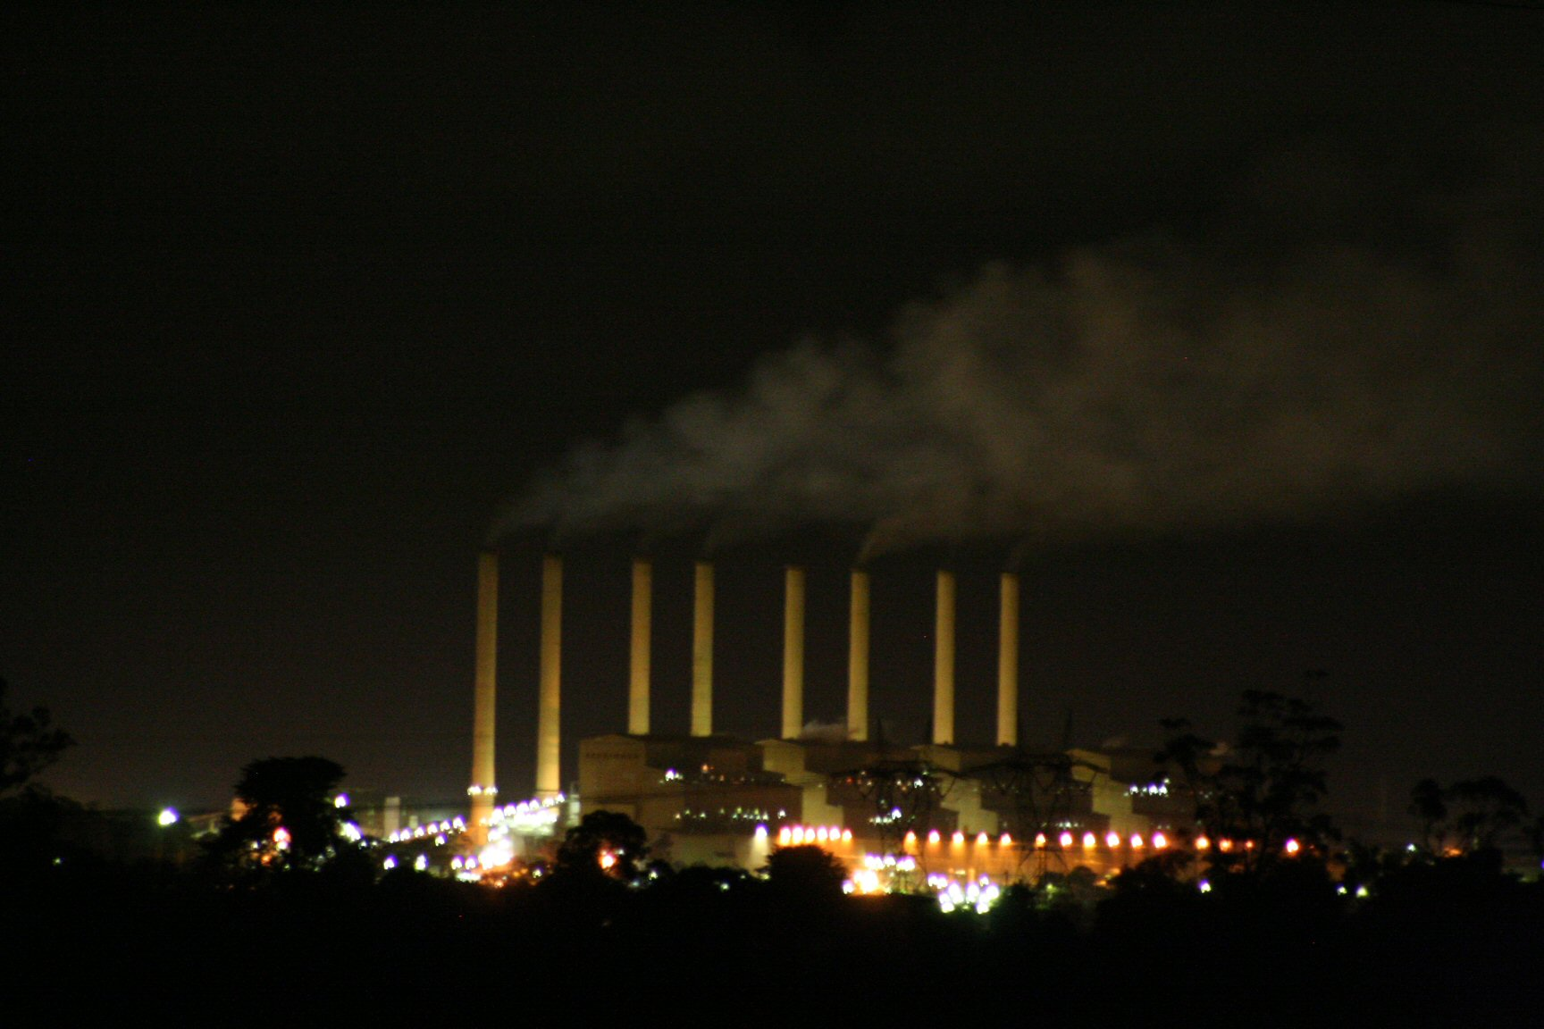
© Simpson fan 66, Hazelwood Power station by night

Slide 5
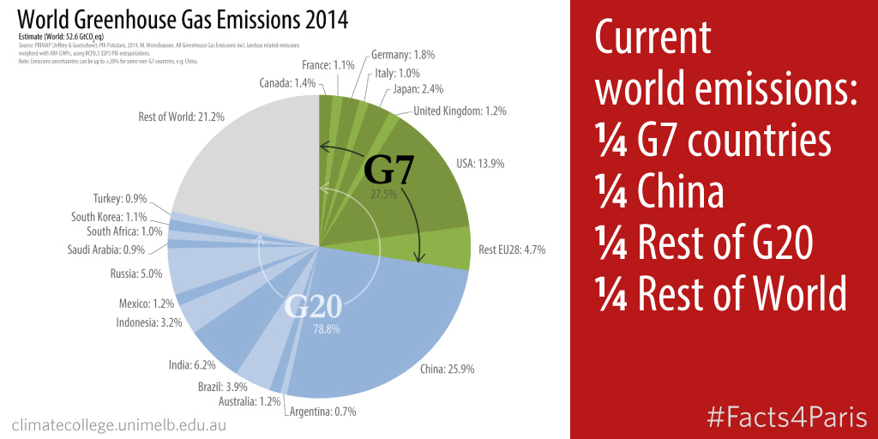

Slide 6
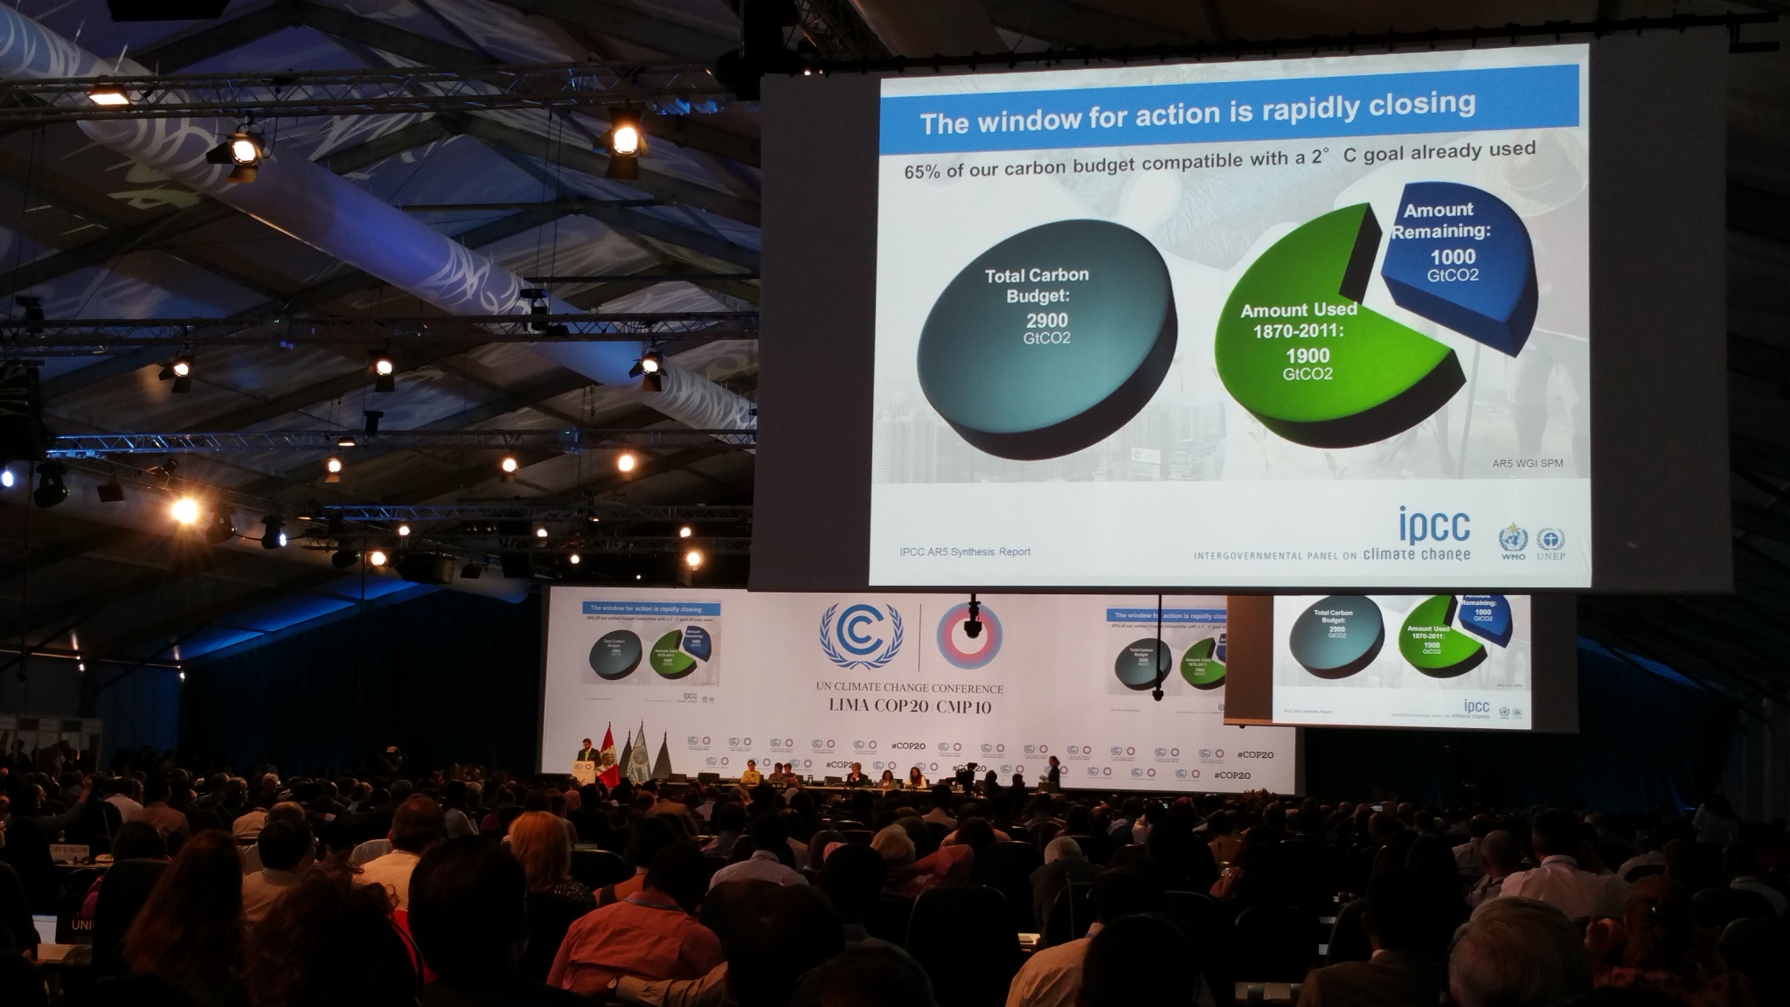

Slide 7
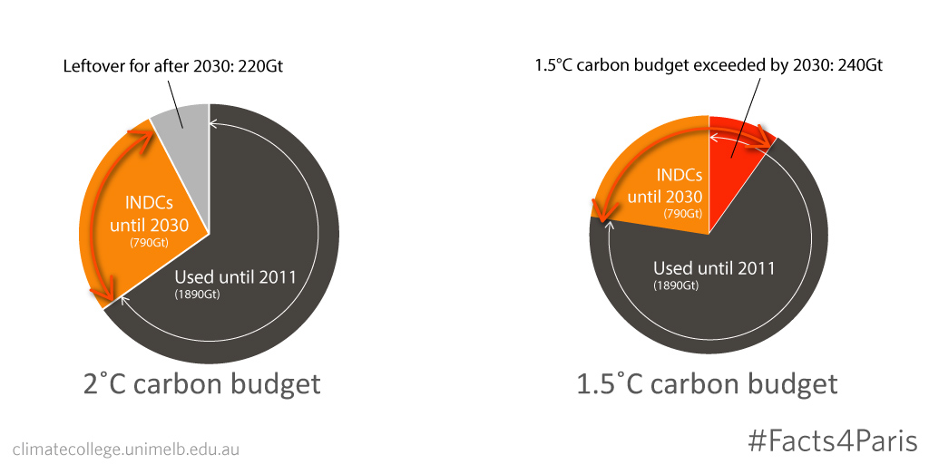

Slide 8
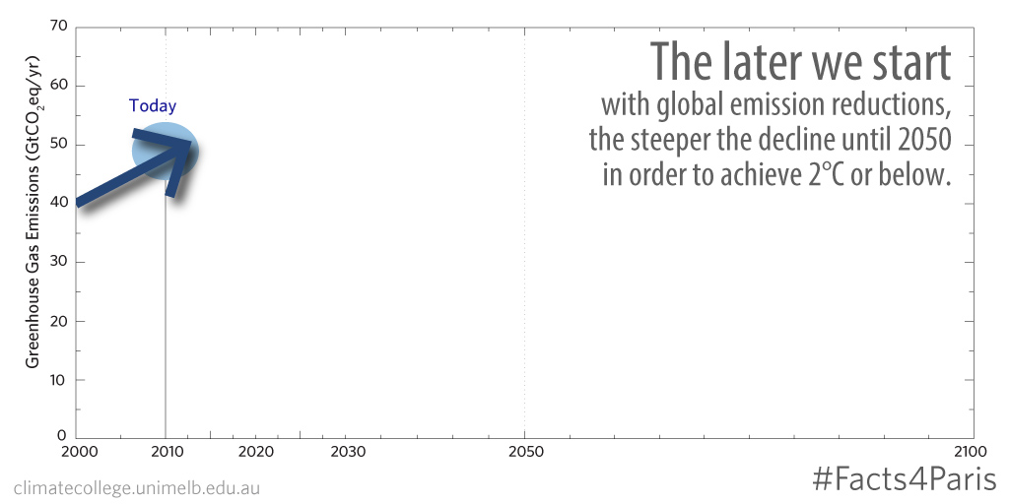
The effect of delay.

Slide 9
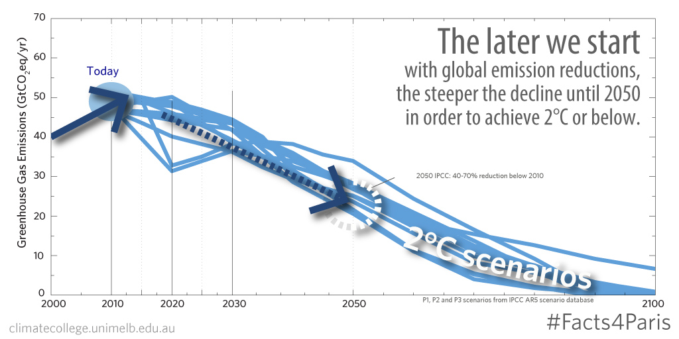

Slide 10
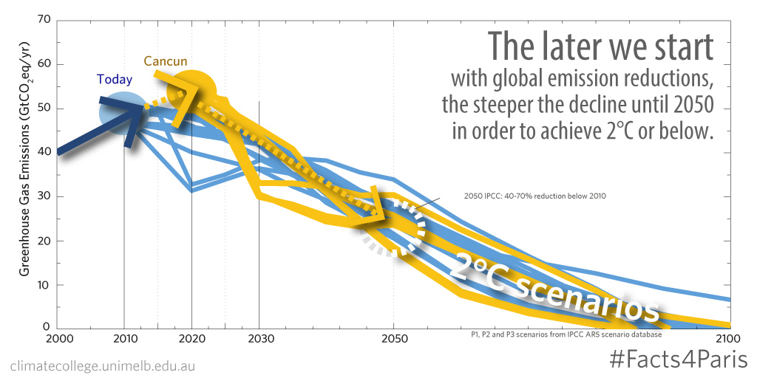

Slide 11
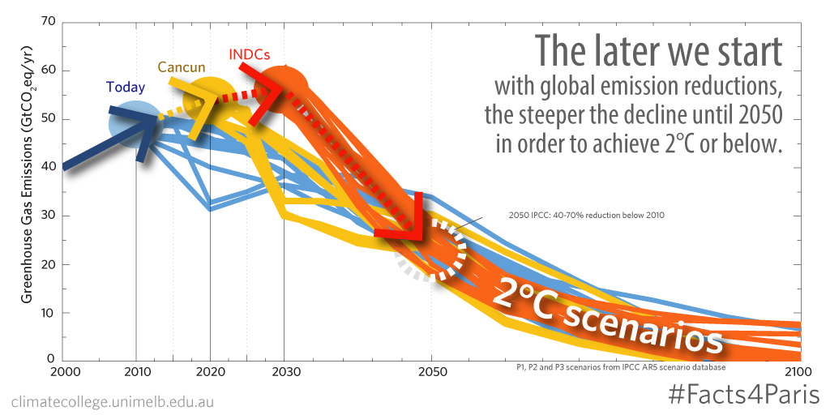

Slide 12
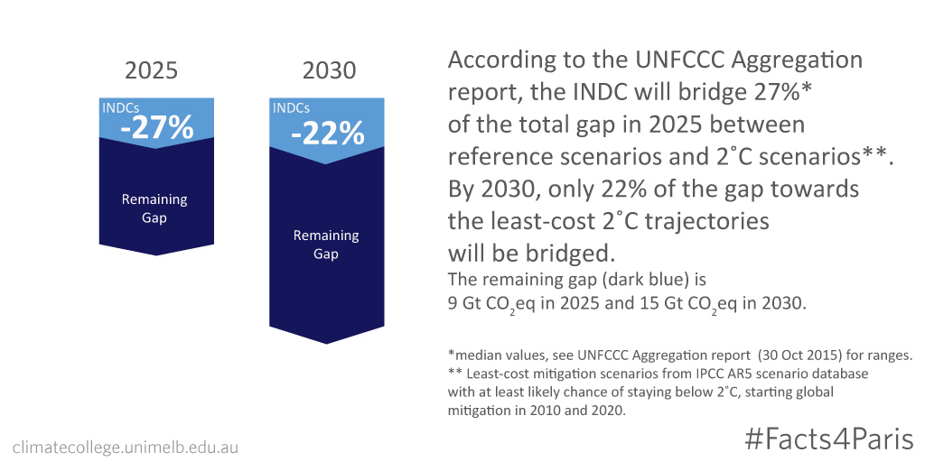

Slide 13
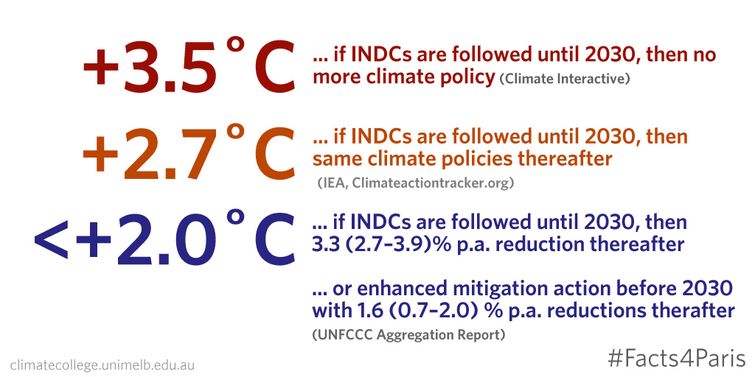

Slide 14
The temperature goal in the Paris Agreement

Slide 15

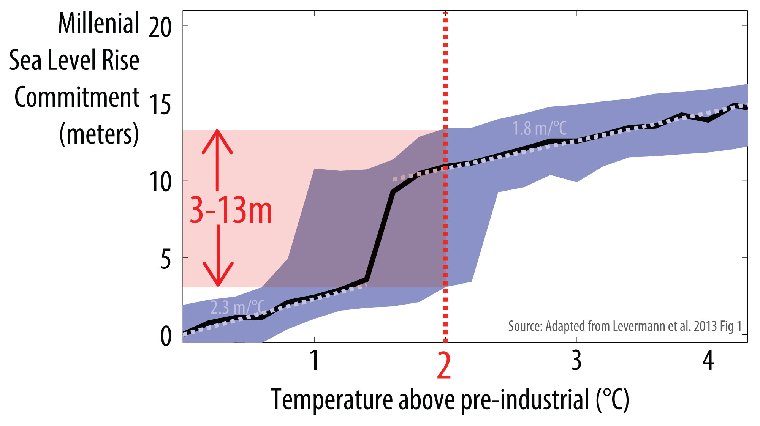
Foto © Ricymar Photography, Melbourne

Slide 18
The long-term global emission goal

Slide 19


Slide 20
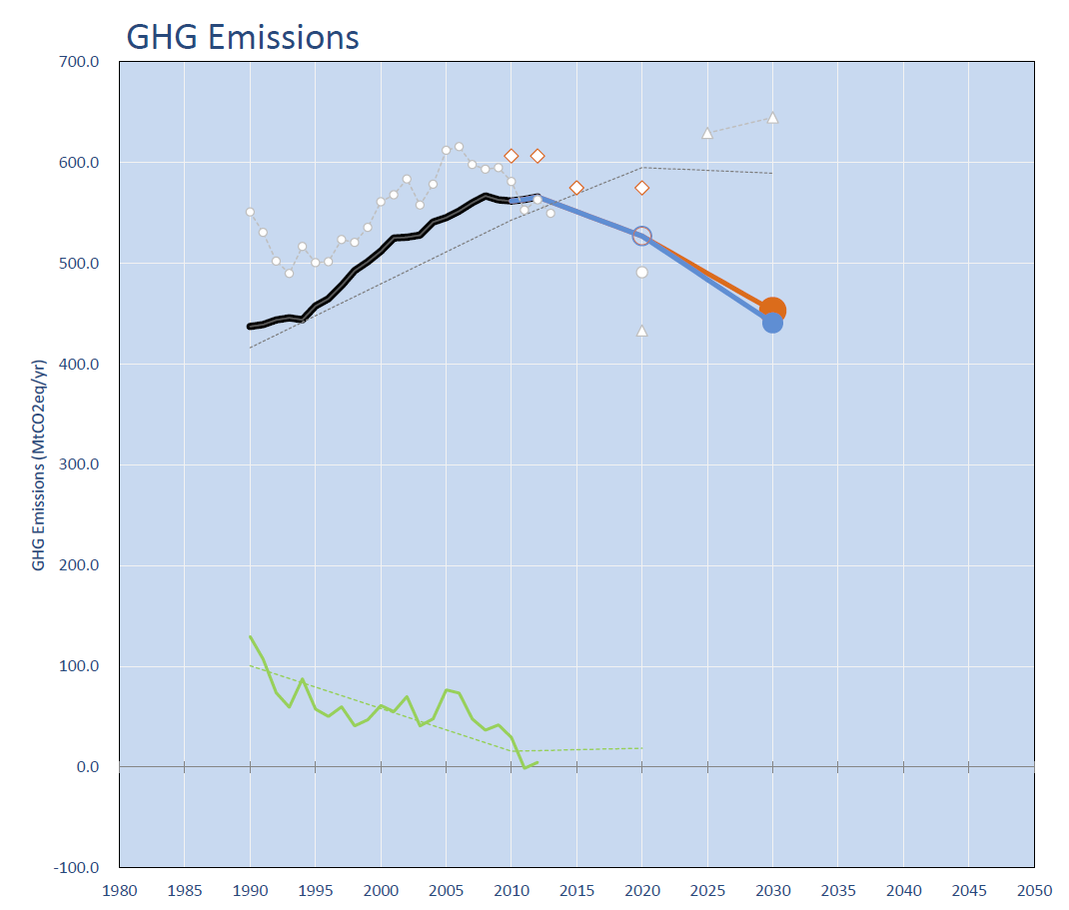
Australia
Fossil & Industry
Emissions

Slide 21
Australia
Deforestation

Slide 22
Australia
Kyoto Targets
2008-2012

Slide 23
Australia
Kyoto II Targets
2013-2020

Slide 24
Australia
2020 Pledge
-5% below 2000

Slide 25
Australia
2030 INDC
-26 to -28% below 2005

Slide 26
Australia
Effective 2020 Target after first week Paris negotiations:
+11% above 2000

Slide 27
climatecollege.unimelb.edu.au
malte.meinshausen@unimelb.edu.au
03 8344 4124

