Slide 1



Leadership Forum on energy transition
A/Prof. Malte Meinshausen
18 April 2016
© Image by Alex Lecea

Slide 2
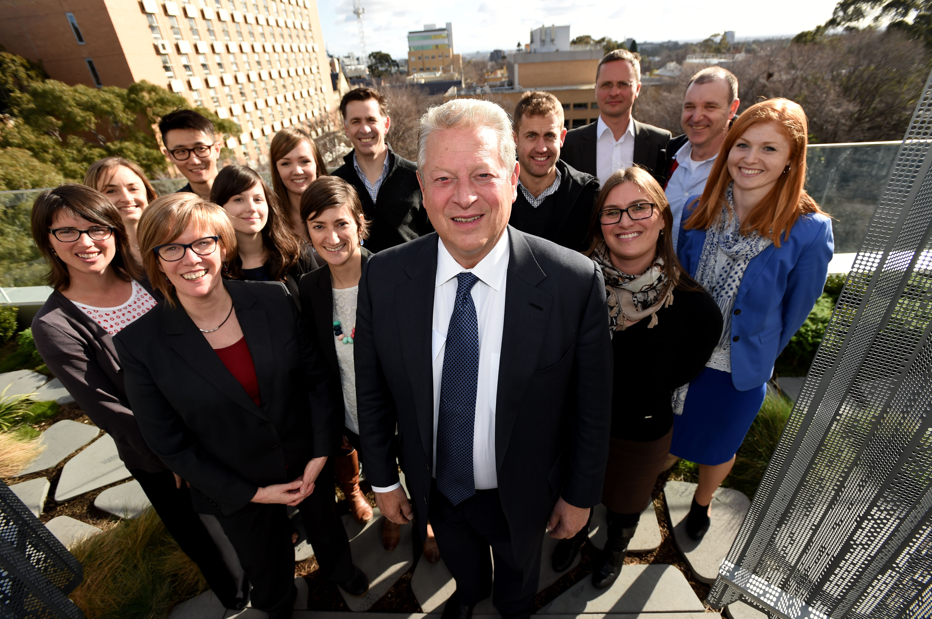

Slide 3
Governments support for climate targets

Slide 4
Governments support for climate targets

Slide 6
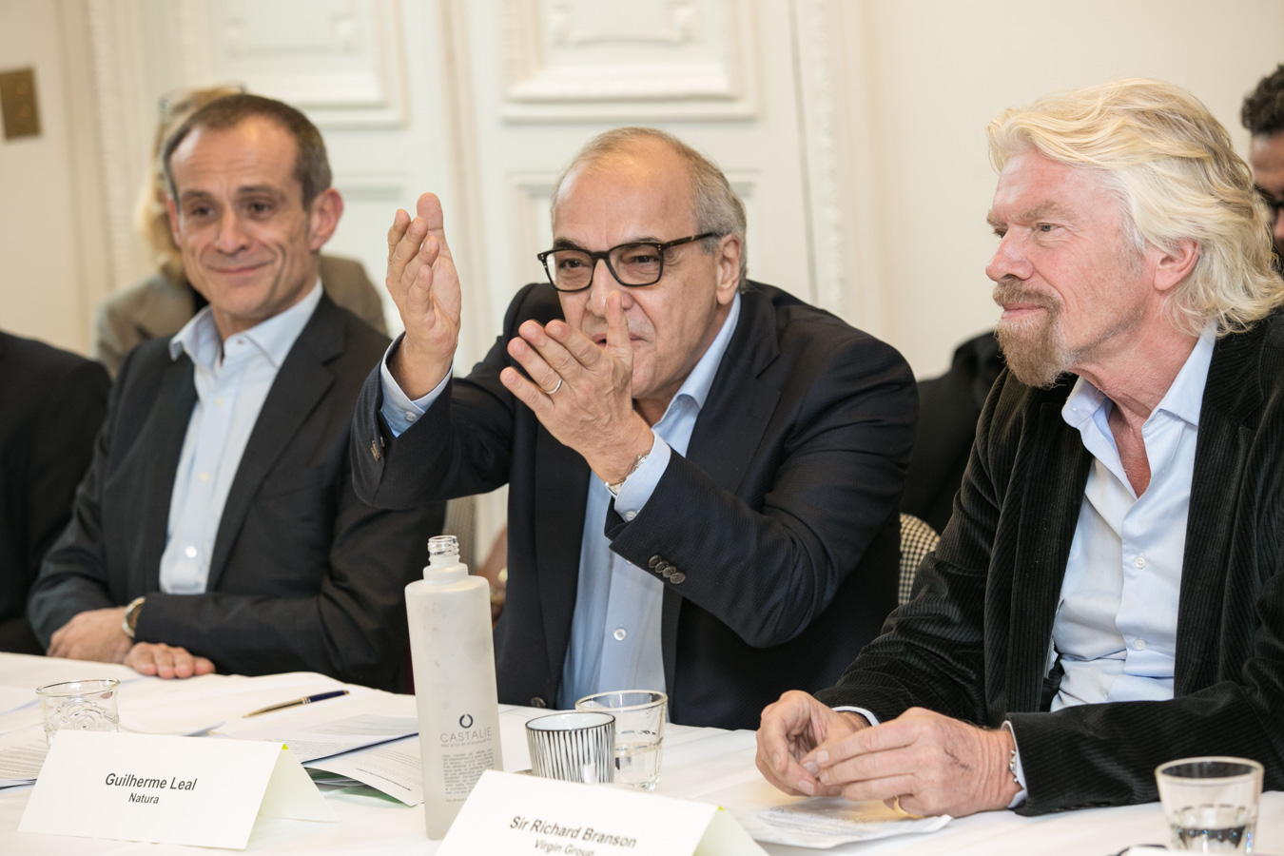
Business Leaders in Paris

Slide 7
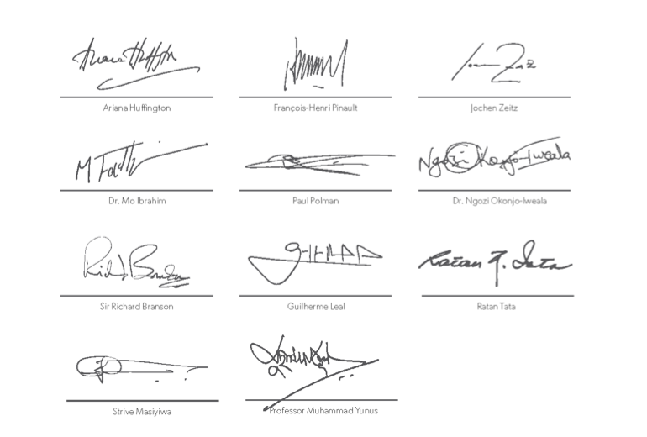
Business Leaders calling for climate action
For governments to commit to a global goal of net-zero greenhouse-gas emissions by 2050, and to embed this in the agreement to be signed at COP21 in Paris.
For businesses to match this ambition by committing to long-term targets and driving low-carbon solutions to scale – thereby enabling the world to achieve the net-zero 2050 target.
For both businesses and governments to adopt meaningful and effective carbon pricing.
For governments to end all fossil fuel subsidies, and to shift this capital to help scale affordable renewable energy solutions to enable a wider economic transformation.
For both businesses and governments to ensure the benefits of responses to climate change flow to vulnerable and impoverished communities that suffer disproportionately from climate change and are least equipped to cope with its impacts.
B-Team in Paris, COP21
http://bteam.org/the-b-team/b-team-open-letter-calls-for-bold-climate-action-at-cop21-in-paris/

Slide 8
The temperature goal in the Paris Agreement

Slide 9
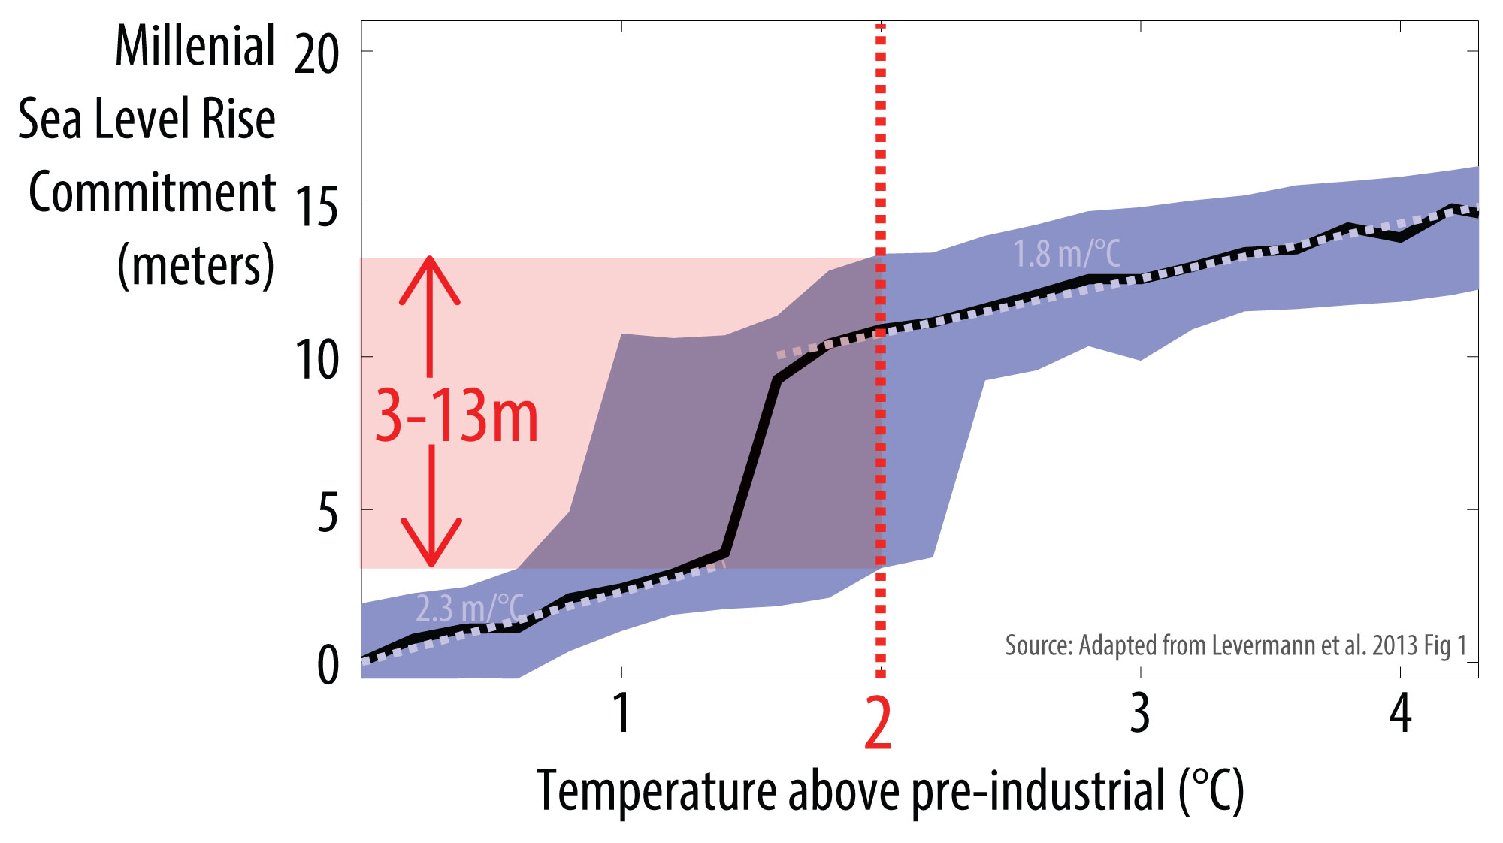
Is 2ºC safe? Or 1.5ºC?

Slide 10
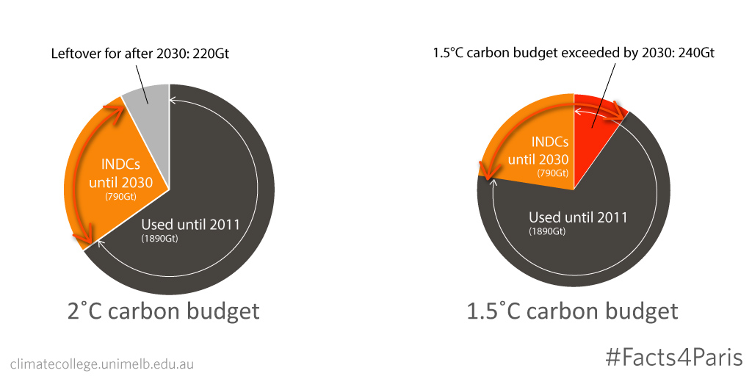
Is current ambition on track for 2ºC or 1.5ºC?

Slide 11
The long-term global emission goal

Slide 15


Slide 16
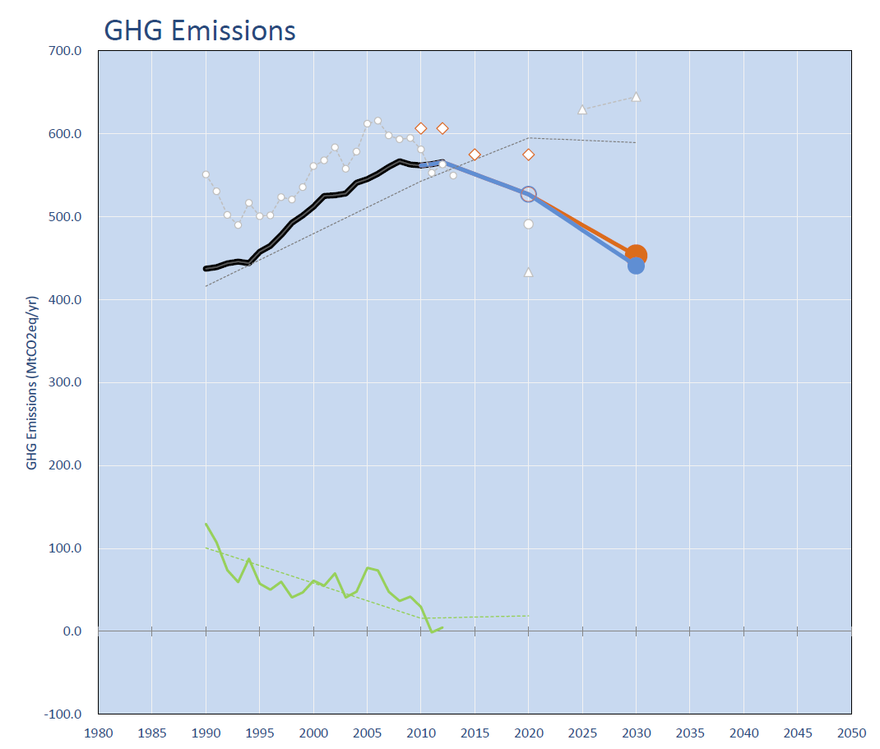
Australia
Fossil & Industry
Emissions
M. Meinshausen, 2016, INDC Factsheets, http://www.climate-energy-college.net/indc-factsheets

Slide 17
Australia
Deforestation
M. Meinshausen, 2016, INDC Factsheets, http://www.climate-energy-college.net/indc-factsheets

Slide 18
Australia
Kyoto Targets
2008-2012
M. Meinshausen, 2016, INDC Factsheets, http://www.climate-energy-college.net/indc-factsheets

Slide 19
Australia
Kyoto II Targets
2013-2020
M. Meinshausen, 2016, INDC Factsheets, http://www.climate-energy-college.net/indc-factsheets

Slide 20
Australia
Effective 2020 Target after first week Paris negotiations:
+11% above 2000
M. Meinshausen, 2016, INDC Factsheets, http://www.climate-energy-college.net/indc-factsheets

Slide 21
Australia
2020 Pledge
-5% below 2000
M. Meinshausen, 2016, INDC Factsheets, http://www.climate-energy-college.net/indc-factsheets

Slide 22
Australia
2030 INDC
-26 to -28% below 2005
M. Meinshausen, 2016, INDC Factsheets, http://www.climate-energy-college.net/indc-factsheets

Slide 23
Australia
If Australia were on
Linear trajectory towards net zero GHG emissions by 2050
M. Meinshausen, 2016, INDC Factsheets, http://www.climate-energy-college.net/indc-factsheets

Slide 24
More material
Our INDC Factsheets for individual countries at http://www.climate-energy-college.net/indc-factsheets
Facts4COP21 – Our collection of science material with relevance to climate negotiations: http://www.climate-energy-college.net/facts4cop21
www.mitigation-contributions.org – Our interactive resource to examine “fair” national 2025 and 2030 targets.
www.track0.org – Collection of material dedicated to zero emission target
UNFCCC Synthesis Report (update coming 4th of May 2016)
UNEP GAP reports

Slide 25
Thank you. climatecollege.unimelb.edu.au
malte.meinshausen@unimelb.edu.au
03 8344 4124

Slide 26
Backup slides

Slide 27
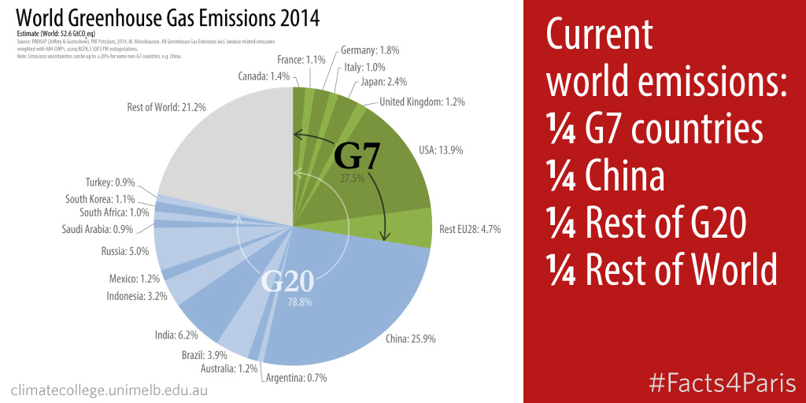

Slide 28
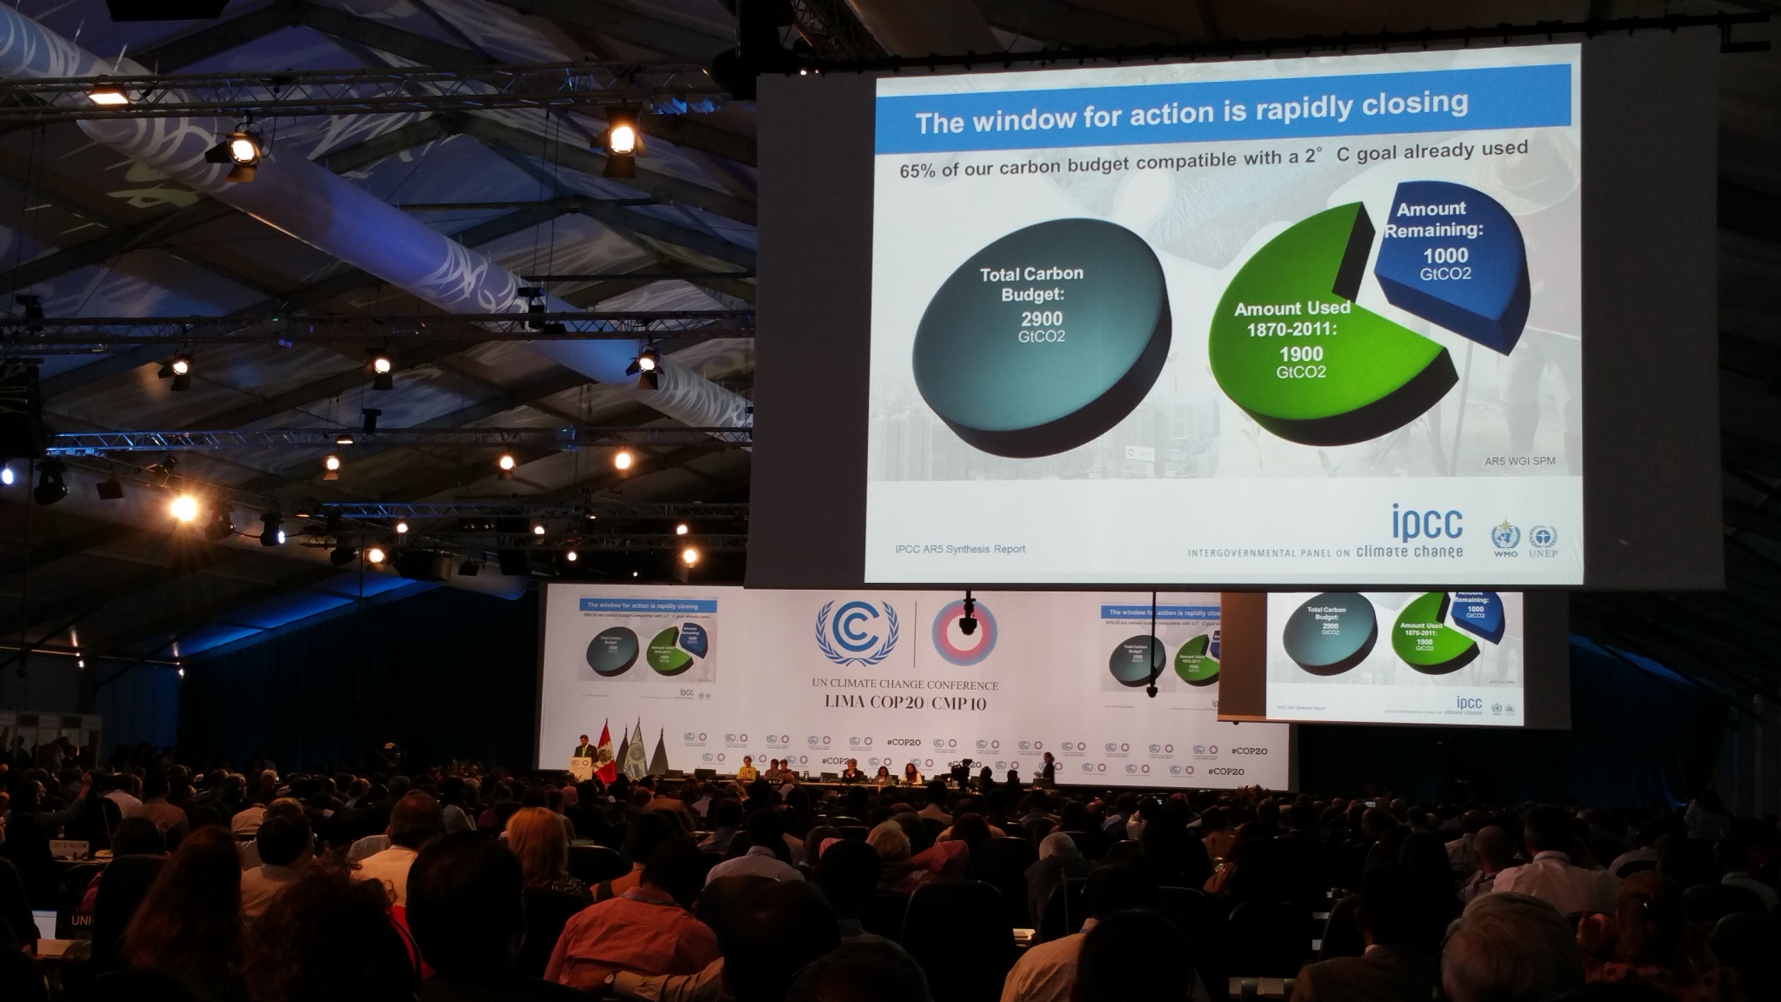

Slide 29
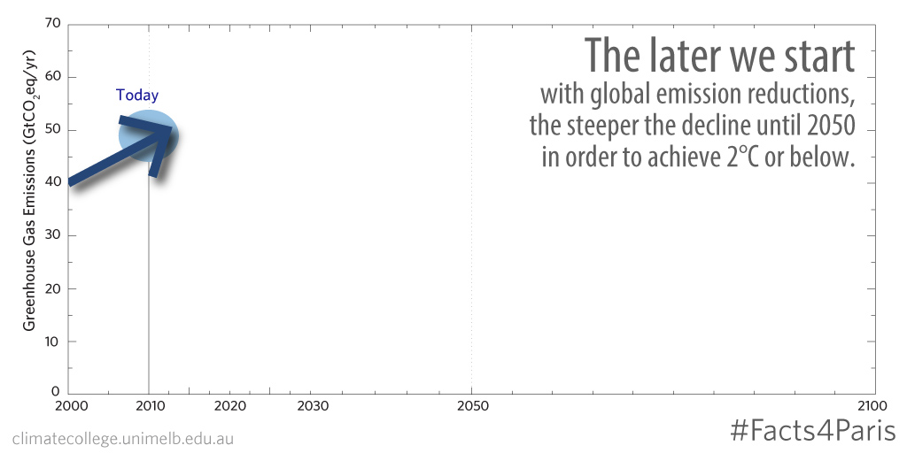
The effect of delay.

Slide 30
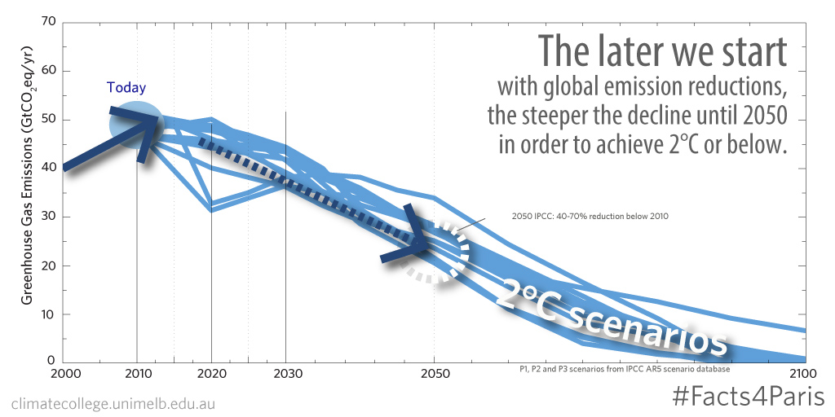

Slide 31
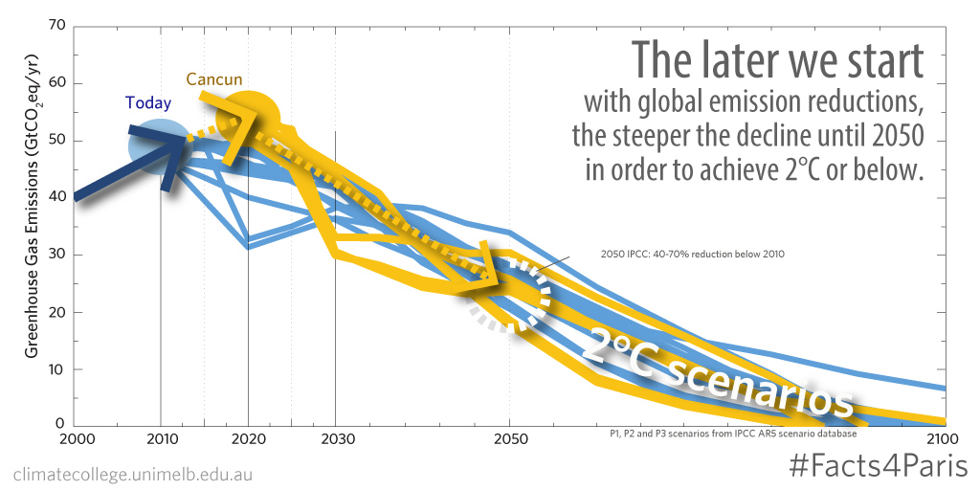

Slide 32
