Slide 1
DEMAND RESPONSE for C&I CUSTOMERS
UNLOCKING NEW OPPORTUNITIES
DR. ALAN RAI
11 MARCH 2020

Slide 2
Agenda
1. | AEMC 101: who we are/what we do
2. | Demand response: what is it?
3. | Wholesale demand response rule change
4. | Whither demand response? A 2-sided market?

Slide 3
Who we are: the roles of each of the market bodies
Energy Security Board (ESB)
Established by the COAG Energy Council to coordinate implementation of the Finkel Review’s recommendations
Five ESB members: AEMC; AER; AEMO; independent deputy Chair; independent Chair
Notes:
There are also three independent market bodies with specific roles and functions that make decisions about the day to day operation, regulation and design of the market:
The Operator (AEMO) is in charge of the day to day operation of the power system and the electricity spot market and parts of our gas markets.
The Regulator (AER) is in charge of setting regulated returns for monopoly network businesses and policing the industry to make sure everyone is playing nicely.
The rule maker (AEMC) (that’s us) makes and amend rules to adapt the energy market design as the world changes. We also provide advice to governments to help inform their decisions in relation to energy policy. Our rules have the force of law - as long as we consult and show how a change will benefit customers over the long term, we are able to make changes to the rules.
These market bodies are independent of government - this is both practical and is intended to provide confidence that the market will not be subject to political interference.
The Energy Security Board (ESB) has been established to oversee and co-ordinate the implementation of the Finkel recommendations.

Slide 4
What is demand response (DR)?
Consumers of electricity changing their level of consumption in the short-term in response to signals to do so
Table 1: Types of demand response
TYPE OF DR | DESCRIPTION
Wholesale (i.e. energy) in market | Participating in the wholesale spot and contract energy markets
Ancillary service in market | Providing ancillary services (e.g. contingency FCAS lower or raise services)
Out-of-market (‘emergency’) | Participate in AEMO’s RERT program, providing out-of-market reserves
Network | Helping a (T/D) network business to provide network services to its consumers
Source: AEMC, Wholesale demand response mechanism, Draft rule determination, 18 July 2019

Slide 5
DR: much more than peak demand ‘shaving’
Today, DR is largely seen as “nega-watts” (NW): saving network and energy costs at peak demand times
But: demand response is increasingly needed in a world of increasing VRE penetration
  Both MW and NW - increasing demand at times of high VRE output to resolve problems caused by falling levels of minimum demand
key role to play in ancillary service markets – potentially a cheaper, non-network, solution to “missing (system services) money”
  potential cheaper alternative to spilling wind and installing sync cons (i.e. low demand cases) as well as peakers (high demand cases)
  loads to be paid by wind generators to avoid being spilled?
storage is an example of “demand response” – can both increase demand (charging) and decrease demand (discharging)

Slide 6
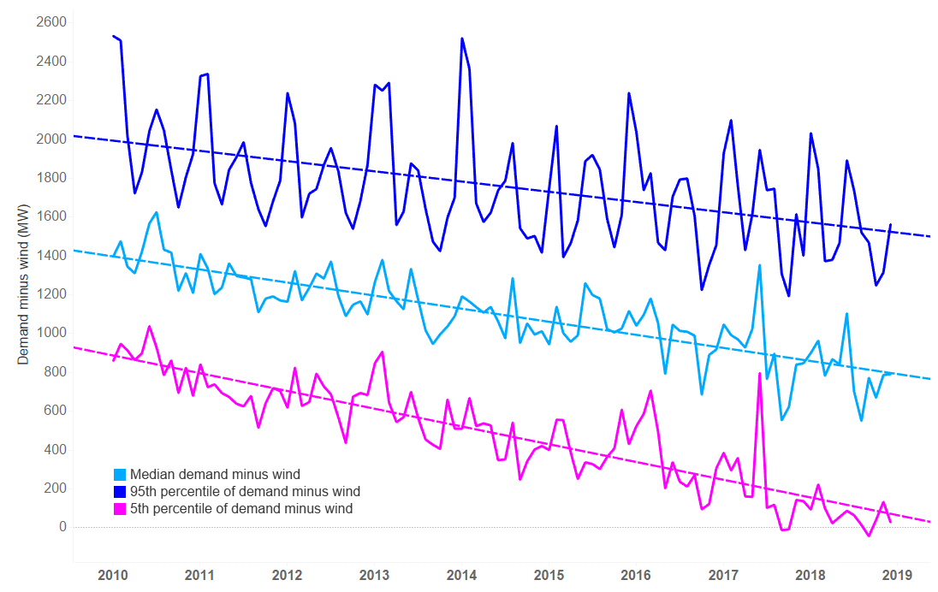
The changing shape of demand and the need for wholesale DR
Median, 95th percentile, and 5th percentile of demand minus wind, SA, 2010-2019

Slide 7
Network demand response – both increases and decreases in demand
SAPN ‘solar sponge’ tariff
Network tariff provides opportunities for residential DR
  even greater benefits for DR under spot (i.e. wholesale) prices
Demand shifting much more profitable during summer
  Higher prices and faster ramps

Slide 8
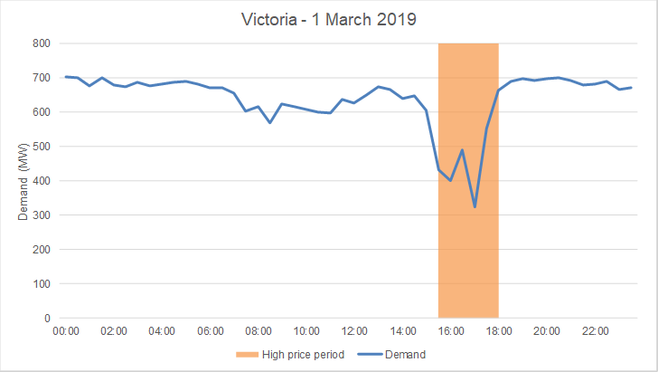
Existing wholesale DR during periods of volatile prices
Time | RRP ($/MWh)
14:30 | 252
15:00 | 3,847
15:30 | 6,915
16:00 | 12,635
16:30 | 12,472
17:00 | 3,572
17:30 | 228
18:00 | 1,911
18:30 | 127

Slide 9
Large customers have led the way when it comes to wholesale DR
To date, almost all wholesale DR has been by relatively large consumers enabled by:
  advanced metering infrastructure and energy monitoring
  flexible sources of load (HVAC and various interruptible industrial processes)
  having on-site generators
Also, energy forms a significant portion of these customers’ overall costs, increasing incentive to take up wholesale DR as a means of achieving lower costs
Historically, almost no wholesale DR undertaken by small customers
Digitalisation, smart-metering, and load-control devices increasingly opening up opportunities for wholesale DR by small customers
Better understanding consumer protection issues (e.g. 3rd party access to data), is why we recommended a 12-month lag for wholesale DR for small consumers

Slide 10
Different consumer types lead to different forms of wholesale DR
Table 2: Types of wholesale DR
TYPE | FIRMNESS OF THE DR | EXAMPLE
Non-firm, discretionary DR | Typically not firm in terms of quantity or when it actually occurs | Sending customers an SMS offering a reward for reducing consumption on an opt-in basis
Contracted demand reduction that is not directly controlled | Depends on the arrangement between buyer and selling | Under specified conditions (e.g. five days per year), an aggregator is able to call on the large customer to reduce consumption
Remotely-controlled DR | The firmness of the response is generally higher. The retailer can usually both observe in real time how much capacity is available and control it in response to signals | Aggregator has direct control over certain load processes or DER and control usage in response to wholesale price
Voluntary DR in response to direct price signals from the wholesale market | Consumer bears the price and volume risk | More accessible to large consumers
Source: AEMC, Wholesale demand response mechanism, Draft rule determination, 18 July 2019

Slide 11
Wholesale DR rule change requests: quick recap

Slide 12
Key aspects of the AEMC’s draft determination
Proposed 1 July 2022 commencement of WDR mechanism for large customers
later start date proposed for small customers (pending a review of consumer protections)

Slide 13
AEMC rule change process: where it is currently at
Rule change requests received: August and October 2018
Consultation paper released: 15 November 2018
Draft determination released: 18 July 2019 (Final Det. proposed: 14 Nov.)
Extension (10 October): Final Det. to be published 05 December
Extension (05 December): Final Det. to be published 11 June 2020
  consider issues raised by AEMO re: implementation costs and design issues
  costs of $40m-$95m: top-end reflects costs of system build to meet all aspects of the AEMC-proposed WDR mechanism; lower costs possible if some design features/functionality needs (e.g. scheduling and baselining of loads) are removed
  morever some of the costs may be wasted if features/systems become redundant under a 2SM

Slide 14
Whither DR – a 2-sided market?
Needed in a digitalised, decarbonised, democratised, distributed, decentralised NEM
Enabling an active 2SM requires the following from demand-side resources:
  greater transparency and information to AEMO at the time of, and prior to, dispatch
  active involvement in the price-setting process, potentially by becoming scheduled
  reviewing existing scheduling requirements to see if they remain fit-for-purpose in a 2SM, and if greater incentives are needed for loads to become scheduled
  providing consumers with greater price certainty. 2SM participation can incur costs upfront for loads, which can be a barrier to participation if expected high wholesale prices don’t occur. An ahead-market can provide the requisite certainty
  maintaining appropriate consumer protections given the new business models and new technologies needed to enable a 2SM
Need for WDR mechanism to incentivise more DR unless/until these issues are resolved
Demand-side participation does not need to be 100% – but all consumers can benefit!

Slide 15
Office address
Level 6, 201 Elizabeth Street
Sydney NSW 2000
ABN: 49 236 270 144
Postal address
PO Box A2449
Sydney South NSW 1235
T (02) 8296 7800
F (02) 8296 7899

