Slide 1
Climate transition risk and the public finances
Climate Policy Initiative Energy Finance
Australia, November 2019

Slide 2
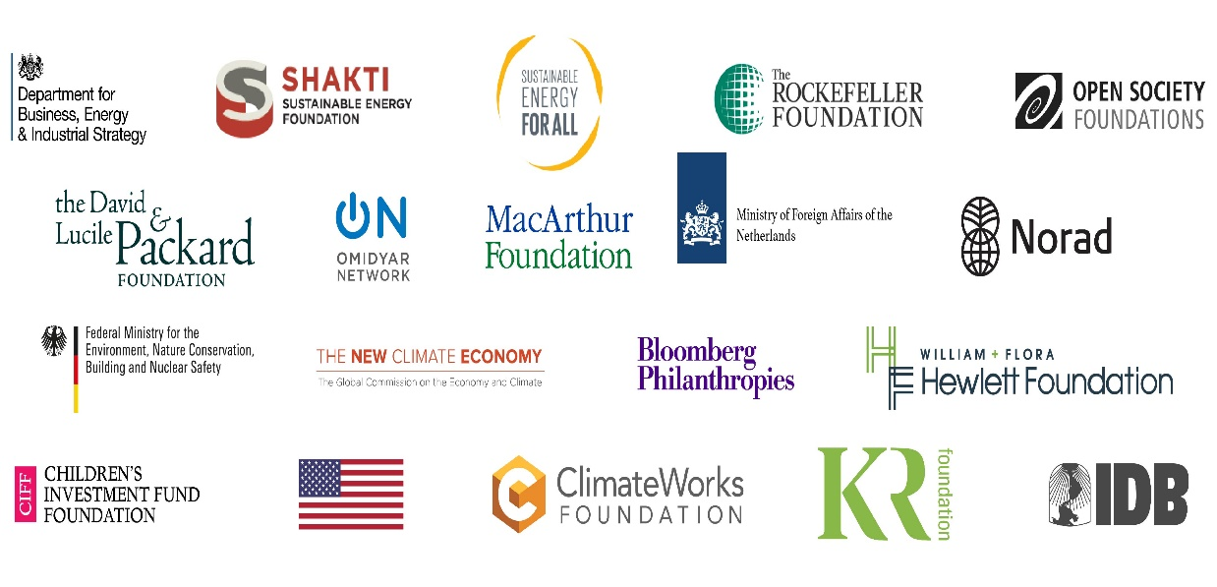
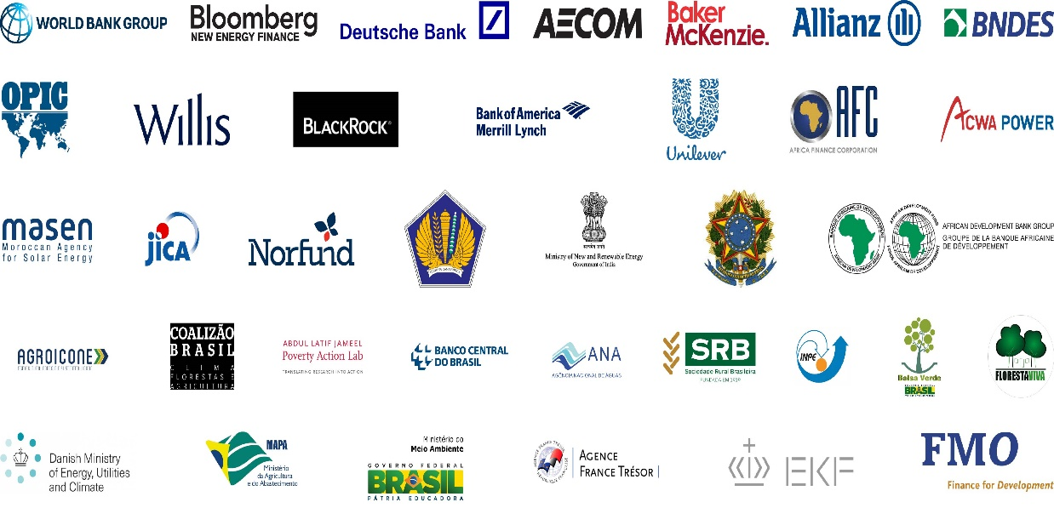
About Climate Policy Initiative
Think tank founded in 2009
Sample Funders
80+ Analysts in 6 offices, with engagements in dozens of countries
CPI Global Offices
Sample Partners
Three practices: Climate Finance, Land Use, and Energy Finance

Slide 3
Agenda
Our approach to climate transition risk
An example of sovereign climate transition risk – South Africa
Transition risk analysis in Australia
Next steps

Slide 4
Our approach to climate transition risk

Slide 5
CPI-EF is developing a series of tools to measure and manage climate transition risk for both public and private sector actors
1. Asset level risk models
Models, often global or regional but segregated by industry, that calculate climate value at risk under different climate transition scenarios on an asset by asset basis
6. Risk based scenarios
Replacement of deterministic scenarios with adaptive and probability driven tools that capture the range potential outcomes, their probability, and the implied risk
2. Risk allocation models
A series of models, for different types of assets and ownership structures, that assess explicit and implicit allocation of climate risk between government, investors, consumers, workers
Direct input
Secondary input
3. Sovereign risk assessment
Assessment of explicit and implicit risk flows/balance at a national level, including impact on:
sovereign balance sheet and financial system stability, consumers, taxpayers, workers, finance sector.
4. Finance, investor, and insurance risk assessment
Evaluation of risk at investment portfolio level, includes development of tools to value and hedge risk
5. Corporate risk assessment
Assessment and aggregation of asset level risk and its allocation to build overall picture of climate transition risk to individual corporations
Provides analysis and advice for policymakers on investment strategies, policy, de-risking, managing energy and worker transition
Portfolio level analysis
Development of investment tools and products for hedging
Enable creation of metric for global pricing of transition and physical risk
Critical input to finance and sovereign assessments
Provides critical input to corporates on strategy, divestment, investment, diversification, and risk management

Slide 6
Macroeconomic policymakers and regulators do not yet have the tools to manage climate transition risk as the nature of the risks is very different to traditional threats to the public finances
Characteristics of transition risks
Implications for measuring and managing risks
Risks materialise at the micro/ asset level driven by macro forces
Modeling and measuring risk requires a hybrid approach to measure how macro changes will affect the value and financial viability of individual assets
Are often driven by non-linear, structural change
The analysis needs to incorporate multiple scenarios to evaluate the largest realistic risk and the path for impact on businesses/assets
The probability of each likely outcome affects the scale of risk
Scenarios need to measure impact on demand/outputs (e.g. oil, steel, automobiles), costs, and margins that shape the value of assets or resources
Depend on the timing and path of the transition
Transfer between stakeholders and can ripple through the economy
Valuation needs to map the flows of the risk from the owners through the economy to accurately measure risk

Slide 7
A case study: our work in South Africa (2018-2019)

Slide 8
Coal exports, electricity generation and coal to liquids have historically been the biggest source of carbon emissions from South African sources
MtCO2 per annum
Creates risk from global mitigation policy (declining global coal use)
Creates risk in coal and power sector from domestic mitigation policy
Coal to liquids
Creates risk in refining sector (and coal) from domestic mitigation policy
Iron and steel
Buildings
Transport (Oil)
Other

Slide 9
Our South Africa study produced several surprising findings for South African stakeholders
Potential Climate Transition Risk
The risk is material (downside of up to $124 billion)
Employment, corporates, financial institutions, workers, all share risk
Source of
Risk
Mainly external – Risk to coal exports account for 2/3 of risk
Global oil markets and domestic policy share the remainder
Flow of
Risk
Risk tends to flow back to government
After initial response, government share of risk increases from 16% to 55%
After flows, the sovereign credit rating could be at risk
Timing of Risk
Half of the downside risk already realized in last few years
Remaining risk realization could accelerate in the early 2020s
South African Options
South Africa has many options to manage the risk, including:
  Avoiding adding more risk through new investment (including $25 bn under consideration)
  Diversifying, divesting, offsetting, hedging, insuring, the rest

Slide 10
Future prospects for South African coal exports have already fallen sharply over the last five years
Yearly Demand for South African Coal Exports
(2018-2035)
Expected yearly net cash flows from South African
Coal Exports
(2018-2035)
mt
NPV $Bn
BAU 2013 forecast
Expected value lost 2013 -2017
Due to changes in global expectations
Decline in future export volume expectations 2013 -2017
Due to changes in global expectations
Further decline in volume
under 2DS
BAU 2017 forecast
Further decline in value
under 2DS
Remaining value
2DS
Remaining volume 2DS
2 degrees (extreme)

Slide 11
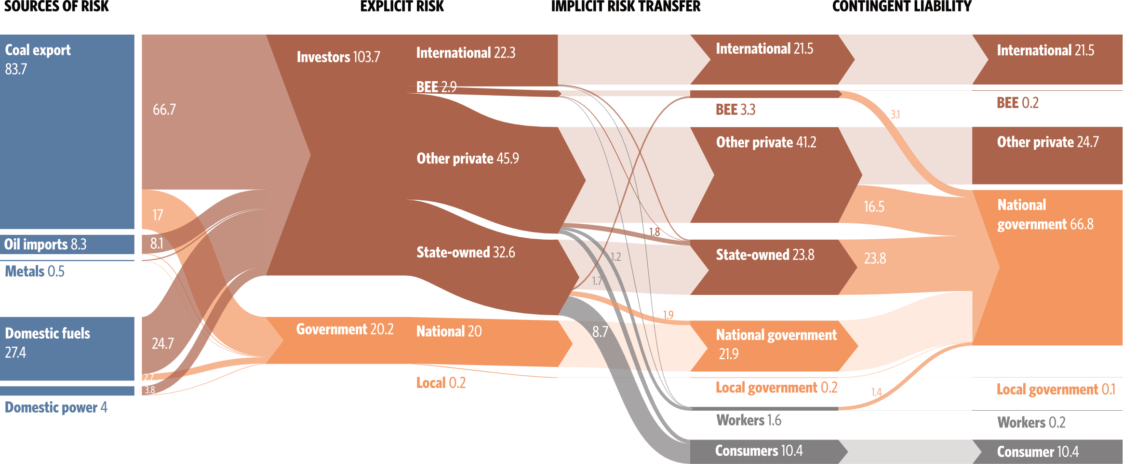
Considering ownership, taxes, regulation and contracts, less than 20% of the risk lies with the public finances

Slide 12
But coal miners will seek to offset their risk by cutting controllable costs, and selling additional volumes to the domestic market

Slide 13
Transition risk could also threaten the viability of infrastructure assets such as the export rail line
Current take or pay rail contracts are set to expire in 2026 – eroding Transnet freight profits but restoring value for struggling exporters
The entire rail line becomes uneconomic after 2032
Virtually no value left for Transnet after 2030

Slide 14
Domestic climate policy could then add further risk for some assets, like the Secunda coal-to-liquids plant, that are already exposed to external transition risk
Secunda will continue to have high margins but will be more severely affected by lower global oil prices
The cost of phasing out Secunda will depend on the replacement
Stranded asset
BAU
Demolition
$27.4bn stranded from replacing CTL with imports
Coal to liquids refinery margins
New capex
Commodity cost
2DS
Crude refinery margins
Minimal change between scenarios
Opex
BAU

Slide 15
As stakeholders respond to new realities, risk will shift back towards the national government, which may end up bearing more than half of the total risk

Slide 16
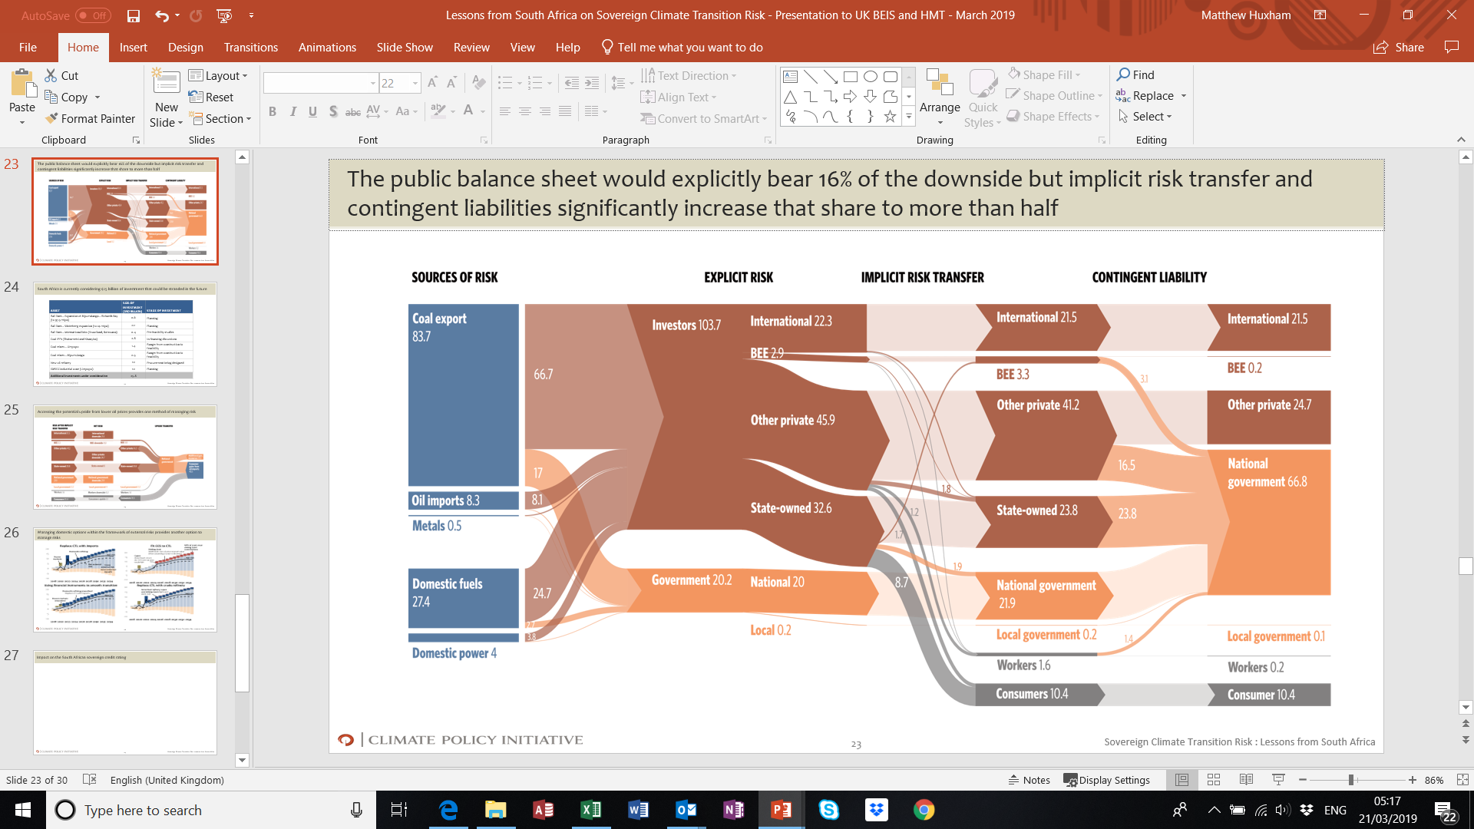
Transition risk, if not identified, monitored and managed, could hurt the South African sovereign credit rating and impact long term growth prospects and social outcomes
SA GDP 2017
SA loses investment grade credit rating?
$450 bn
Debt / GDP
70% (Brazil 2018, Ba2)
Weaker access to external credit
$307 bn
Transition risk
68% (SA 2017 + transition risk)
Higher borrowing costs
$240 bn
53% (SA 2017, Baa3)
Increased FX volatility
Public debt 2017
Impact on inflation
20% (SA govt target, National Development Plan)
Impact of transition risk on public balance sheet
Bailouts / financial support for firms and munis in distress
Additional debt guarantees for SOEs
Additional social spending
Transition risk could significantly increase public debt / GDP, a key metric for rating agencies
Timing and profile of risk is key
If transition risk not managed: weaker social and development outcomes, lower growth potential, increased social and political risk

Slide 17
We have proposed a series of recommendations and are exploring how to implement them with our South African partners
AVOID
Potential investments to evaluate under 2C scenarios
ADAPT PLANNING AND MONITORING
Monitor transition risk more systematically across the economy
ASSET | INVEST-MENT (USD BILLION) | STAGE OF INVESTMENT
Rail lines – Expansion of Mpumalanga – Richards Bay | 0.6 | Planning
Rail lines – Waterberg expansion | 0.1 | Planning
Rail lines – International links | 0.4 | Pre-feasibility studies
Coal IPPs (Thabametsi and Khanyisa) | 2.8 | In financing discussions
Coal mines – Limpopo | 1.4 | Range: construction to feasibility
Coal mines – Mpumulanga | 0.5 | Range: construction to feasibility
New oil refinery | 10 | Procurement being designed
EMSEZ Industrial zone (Limpopo) | 10 | Planning
Additional investments under consideration | 25.8

Slide 18







We are planning to build on and improve the approach in South Africa through our discussions and analysis in other countries
LESSONS LEARNED – engage early and widely!
1. Building trust and engagement with public institutions from the start increases the chance that the study will add value in the context of existing policy initiatives around climate risk
2. Partnering with local analytical institutions (where possible) increases the chance that the analysis might be replicated in future in-house
3. Increasing the focus on solutions as well as diagnosis can improve the political reception
4. There is significant demand from both private and public sector for the detail that this work provides. It can be just as useful to local government and officials planning a “just transition” in the coal sector as for macroeconomic and fiscal policymakers
EXTENDING THE PROGRAMME
We hope to refine and extend our analysis by conducting similar studies in other countries:
We are actively designing work in the following countries:
We are also working with the NGFS, IDFC and the World Bank to broaden the adoption of this type of analysis

Slide 19
Transition risk analysis in Australia

Slide 20
Australia’s emissions footprint outside of the country is larger than its domestic emissions, meaning a significant proportion of its transition risk is outside of its control
MtCO_{2e}
per
annum
Emissions from Fuel exports*
Land use, land use change and Forestry (LULUCF)
Electricity generation
Transport
Industrial energy use
Industrial process
Waste
Agriculture
Other

Slide 21
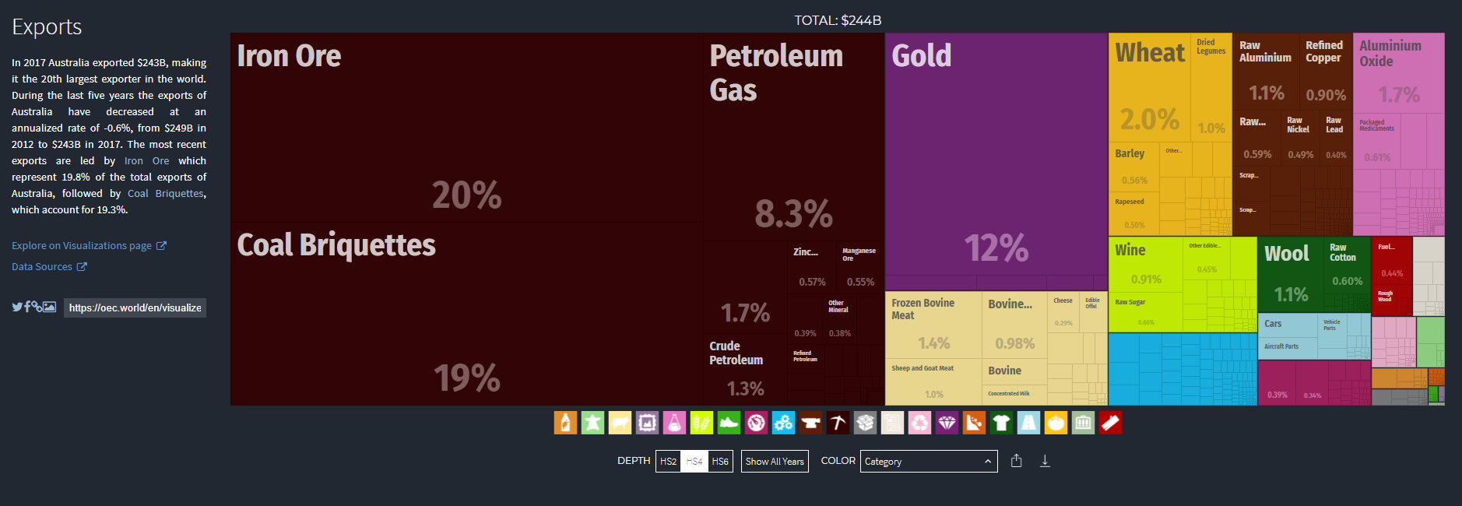
Mining’s share of Australian GDP is only in single figures but transition risk exposed commodities make up half of Australia’s exports
Thermal coal, metallurgical coal, natural gas and iron ore all face potentially material transition risk

Slide 22
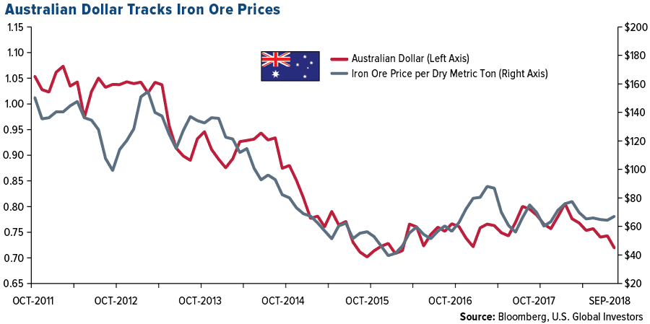
Changing commodity prices and the trade balance are already a major concern for monetary policy

Slide 23
Thermal coal export volumes will fall sharply in a low carbon scenario
Illustrative Australia analysis
Preliminary analysis: transition risk in Australian thermal coal exports
mt
1. Other than India and South East Asia, all of Australia’s export thermal coal markets are in decline
2. India’s domestic coal mining ramp up has as much of an impact on import volumes as its climate policy
3. Growth prospects in South East Asia are moderating as renewables costs fall and capital for new coal plant construction becomes more limited
Illustrative, based on initial CPI analysis
BAU 2017 forecast
2 degrees
Source: CPI analysis

Slide 24
In LNG, Australia is likely to face price, rather than volume risk
Illustrative Australia analysis
Australian LNG export volume
Weighted average Australian LNG export price
Illustrative, based on initial CPI analysis
Mt
US$/MMBtu
BAU
2 degrees

Slide 25
Demand for metallurgical coal is likely to peak later than thermal coal, but blast furnaces in any low carbon scenario would be gradually displaced
Illustrative Australia analysis
Annual global seaborne metallurgical coal volumes
Illustrative, based on initial CPI analysis
Thousand tonnes
Global growth in steel demand drives growth in demand for met coal
BAU
Chinese steel production peaks
Increasing market share of electric arc furnaces in India
2 degrees
Growth of “clean” hydrogen as a reducing agent

Slide 26
The prospects for Australian iron ore could vary widely, depending on which emissions reduction pathway the global steel industry takes
Illustrative Australia analysis
Thousand tonnes
Annual global seaborne iron ore volumes
Illustrative, based on initial CPI analysis
BAU
If India pursues smelt reduction technology at scale, it could improve resource efficiency and allow it to use its own low quality iron ore resources
2 degrees

Slide 27
An economy-wide study would also need to cover export infrastructure, domestic transition pathways and sources of potential transition risk upside
“External” downside risk”
Thermal coal, met coal, natural gas, iron ore exports; export-oriented infrastructure that cannot be repurposed (eg, Newcastle port?)
“Domestic” downside risk
Thermal power stations, oil refineries, steel and cement production
Upside potential
Renewable energy developers and supply chain; hydrogen production (and export?); mining of minerals used in the clean energy transition?

Slide 28
We would be very keen to hear your thoughts and to discuss this further
Thomas Heller, Director of Stanford Sustainability Finance Institute; Chairman of the Board and Senior Strategic Advisor, Climate Policy Initiative
Tom.Heller@cpisf.org
Matthew Huxham, Principal, Climate Policy Initiative Energy Finance
Matthew.Huxham@cpilondon.org

Slide 29

Upcoming seminars
Date/Location | Presenter | Topic
Fri 22 Nov 1-2pm Climate College | Kristina Haverkamp (German Energy Agency) | The German energy transition: Challenges, opportunities and collaboration with Australia
Wed 27 Nov 11am-12pm Climate College | Dr. Tobias Ide (University of Melbourne) | The impact of climate change on armed conflict
Wed 4 Dec 11am-12pm Climate College | Dr. Ben Henley (University of Melbourne) | Amplification of risks to Melbourne’s water supply at 1.5°C and 2°C
climatecollege.unimelb.edu.au/seminars
@climatecollege

Slide 30
Backup slides

Slide 31
CPI-Energy Finance works at the intersection of policy and finance to develop innovative solutions to help markets and policy makers mitigate climate change
Managing Climate Transition Risk
The concentration of climate transition risk encourages stakeholders to delay the policy and investment needed to mitigate climate change.
We assess the risk and develop tools to help stakeholders mitigate and diversify their climate transition risk:
  Sovereigns and Sub-national governments
  Investors and Asset Owners
  Companies, Workers, others
Encouraging Market Reform
Using Finance as a Catalyst
Current market structures are often designed to optimize the traditional higher-carbon strategies
We are focusing on energy market design to:
Build markets tailored to low-carbon solutions
Reduce the relative cost of capital of low-carbon by allocating risks better and creating better incentives
Incentivize innovation, the appropriate infra- structure, energy system flexibility, energy efficiency
Encourage the next generation of energy companies
New financing solutions can overcome investment barriers and reduce the cost of capital for low carbon investments and innovation
We lead efforts to:
Create lower cost investment solutions for institutional investors
  Make green investment products effective
  Avoid stranded assets while fitting a fossil fuel phaseout into the transition
  Tailor solutions for emerging markets

