Slide 1
Different speeds of acknowledgement?
Carbon dioxide removal governance in EU’s multi-level system
Felix Schenuit
Notes:
Thanks for hosting me
Work in progress
Hamburg

Slide 2
Structure
Why are we talking about Carbon Dioxide Removal?
… and what exactly are we talking about?
… and why should we already talk about its governance?
CDR-relevant governance in the EU
EU climate policy
EU Green Deal / 2050 long-term strategy
Climate and Energy Framework 2030
Member States case studies
Conclusions
Notes:
Not self-evident that we are talking about this; needs a good reason and to be transparent
Several short-cuts; if you disagree or want to know more I‘m very happy to discuss that

Slide 3
Carbon Dioxide Removal
“Anthropogenic activities removing CO₂ from the atmosphere and durably storing it in geological, terrestrial, or ocean reservoirs, or in products. […]” IPCC, Special Report on 1.5°C Global Warming, Glossary
What for?
Residual emissions (to achieve ‘net-zero‘ targets)
Net-negative emissions

Slide 4
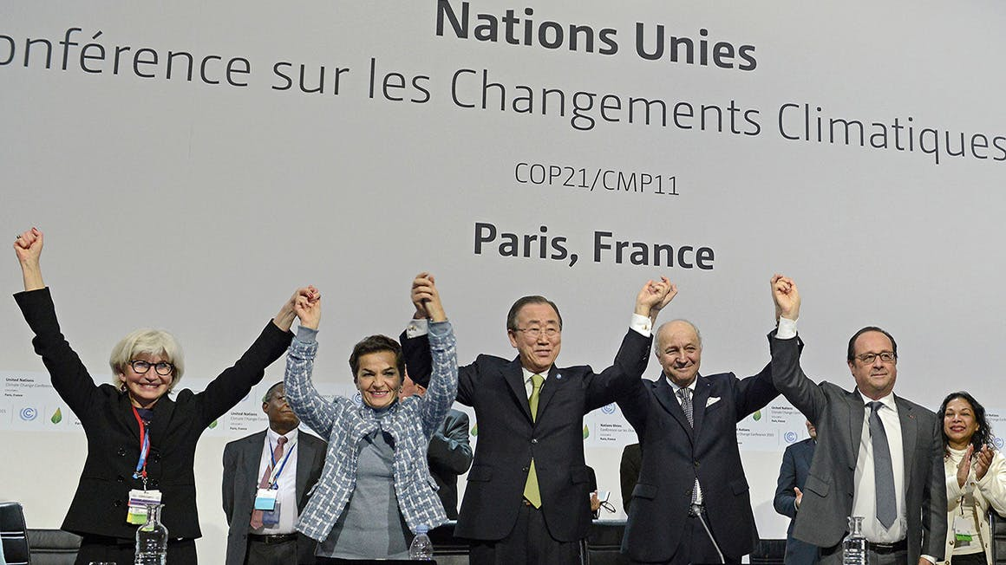
Why are we talking about Carbon Dioxide Removal?
Art. 4.1, Paris Agreement
[…] achieve a balance between anthropogenic emissions by sources and removals by sinks of greenhouse gases in the second half of this century, […]
Notes:
→ Residual emissions → net-zero target; what happens to the hard-to-mitigate emissions?

Slide 6
“All pathways that limit global warming to 1.5°C with limited or no overshoot project the use of carbon dioxide removal (CDR) on the order of 100–1000 GtCO₂ over the 21st century.”
IPCC, SR15, SPM
Notes:
100–1000 GtCO2 over the 21st century
(AFOLU): agriculture, forestry and land-use
C.3 All pathways that limit global warming to 1.5°C with limited or no overshoot project the use of carbon dioxide removal (CDR) on the order of 100–1000 GtCO2 over the 21st century. CDR would be used to compensate for residual emissions and, in most cases, achieve net negative emissions to return global warming to 1.5°C following a peak (high confidence). CDR deployment of several hundreds of GtCO2 is subject to multiple feasibility and sustainability constraints (high confidence). Significant near-term emissions reductions and measures to lower energy and land demand can limit CDR deployment to a few hundred GtCO2 without reliance on bioenergy with carbon capture and storage (BECCS) (high confidence). {2.3, 2.4, 3.6.2, 4.3, 5.4} [p.17]
C.3.3 Pathways that overshoot 1.5°C of global warming rely on CDR exceeding residual CO2 emissions later in the century to return to below 1.5°C by 2100, with larger overshoots requiring greater amounts of CDR (Figure SPM.3b) (high confidence). Limitations on the speed, scale, and societal acceptability of CDR deployment hence determine the ability to return global warming to below 1.5°C following an overshoot. Carbon cycle and climate system understanding is still limited about the effectiveness of net negative emissions to reduce temperatures after they peak (high confidence). {2.2, 2.3.4, 2.3.5, 2.6, 4.3.7, 4.5.2, Table 4.11} [p.17]

Slide 7
“Fast growing research on negative emissions“
Minx et al. (2017)

Slide 8
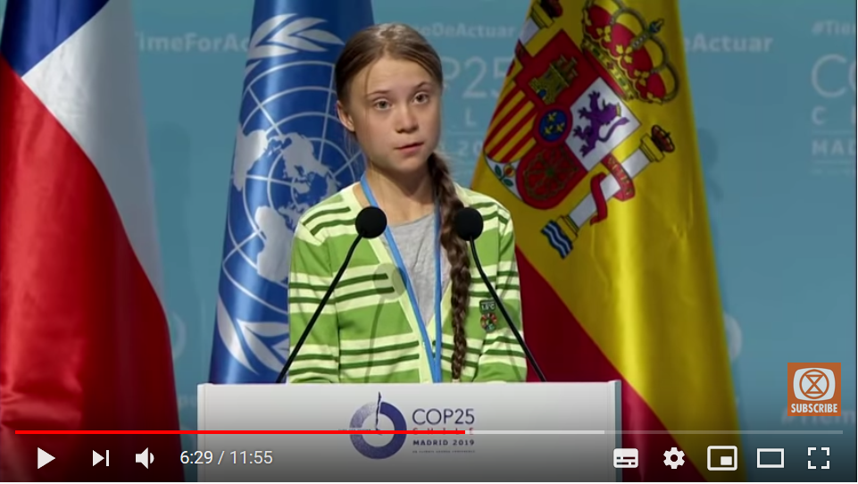
[…]
Most models assume, however, that future generations will somehow be able to suck hundreds of billions of tons of CO₂ out of the air, with technologies that do not exist in the scale required and maybe never will.
Greta Thunberg at COP25

Slide 9
….and what exactly are we talking about?
UNEP Emissions Gap Report 2017, p. 58

Slide 10
… and why should we already talk about its governance?
“Most current and potential CDR measures could have significant impacts on land, energy, water or nutrients if deployed at large scale […] Effective governance is needed to limit such trade-offs and ensure permanence of carbon removal in terrestrial, geological and ocean reservoirs (high confidence).”
IPCC, Special Report on 1.5°C Global Warming SPM
Notes:
If poorly implemented, CDR options such as BECCS and AFOLU options would lead to trade-offs. Context-relevant design and implementation requires considering people’s needs, biodiversity, and other sustainable development dimensions (very high confidence). (Figure SPM.4) {5.4.1.3, Cross-Chapter Box 7 in Chapter 3} [p.21]

Slide 11
… and why should we already talk about its governance?
CDR governance structures are often considered to contain pitfalls for overall climate action & governance
Moral hazard
“Mitigation deterrence“ (McLaren et al.)
Tracking emergence of CDR-relevant governance structures
Notes:
Need to understand wo starts talking about this? In what ways?
What are different approaches of dealing with it and what alliances ánd other political developments are to be anticipated?

Slide 12
CDR relevant governance in EU‘s multi-level system
Notes:
EU climate policy
Commission
EU 2030 Legislation
Longterm Strategy

Slide 13
EU Green Deal
European Commission (2020)
Notes:
Wider political context
Everybody talks auf EU Green Deal, but for now still not clear what it actually is about.
Political initiative by most senior EU politicians who invest a lot of political capital into this
Success is important – it the Public Relations are also being intesified; and it is getting harder to track actual progress.
2030 target (election VdL)

Slide 14
Leak of draft EU Climate Law (02/03/2020)
Natural & technological solutions
Greenhouse gases – not CO₂
Domestically
Net removals / net-negative after 2050
European Commission (2020) Draft EU Climate Law
Notes:
A bit more concrete the day before yesterday
We now better understand what „Climate Neutrality“ means –
before EU used it rather ambigous ways (CO2/GHG)
Domestically
Net-negative

Slide 15
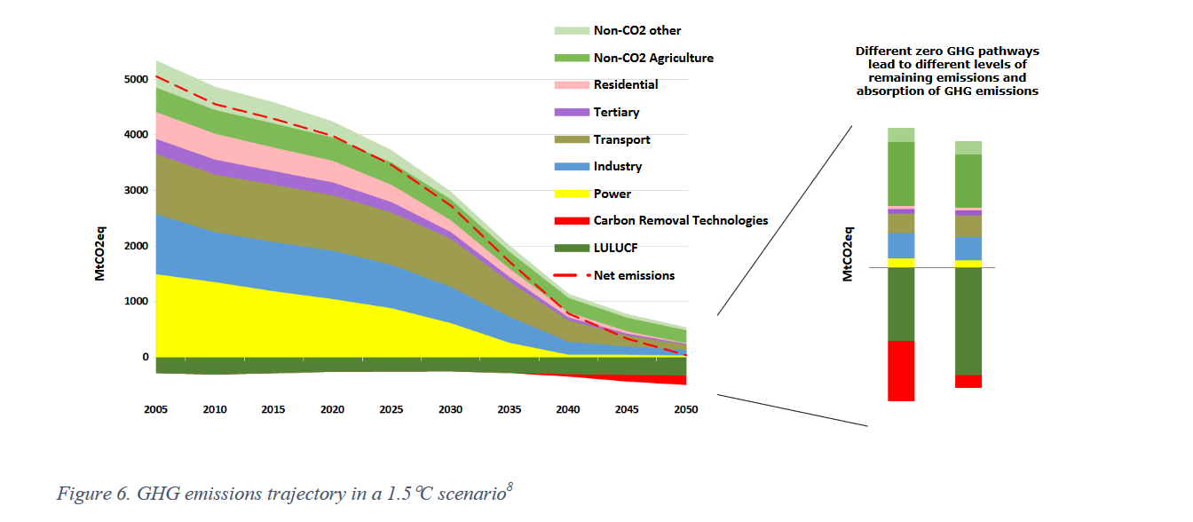
European Commission‘s 2050 long-term strategy
European Commission (2018): 2050 Long-terms strategy
Notes:
LTS-modelling
CDR necessary to reach net-zero; both natural as well as technological

Slide 16
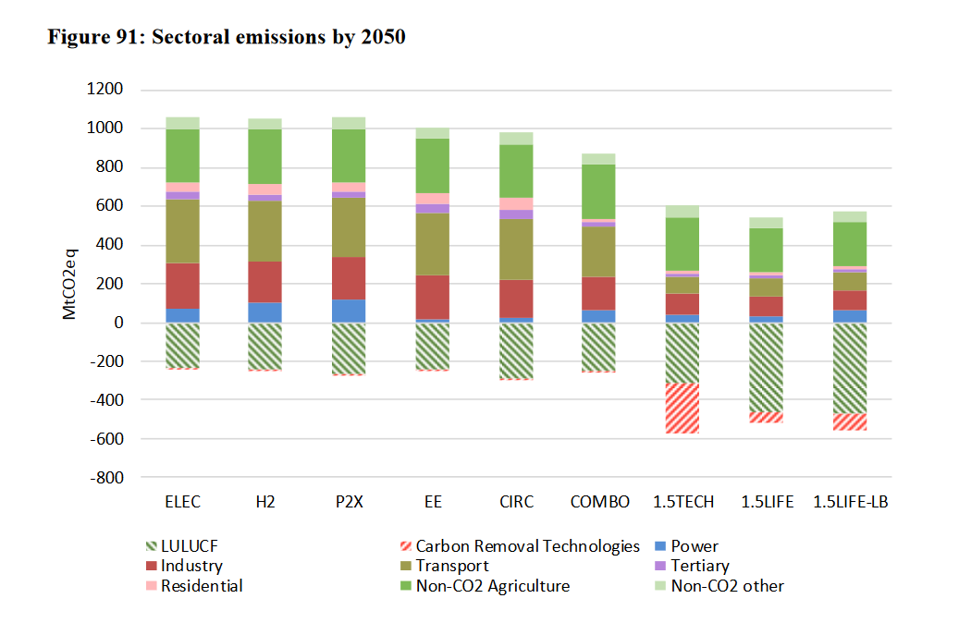
European Commission‘s 2050 long-term strategy:
Sectoral emissions in 2050
European Commission (2018): 2050 Long-term strategy, section of fig. 91
Notes:
See it a bit better on this graph: sectoral emissions in 2050
Comission adresses the issue quite openly
Chapter: „Towards negative emissions“
Mentioned in two out of seven „building blocks“ of LTS
→ not legally binding; what is legally binding is legislation from the 2030 Climate and energy framework;

Slide 17
Climate and Energy Framework 2030
Regulation (EU) 2018/1999 Governance of the Energy Union and Climate Action.
“[…] the Union should aim to achieve a balance between anthropogenic GHG emissions by sources and removals by sinks as early as possible and, as appropriate, achieve negative emissions thereafter.”
Notes:
When it comes to actual, already agreed, legislation, we have to talk about Climate and Energy Framework
Here, the term „negative emissions“ appeared for the first time → here in the context of net-negative emissions
The regulation, however, does not adress CDR.

Slide 18
Climate and Energy Framework 2030: 3 Pillars
Effort Sharing
(Ø 30%)
LULUCF
(no-debit)
EU ETS
(-43%)
no interaction
net emissions (=debits)
net removals (=credits)
Very limited amount: 280Mt from 2021-2030
Notes:
3 Pillars
LULUCF new: interaction / flexibility
Explain
not a CDR initiative, but conceptually: CDR-governance by other means
CDR-relevant governance structures that already shape interests of MS and sets incentives.
It is antipiated that MS – esp. those with large LULUCF sinks – will ask for extension of the very limited amount.

Slide 19
Member States: New EU reporting structure
10-year National Climate and Energy Plans
(Source: European Council 2019)
Notes:
Same template
Good source for empirical material
How many pages 28 Member States can produce and;
how less they care about deadlines decided on in Brussels
7 missing countries (excl. UK)

Slide 20
3 case studies
Germany / United Kingdom / Poland
Case selection:
Substantial influence on EU climate governance
Among the biggest emitters (GER 1st, UK 2nd, PL 5th)
Different approaches to climate policy
Different ways of dealing with CDR
Notes:
Reflect on UK
Regulative cooperation
Relevant CDR-case

Slide 21
Germany
Known as a frontrunner in energy transition & climate policy
NECP with strong focus on mitigation through renewables
CDR-related: “closing the carbon cycle“ in industrial processes
Reluctant on CDR in general („divert focus away“ + toxic CSS debate)
But: Research program on geoengineering & after SR15, BMBF announced funding.

Slide 22
United Kingdom
In 2016, Committee on Climate Change provided recommendations – including the need of CDR (100 MtCO2e/y)
Draft NECP provides a „Negative Emissions Pathway“
Creating “headroom” for other sectors to decarbonise later
Funding for CCS/CDR research & projects
Debates about policy frameworks emerge

Slide 23
Poland
Political negotiations on climate ambitions
Diversify the pace for climate neutrality
Just Transition Fund (~2bn for PL)
“[…] Paris Agreement does not lead to the elimination of fossil fuels, but to a development of new, low-emission technologies and strengthening the potential for the CO₂ removal, for example by forests which abound in Poland.” Press statement, Jan Szyszko, Minister of Environment during COP22.
Notes:
Not ambitious climate policy
Political negotiations on climate ambitions
Diversify the pace for climate neutrality
Just Transition Fund (~2bn for PL)
Interpretation of the PA
Forest Carbon Farming

Slide 24
Conclusions – 3 different ways of approaching CDR politically
strategic offsetting
progressive policy-entrepreneur
restrained wait-and-see

Slide 25
Conclusions
Different speeds & ways of acknowledging the need for CDR
CDR-relevant aspects in EU’s inner core of climate governance – tracking these developments important.
We will have to talk about effective & credible CDR-governance
Removal target(s)?
Technological / natural measures?
Import of negative emissions?

Slide 26
Thank you!
@FelixSchenuit

Slide 27
CDR-relevant aspects in [draft] NECPs
Taking up the idea of CDR (5)
Denmark, France, Netherlands, Sweden, UK
Mentioning removal without adressing concept of CDR (20)
Differ in degree to which they refer to CCS and enhancing LULUCF sink
Not adressing carbon removal (3)
Romania, Hungary, Slovenia

Slide 28
“The economic improvement has two main sources.
First is the extraordinary fall in the cost of equipment for solar and wind energy and of storage to meet the challenge of intermittency. [...]
Second is the immense opportunity for capturing and sequestering, at relatively low cost, atmospheric carbon in soils, pastures, woodlands, forests and plantations.” (p.8f)

Slide 29
“Where these locations are adjadenct to high-quality geosequestration sites, as in southwest Western Australia, and Victoria, capture and storage of emissions will lead to the holy grail of climate change mitigation: negative emissions through bioenergy carbon capture and storage (BECCS)” (p. 123)

Slide 30
WWF/Greenpeace

Slide 32
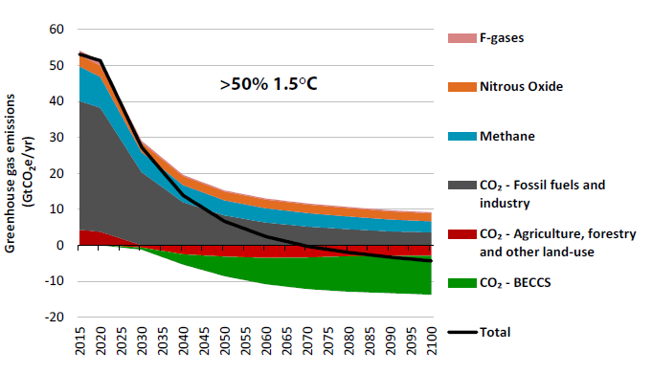
United Kingdom
UK Committee on Climate Change: Net Zero (2019)

Slide 35
Poland

Slide 36
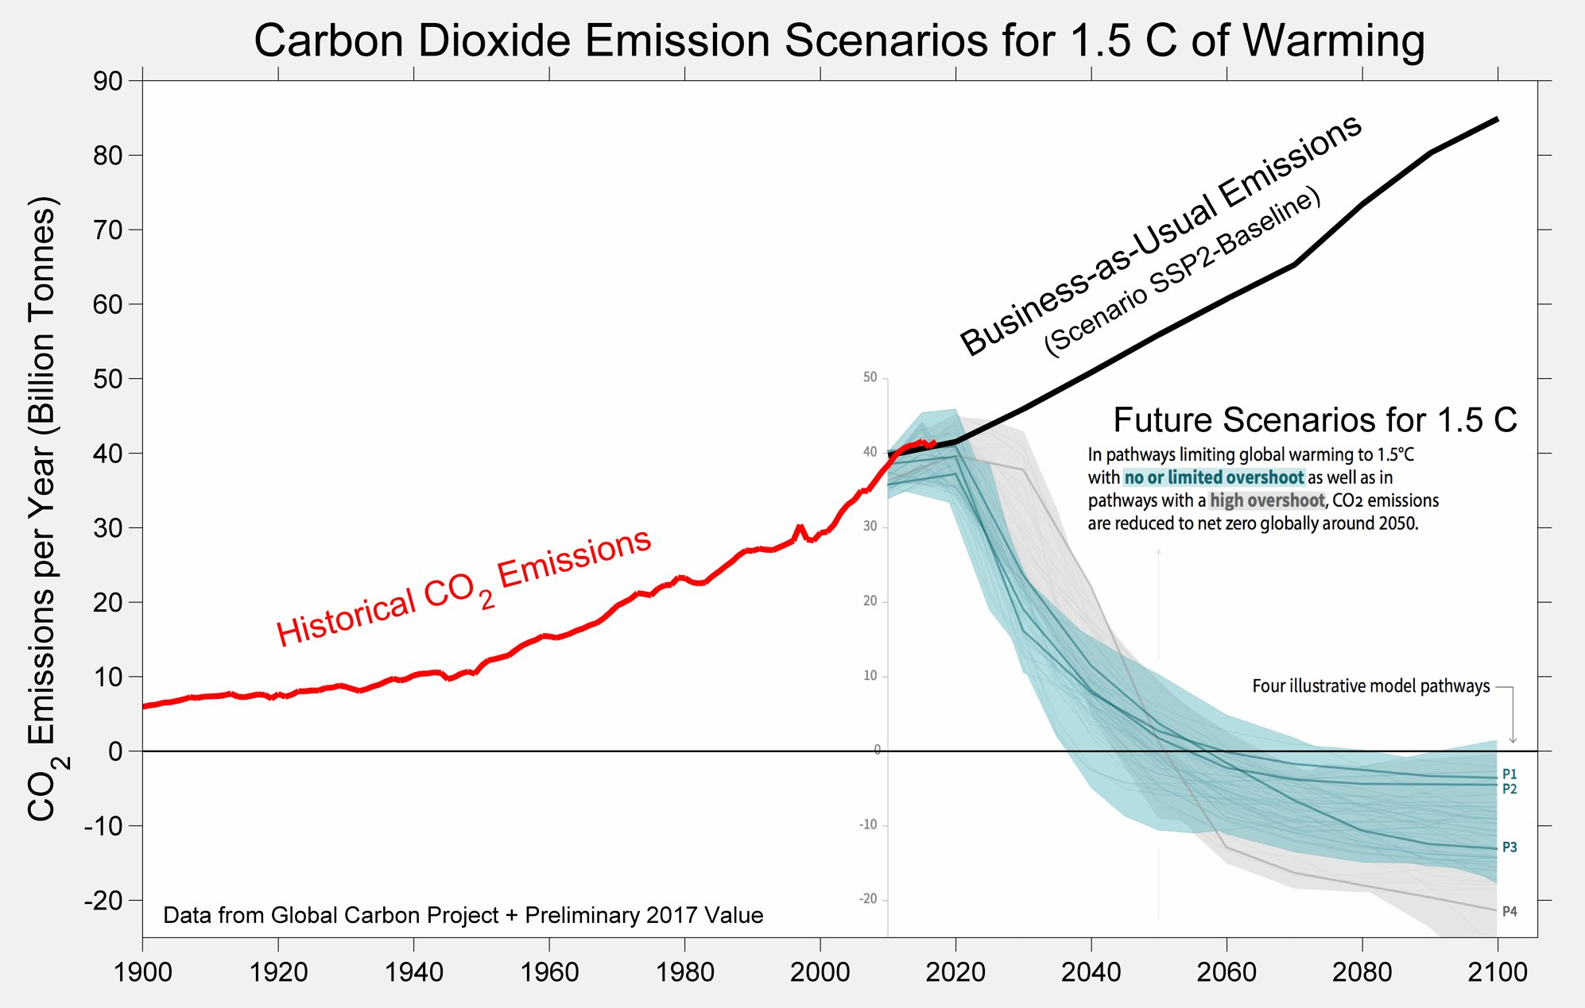
graph by Robert Rohde
Notes:
CO₂-Emissionen
bis 2030 um etwa -45%
bis 2050 “Nettonull”

