Slide 1



Slide 2

Scenarios to unlock a brighter future: 200% renewable energy for Australia
Dylan McConnell
Changlong Wang
Slides by Malte Meinshausen

Slide 3
2018
IPCC SR 1.5

Slide 4
Is it optimal for Australia to reduce 28% in the electricity sector?
(when reducing only 28% across all sectors…)

Slide 5
Short answer: No.
Transport and industry emissions are harder to reduce
Zero-emissions electricity prerequisite to electrify other sectors and bring down emissions.
Cost-optimal scenarios show electricity sector emissions generally reduced much stronger.

Slide 6
Climate Change as
“Moral issue”
“Economic issue”

Slide 7
Where climate change is a moral issue, we Liberals do it tough.
Where climate change is an economic issue – as the result tonight shows – we do very, very well.
Tony Abbott, 18th May 2019

Slide 8

Tradition
1. Mining

Slide 9

Tradition
1. Mining
> 2. Shipping

Slide 10

Tradition
1. Mining
> 2. Shipping
> 3. Overseas
Processing &
Burning

Slide 11
Or is it?
Is there a moral vs. an economic dilemma for Australia?

Slide 12

Suppose….
1. Mining

Slide 13

1. Mining Dirt, Sun & Wind

Slide 14

1. Mining Dirt, Sun & Wind
> 2. More
Processing
here

Slide 15

1. Mining Dirt, Sun & Wind
> 2. More
Processing
here
> 3. Shipping

Slide 16
Climate Change as
“Moral issue”
“Economic issue”

Slide 17
Options for renewable exports

Slide 18
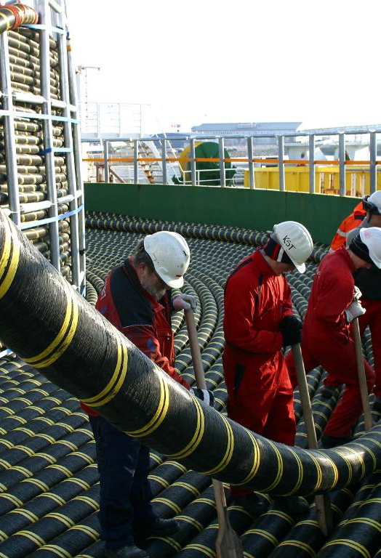
Options for renewable exports:
High Voltage Direct Current lines (HVDC) to Indonesia, Singapore…
Hydrogen in the form of ammonia or LOHC or liquified.
Embedded energy in energy-intensive products: green steel, alumina etc.
http://www.youris.com/energy/gallery/undersea-hvdc-cables-discovering-some-of-the-worlds-top-power-interconnections.kl

Slide 19
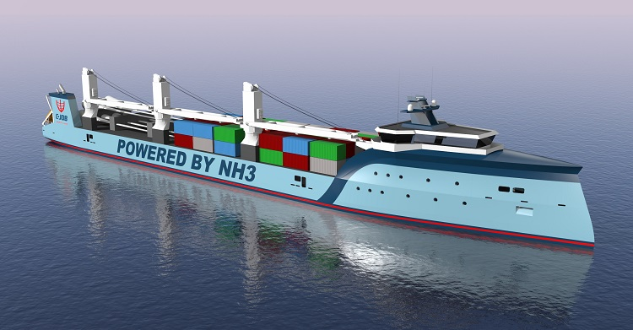
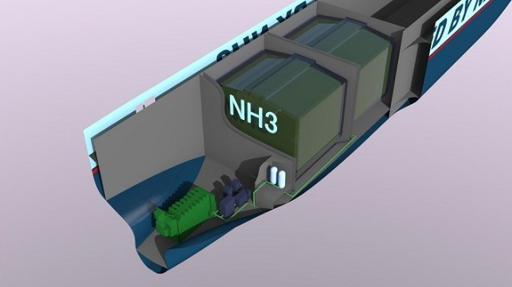
Shipping H2 in form of NH3.
(and also powering the ships)
Images from C-Job Naval Architects;
https://www.maritime-executive.com/article/with-ammonia-there-s-no-chicken-or-egg-dilemma

Slide 20
HVDC. Technically doable.
Geopolitically doable?

Slide 21
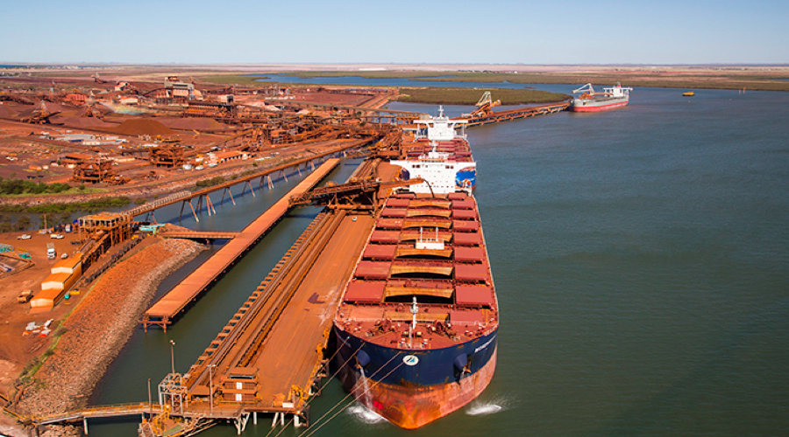
Shipping iron ore…
Or maybe shipping neither iron ore nor H2?

Slide 22
1. Mining Dirt, Sun & Wind
> 2. More
Processing
here
> 3. Shipping

Slide 23
Modelling the futures.
From status-quo continuation to energy superpower scenarios.

Slide 24















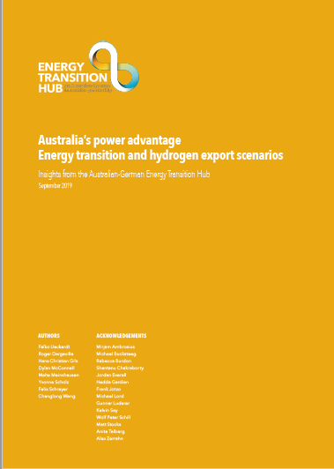



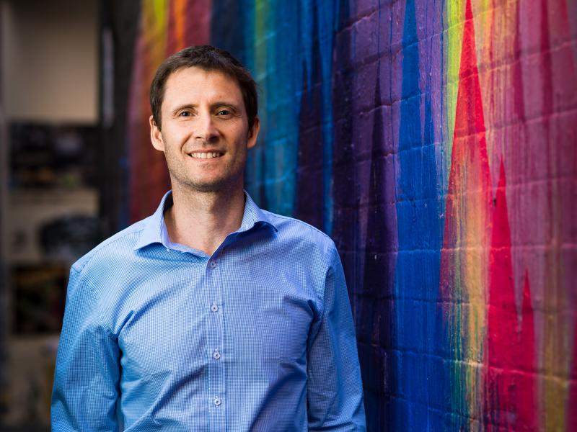



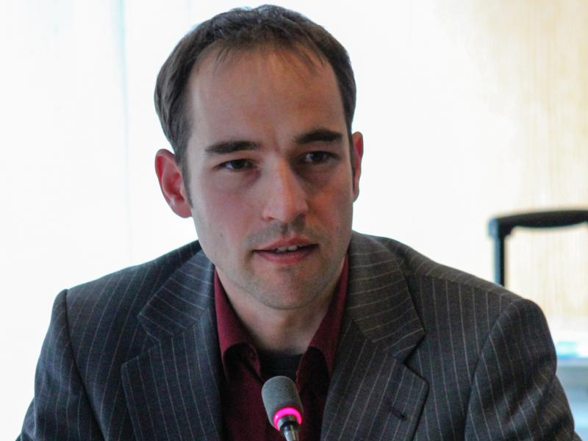

Multi-model Energy Transition and Export Scenarios for Australia
Notes:
This is one of 10 working groups that we have in the hub.
It is a continuous group effort.
This group is bilateral: combining modeling experience and tools from both countries with local knowledge and data.
We published a short report with first modeling results.
6 institutions (pik, monash, uom, dlr, murdoch, diw)

Slide 25
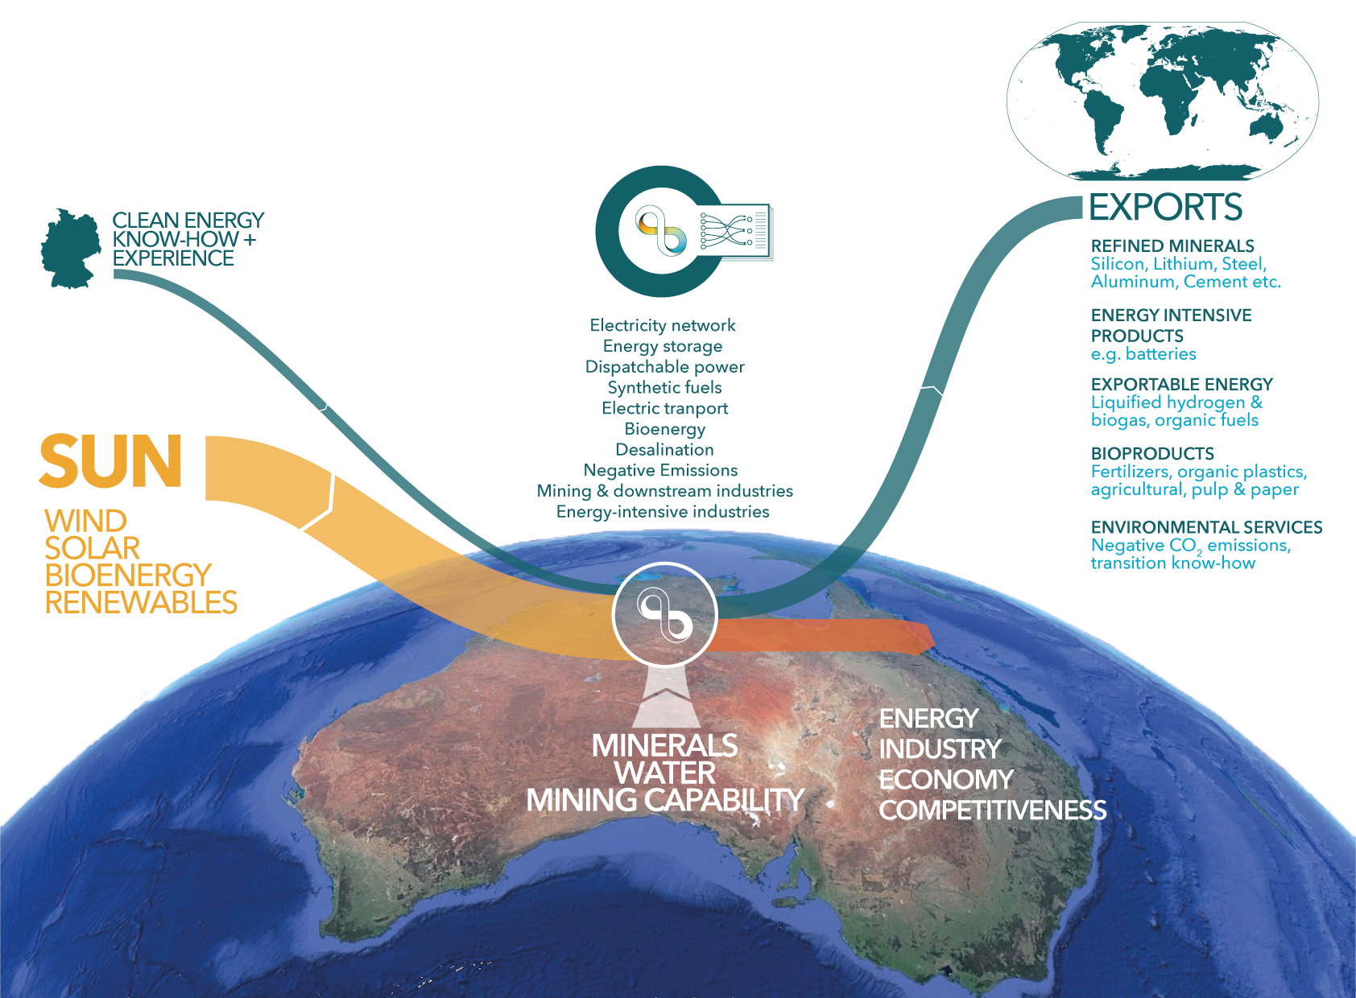
Energy Superpower Australia

Slide 26
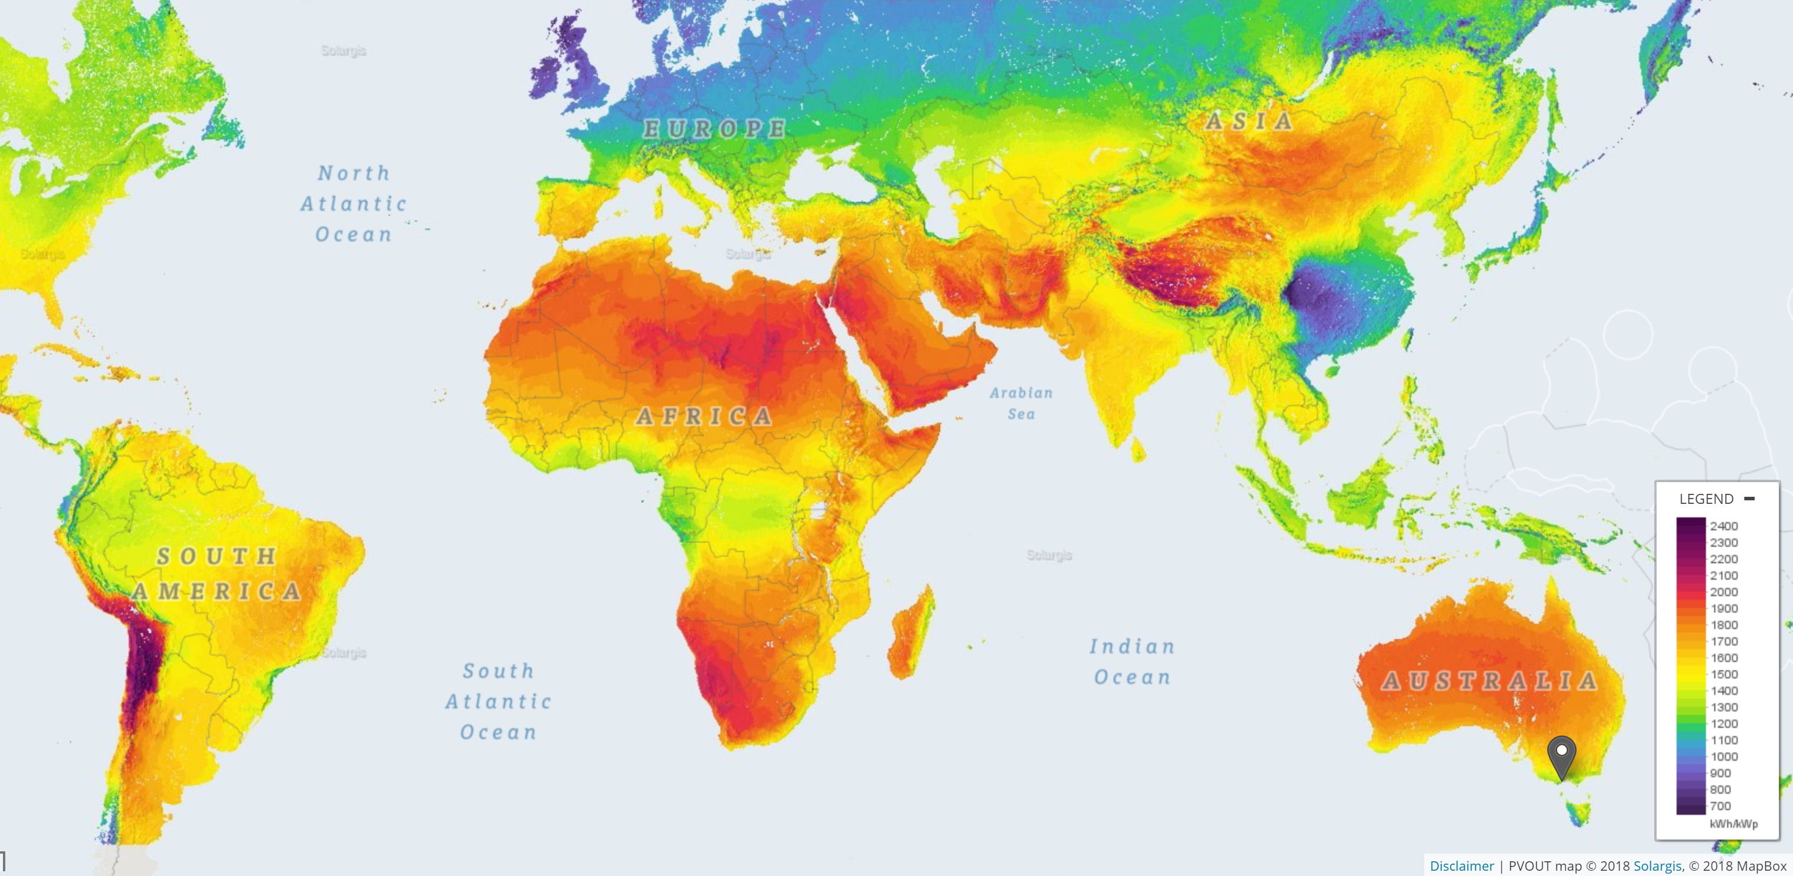
Best German solar =
Worst Australian solar

Slide 27
Energy(-intensive)
exports
Tooling &
Know-How
Energy(-intensive) exports
Policy Laboratory results
Negative emissions

Slide 28
Similarity: Installed renewables per capita: Australia maybe overtaking Germany in next decade?

Slide 29
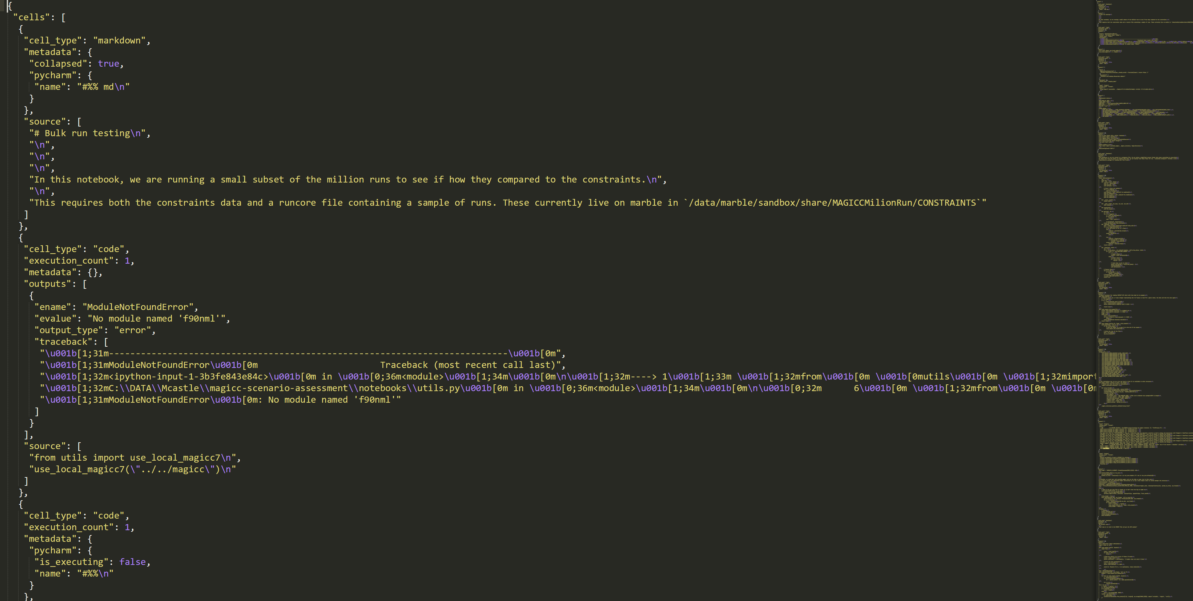
Four models derive cost-optimal transition scenarios of Australia‘s electricity supply until 2050

Slide 30
Model: | REMIND “global background” | MUREIL “our workhorse model” | OpenCEM “shooting star” | REMix (Australia) “high detail”
Type & scope | Global integrated assessment model (energy, economy, climate), 2015-2100 | Capacity expansion model of Australian power system (2020-2050) | Capacity expansion model of NEM (2020-2050) | Snapshot: Capacity and dispatch model of Australian power system, 2050
Temporal resolution | 5-year investment, RLDCs | Hourly (represent. days), 5-year investment | Hourly, 5-year investment | Hourly
Spatial resolution | 13 world regions | - 23 demand regions - 61 renewable locations incl. NT and Pilbara in WA | - 16 AEMO NTNDP Zones - 23 AEMO’s ISP renewable zones | 27 demand regions
character-istics | Global hydrogen demand, future global trade pattern | Modelling “Transition” with existing infrastructures; HVDC export studies | Open-source development in ARENA funded collaborations | High technological detail including “sector coupling”

Slide 31
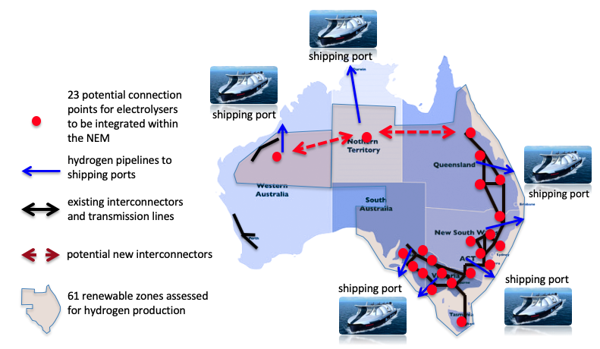
Example: MUREIL system modelling setup
Electrolysers-NEM coupled:
21 NEM regions
Central NT
Pilbara in WA
Renewables Location:
(standalone/off-grid)
43 NEM regions
12 central NT regions
6 WA regions
Infrastructures:
when? where? what? to build for generation, electrolysers and transmission
Notes:
We answer these question, through system modeling.
The least-cost optimisation model should also give us hint on when, where, and what type of technology and its capacity we need to build for generation, transmission and electrolysers to realize the ambitious goal.
This schematic shows the modeling geographic scope. We look at 21 locations in the NEM plus central Northern territory and Pilbara in Western Australia as shown by the red dot.
We explore 43 locations around the NEM and 12 locations in central northern territory plus 6 locations in Western Australia.
The optimisation also can decide whether to build extra interconnector from the NEM to NT and NT to Pilbara in WA.
The solid line is the current existing network. The blue line is the nearest hydrogen shipping port.

Slide 32
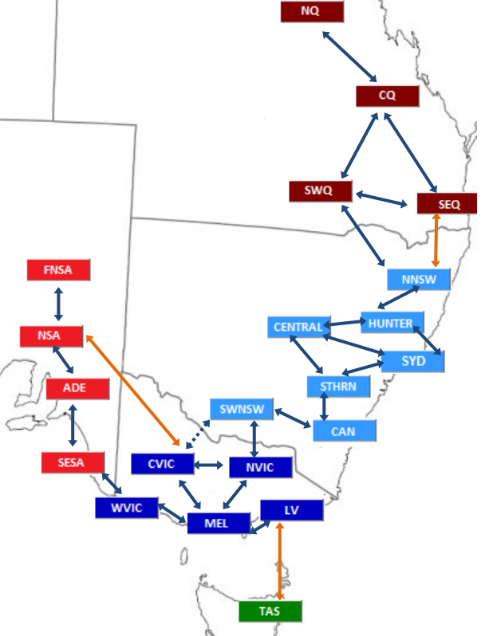
Least-cost co-optimisation of generation, transmission and green hydrogen systems
Focusing on “Transition” from the current NEM with existing generation fleets and their retirement, etc.
Hydrogen production assumptions closed aligned with ACIL Allen’s export scenarios
Water constraint for hydrogen production – desalination
21-node transmission system with hourly demand data
20% sync constraints for frequency control in each NEM state; no sync constraints for CNT and WA; Ramping and linearized Unit Commitment, etc.
Tech cost: CSIRO GenCost 2018 Report – rapid declining cost of technologies, especially solar PV, e.g. for 2050, $580/kW Solar, $1150/kW PHES, $3700/KW CSP, $1750/kW Wind, etc.
ReMix uses cost assumptions from various European studies, e.g. Battery will be the least-cost storage option, etc.
MUREIL Transmission Model
Transmission Model by ROAM Consulting
Commissioned by AEMC

Slide 33
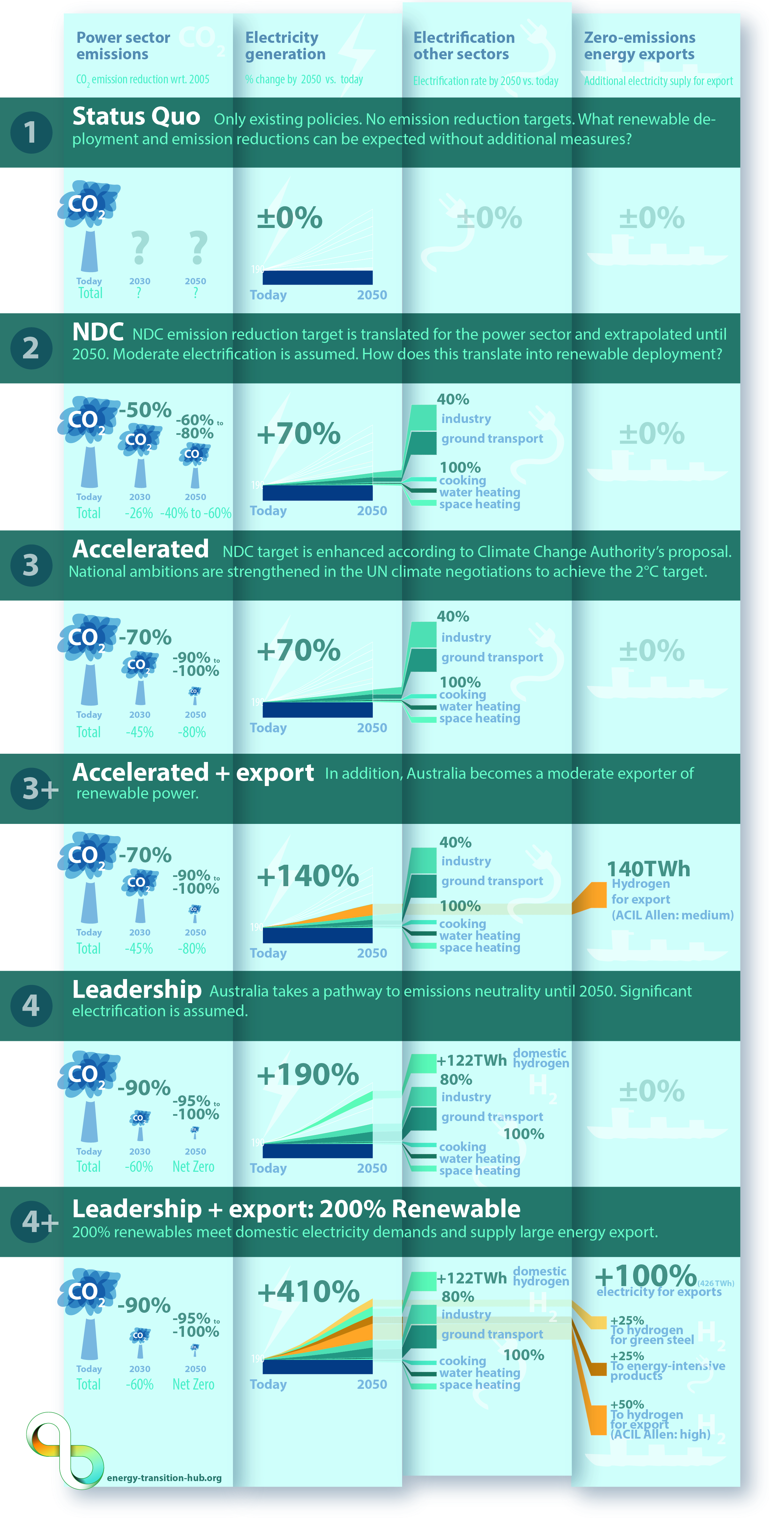
Scenario 1
1 X NEM
Notes:
200% renewable scenario is a power system that grew by a factor of four.
Two times doubling 1) electrification, 2) export
Assumption of functioning markets: cost advantages translate into investment decisions.
Focus: Electricity supply. Backbone of the energy transition. Implicit demand sectors: Broad electrification and domestic demand of hydrogen. Load profiles and flexibility of additional demand.
Our focus on electricity supply and the way of rather implicitly considering the demand side, is somewhat representative for the current practise of energy modeling in Australia.
Future research direction for the next years is clearly connecting bottom-up work and industry expertise and comprehensive system-wide scenario modeling)
Status quo scenario: no additional policies, no policies that are dedicated to emission reduction policies.
NDC, Accelerated, leadership. Export and electrification.

Slide 34
Scenario 2
1.7 X NEM
Notes:
200% renewable scenario is a power system that grew by a factor of four.
Two times doubling 1) electrification, 2) export
Assumption of functioning markets: cost advantages translate into investment decisions.
Focus: Electricity supply. Backbone of the energy transition. Implicit demand sectors: Broad electrification and domestic demand of hydrogen. Load profiles and flexibility of additional demand.
Our focus on electricity supply and the way of rather implicitly considering the demand side, is somewhat representative for the current practise of energy modeling in Australia.
Future research direction for the next years is clearly connecting bottom-up work and industry expertise and comprehensive system-wide scenario modeling)
Status quo scenario: no additional policies, no policies that are dedicated to emission reduction policies.
NDC, Accelerated, leadership. Export and electrification.

Slide 35
Scenario 3
1.7 X NEM
Notes:
200% renewable scenario is a power system that grew by a factor of four.
Two times doubling 1) electrification, 2) export
Assumption of functioning markets: cost advantages translate into investment decisions.
Focus: Electricity supply. Backbone of the energy transition. Implicit demand sectors: Broad electrification and domestic demand of hydrogen. Load profiles and flexibility of additional demand.
Our focus on electricity supply and the way of rather implicitly considering the demand side, is somewhat representative for the current practise of energy modeling in Australia.
Future research direction for the next years is clearly connecting bottom-up work and industry expertise and comprehensive system-wide scenario modeling)
Status quo scenario: no additional policies, no policies that are dedicated to emission reduction policies.
NDC, Accelerated, leadership. Export and electrification.

Slide 36
Scenario 4
3 X NEM
Notes:
200% renewable scenario is a power system that grew by a factor of four.
Two times doubling 1) electrification, 2) export
Assumption of functioning markets: cost advantages translate into investment decisions.
Focus: Electricity supply. Backbone of the energy transition. Implicit demand sectors: Broad electrification and domestic demand of hydrogen. Load profiles and flexibility of additional demand.
Our focus on electricity supply and the way of rather implicitly considering the demand side, is somewhat representative for the current practise of energy modeling in Australia.
Future research direction for the next years is clearly connecting bottom-up work and industry expertise and comprehensive system-wide scenario modeling)
Status quo scenario: no additional policies, no policies that are dedicated to emission reduction policies.
NDC, Accelerated, leadership. Export and electrification.

Slide 37
Scenario 3+export
2.5 X NEM
Notes:
200% renewable scenario is a power system that grew by a factor of four.
Two times doubling 1) electrification, 2) export
Assumption of functioning markets: cost advantages translate into investment decisions.
Focus: Electricity supply. Backbone of the energy transition. Implicit demand sectors: Broad electrification and domestic demand of hydrogen. Load profiles and flexibility of additional demand.
Our focus on electricity supply and the way of rather implicitly considering the demand side, is somewhat representative for the current practise of energy modeling in Australia.
Future research direction for the next years is clearly connecting bottom-up work and industry expertise and comprehensive system-wide scenario modeling)
Status quo scenario: no additional policies, no policies that are dedicated to emission reduction policies.
NDC, Accelerated, leadership. Export and electrification.

Slide 38
Scenario 4+export
5 X NEM
Notes:
200% renewable scenario is a power system that grew by a factor of four.
Two times doubling 1) electrification, 2) export
Assumption of functioning markets: cost advantages translate into investment decisions.
Focus: Electricity supply. Backbone of the energy transition. Implicit demand sectors: Broad electrification and domestic demand of hydrogen. Load profiles and flexibility of additional demand.
Our focus on electricity supply and the way of rather implicitly considering the demand side, is somewhat representative for the current practise of energy modeling in Australia.
Future research direction for the next years is clearly connecting bottom-up work and industry expertise and comprehensive system-wide scenario modeling)
Status quo scenario: no additional policies, no policies that are dedicated to emission reduction policies.
NDC, Accelerated, leadership. Export and electrification.

Slide 39
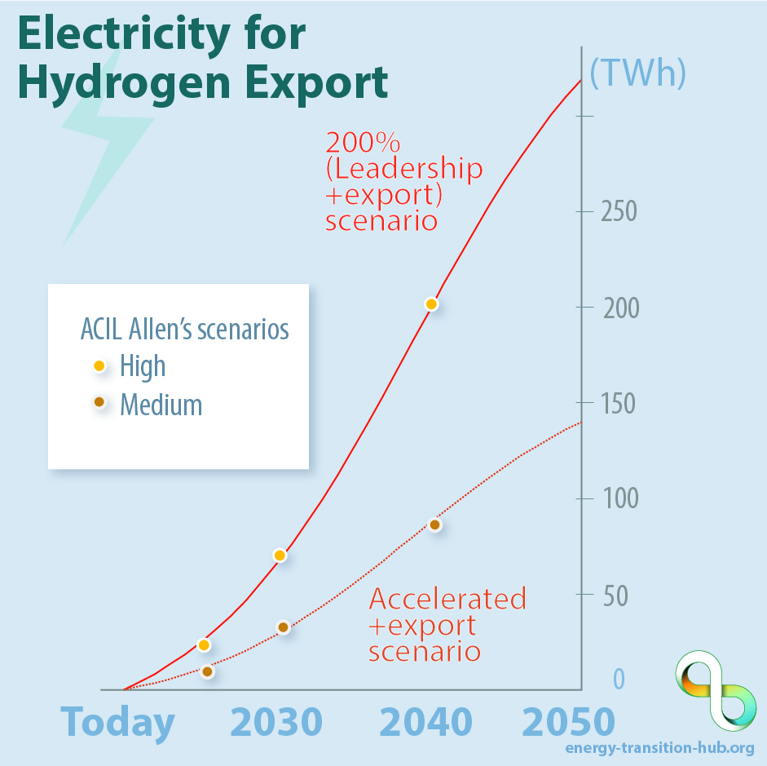

Our hydrogen export assumptions are in line with other studies
Approximately 300 TWh of hydrogen imports is what Germany envisages for its net-zero future by 2050.
320 TWh
hydrogen
export
electricity
Notes:
Status quo scenario: no additional policies, no policies that are dedicated to emission reduction policies.
NDC, Accelerated, leadership. Export and electrification. +100%.
Japan, South Korea.
So far, mainly assumptions, now results.

Slide 40
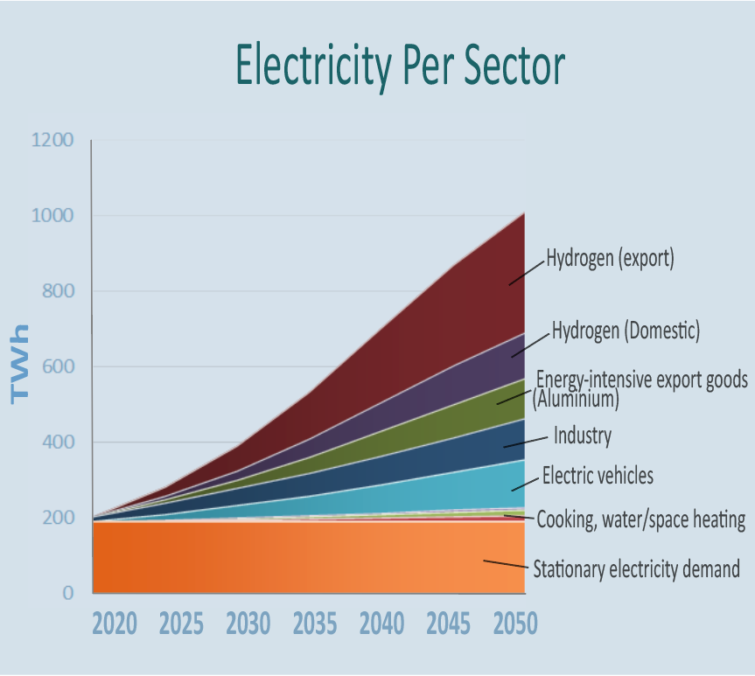
A big vision – needing concerted action
5 X NEM
+410%
electricity demand
Notes:
Status quo scenario: no additional policies, no policies that are dedicated to emission reduction policies.
NDC, Accelerated, leadership. Export and electrification. +100%.
Japan, South Korea.
So far, mainly assumptions, now results.

Slide 41
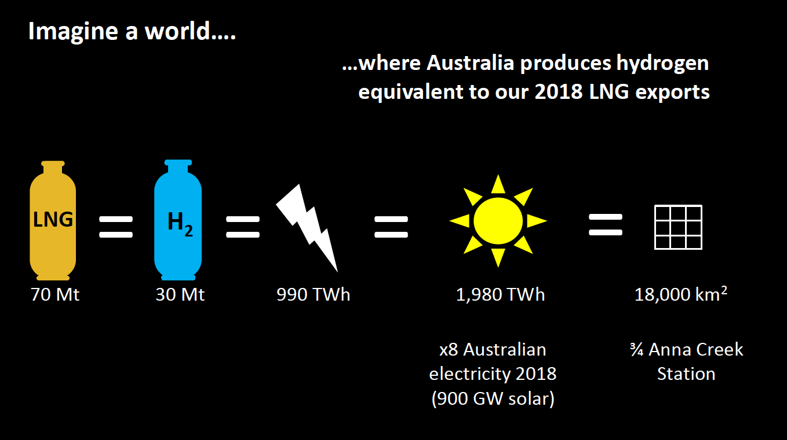
20 X
8X
Slide by Australia‘s Chief Scientist Alan Finkel at ACI and Federation University Hydrogen forum

Slide 42
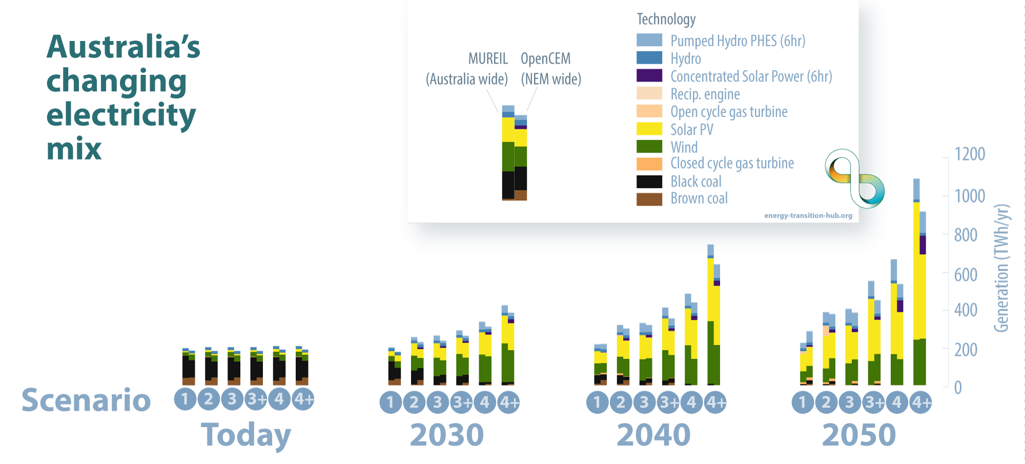

Main result 1: Solar PV and wind power dominate Australia’s electricity future
Even without climate policy: electricity emissions reduce by
40-48% in 2030 (rel. to 2005).
→ close to meeting
cross-sectoral NDC target
Notes:
Gap?
Across the scenarios and models, This includes status quo. No new coal power plant. PV and wind dominate. lowest-cost source of new electricity supply. Expansion is determined by the technical or economic end of lifetimes of coal power plants.
NDC: CO2 price of zero.
1) Australia‘s power advantage: a large country that is scarcily populated and is located mostly in the tropics and subtropics.
2) NDC is not very ambitious.
Even without additional policy, renewable electricity shares increase up to about 40 to 50 percent in 2030, decreasing Australia’s electricity emissions by around 40 to 48 percent compared to 2005 levels. This translates into Australia achieving its NDC target of -26% - even if non-electricity emissions would be increasing by about 10% from now up to 2030. CO2 price of zero. Assuming that markets are working efficiently.
In 2040, renewables are at ~75 percent.

Slide 43
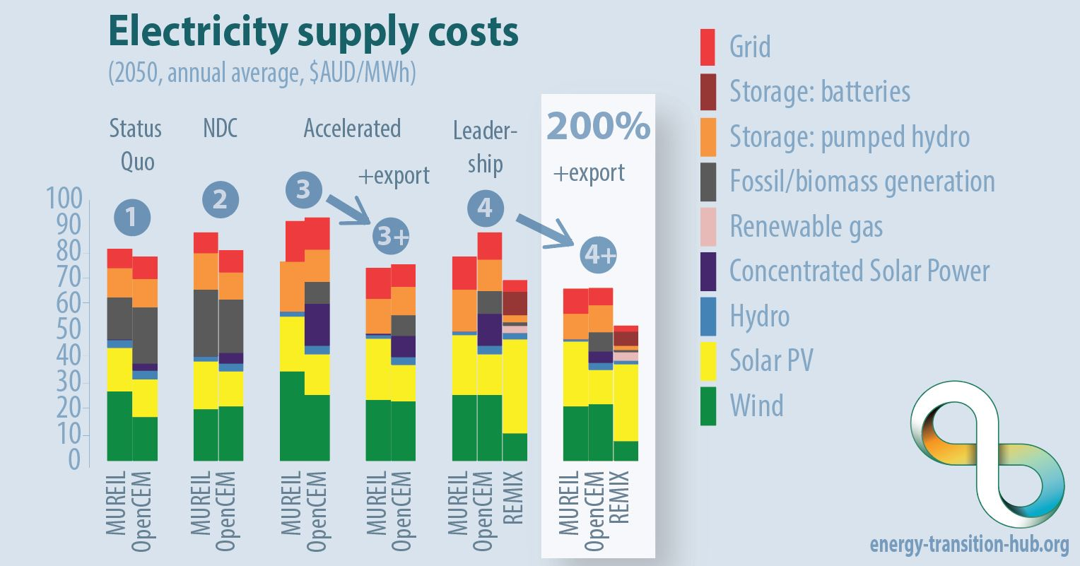




Main result 2: Renewable-based system costs are similar or lower than today
electrification
Average 2050 costs (total and by source) of supply per unit of electricity demand (domestic and export) across the scenarios and models. These long-term marginal costs comprise all costs (variable and fixed as annuities) for a 2050 equilibrium power system, while costs for hydrogen production and related infrastructure are not included. In perfect markets, these long-term marginal costs translate into average wholesale electricity prices. While average costs results are similar across models, the remaining differences are due to model-specific parameter assumptions, scope, detail and structure.
Notes:
Future renewable-based system costs are similar or lower than today. EXPLAIN COST METRIC.
This is not surprising given that we know that the LCOE of renewables are falling below those of dispatchable generation.
This is true for 100% systems. (REMIX: different weather years?)
However, the variability and intermittency causes costs, sometimes called integration costs. Balancing in time and space (Also required for fossil system).
We find that these costs are about one third of generation costs for most scenarios in 2050. Some insights.
Slight costs of increasing emission reductions
Coal substituted by concentrated solar power.
Suboptimal pathway costs
Electrification
Ground transportation and industry?
REMIX cheaper: no pathway
Export (hydrogen
In the long term, electrolysers are build in the NEM.
The average costs of electricity supply can be decreased. Hydrogen costs can be reduced.
When adding fully flexible electricity demand (flexible in time and space).
CO2 prices? Average mitigation costs?

Slide 44
Main result 2: Renewable-based system costs are similar or lower than today
100%
Average 2050 costs (total and by source) of supply per unit of electricity demand (domestic and export) across the scenarios and models. These long-term marginal costs comprise all costs (variable and fixed as annuities) for a 2050 equilibrium power system, while costs for hydrogen production and related infrastructure are not included. In perfect markets, these long-term marginal costs translate into average wholesale electricity prices. While average costs results are similar across models, the remaining differences are due to model-specific parameter assumptions, scope, detail and structure.
Notes:
Future renewable-based system costs are similar or lower than today. EXPLAIN COST METRIC. 100% systems.
integration costs. Balancing in time and space (Also required for fossil system).
We find that these costs are about one third of generation costs for most scenarios in 2050. Some insights.
Slight costs of increasing emission reductions
Coal substituted by concentrated solar power.
Suboptimal pathway costs
Electrification
Ground transportation and industry?
REMIX cheaper: no pathway
Export (hydrogen
In the long term, electrolysers are build in the NEM.
The average costs of electricity supply can be decreased. Hydrogen costs can be reduced.
When adding fully flexible electricity demand (flexible in time and space).
CO2 prices? Average mitigation costs?

Slide 45

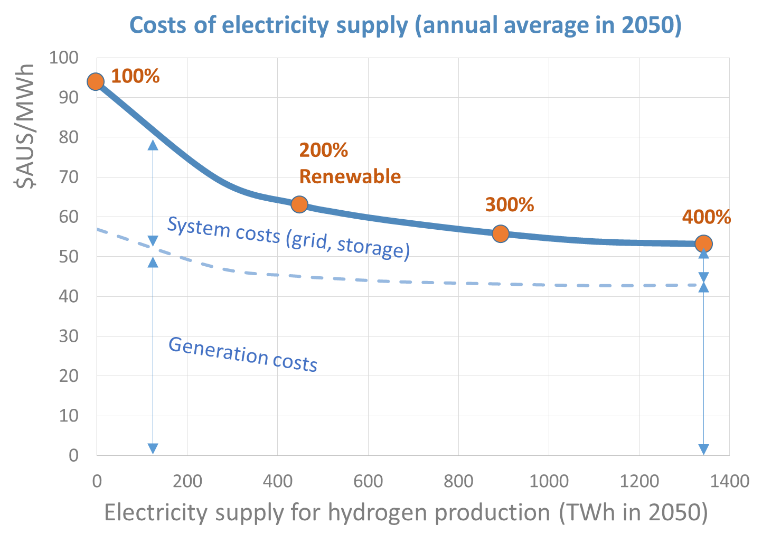
Main result 2: Renewable-based system costs are similar or lower than today
Hydrogen production decreases the costs of renewable-based electricity supply
To replace the current
LNG export
Leadership scenario 2050
with increasing hydrogen demand (MUREIL)
Average 2050 costs (total and by source) of supply per unit of electricity demand (domestic and export) across the scenarios and models. These long-term marginal costs comprise all costs (variable and fixed as annuities) for a 2050 equilibrium power system, while costs for hydrogen production and related infrastructure are not included. In perfect markets, these long-term marginal costs translate into average wholesale electricity prices. While average costs results are similar across models, the remaining differences are due to model-specific parameter assumptions, scope, detail and structure.
Notes:
Future renewable-based system costs are similar or lower than today. EXPLAIN COST METRIC. 100% systems.
integration costs. Balancing in time and space (Also required for fossil system).
We find that these costs are about one third of generation costs for most scenarios in 2050. Some insights.
Slight costs of increasing emission reductions
Coal substituted by concentrated solar power.
Suboptimal pathway costs
Electrification
Ground transportation and industry?
REMIX cheaper: no pathway
Export (hydrogen
In the long term, electrolysers are build in the NEM.
The average costs of electricity supply can be decreased. Hydrogen costs can be reduced.
When adding fully flexible electricity demand (flexible in time and space).
CO2 prices? Average mitigation costs?

Slide 46
Main result 3: hydrogen costs can be reduced with “NEM electrolysis”
Notes:
€/kg? AUD/kg.
hydrogen costs can be reduced with “NEM electrolysis”
Weekly picture: domestic demand is met by oversized renewable system. The over production is shaved for hydrogen production.
This is a mainly solar world. This is the REMIX model (German aerospace center): green field.
Hourly: diurnal spikes. Short-term storage (here battery) is smoothening this across the day. Electrolyser follow solar. (how does this look for MUREIL/OpenCEM)?
This picture reminds me and maybe many in the audience of a German debate that started 10years ago: H2 not only from excess power for two reasons i) not enough excess electricity, and ii) costs would be high due to small FLH. Both is not necessarily true for Australia.
Floor electricity price in case of residual synchronous generation for frequency controll. How does it look without floor price?
Should I do the excurse? Could explain to the Germans that the economics are not necessarily worsened.

Slide 47
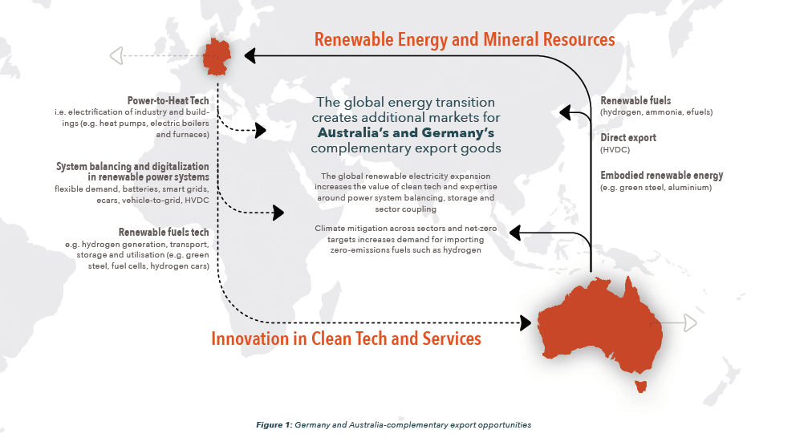


Slide 48

Thank you!

Slide 49

Upcoming seminars
Date/Location | Presenter | Topic
Thu 31 Oct, 12.30-1.30pm Basement Theatre, Glyn Davis Building | Prof. Neil Gunningham (ANU) | Averting climate catastrophe: Extinction rebellion, business and people power
Wed 6 Nov, 11am-12pm Climate College | Dr. Martin Wainstein (Yale) – via Zoom videconference | Information session on Global Climate Collabathon
Wed 13 Nov, 6-7.30pm Kathleen Fitzpatrick Theatre | Ross Garnaut, Audrey Zibelman & Rod Sims | Ross Garnaut Book Launch Superpower: Australia’s Low-Carbon Opportunity
climatecollege.unimelb.edu.au/seminars
@climatecollege

